Slide 1
1.1 Introduction to Cells
Essential idea: The evolution of multicellular organisms allowed cell specialization and cell replacement.
The background image shows totipotent stem cells. These unspecialised cell will be divide and some will become the cells that form heart muscle, neurones in the brain and lymphocytes in the blood. These three types of specialised human cells are structurally very different and perform certain functions much more efficiently than an unspecialised cell, such as the embryonic cells above, could.
Another advantage that multicellular organisms have over unicellular organisms is that severe damage to a cell does not mean the end of an organism. Stem cell persist through the life of a multi-cellular organism, this enables organisms to digest severely damaged cells and replace them, i.e. wounds can be healed.

Slide 2
Understandings
 | Statement | Guidance
1.1.U1 | According to the cell theory, living organisms are composed of cells.
1.1.U2 | Organisms consisting of only one cell carry out all functions of life in that cell. | Students are expected to be able to name and briefly explain these functions of life: nutrition, metabolism, growth, response, excretion, homeostasis and reproduction.
1.1.U3 | Surface area to volume ratio is important in the limitation of cell size.
1.1.U4 | Multicellular organisms have properties that emerge from the interaction of their cellular components.
1.1.U5 | Specialized tissues can develop by cell differentiation in multicellular organisms.
1.1.U6 | Differentiation involves the expression of some genes and not others in a cell’s genome.
1.1.U7 | The capacity of stem cells to divide and differentiate along different pathways is necessary in embryonic development and also makes stem cells suitable for therapeutic uses.

Slide 3
Applications and Skills
 | Statement | Guidance
1.1.A1 | Questioning the cell theory using atypical examples, including striated muscle, giant algae and aseptate fungal hyphae.
1.1.A2 | Investigation of functions of life in Paramecium and one named photosynthetic unicellular organism. | Chlorella or Scenedesmus are suitable photosynthetic unicells, but Euglena should be avoided as it can feed heterotrophically.
1.1.A3 | Use of stem cells to treat Stargardt’s disease and one other named condition.
1.1.A4 | Ethics of the therapeutic use of stem cells from specially created embryos, from the umbilical cord blood of a new-born baby and from an adult’s own tissues.
1.1.S1 | Use of a light microscope to investigate the structure of cells and tissues, with drawing of cells. Calculation of the magnification of drawings and the actual size of structures and ultrastructures shown in drawings or micrographs. (Practical 1) | Scale bars are useful as a way of indicating actual sizes in drawings and micrographs.

Slide 4
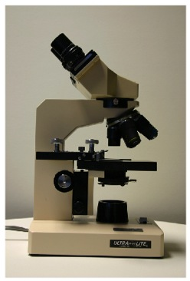
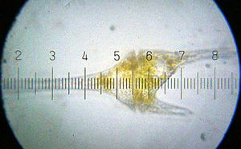
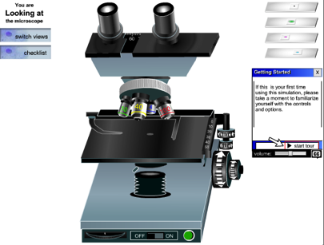
1.1.S1 Use of a light microscope to investigate the structure of cells and tissues, with drawing of cells. Calculation of the magnification of drawings and the actual size of structures and ultrastructures shown in drawings or micrographs. (Practical 1)
Microscopes are best learn through experience the below links are primarily for those without access to a microscope.
Source: https://microbewiki.kenyon.edu/index.php/Dinoflagellata
Virtual microscope: http://www.udel.edu/biology/ketcham/microscope/scope.html
Learn about Microscopes: http://www.wisc-online.com/objects/ViewObject.aspx?ID=BIO905

Slide 7
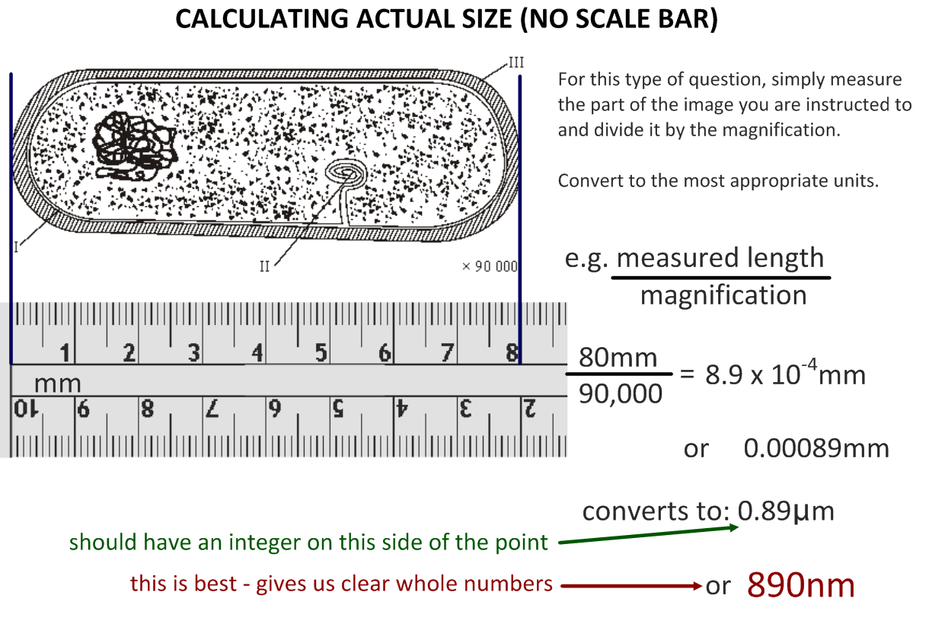

Slide 8
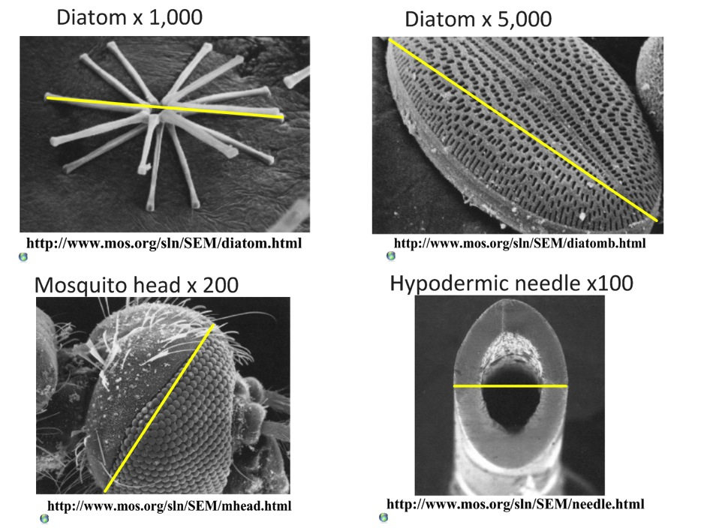

Slide 11
1.1.U1 According to the cell theory, living organisms are composed of cells.
Cell theory states that:
All living things are composed of cells (or cell products)
The cell is the smallest unit of life
Cells only arise from pre-existing cells
Source: http://www.engr.uconn.edu/alarm/research?id=63

Slide 12
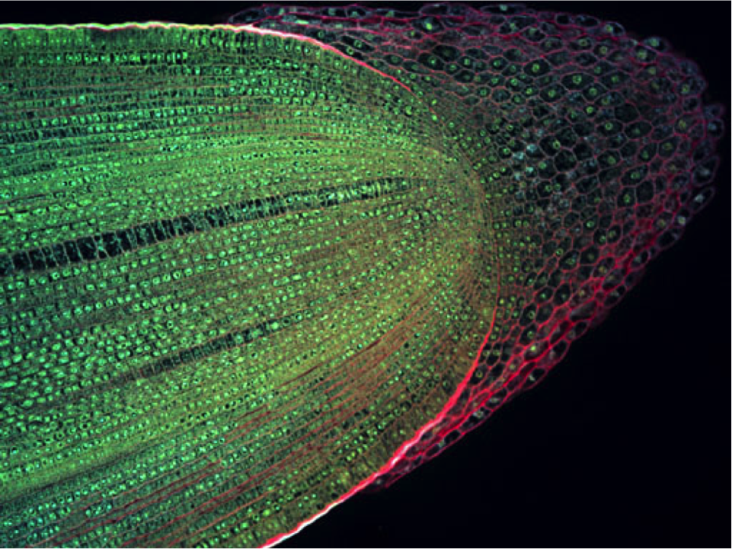
1.1.U1 According to the cell theory, living organisms are composed of cells.
All living things are composed of cells (or cell products)
Longitudinal section of a root tip of Maize (Zea mays)
by Science and Plants for Schools on Flickr (CC) http://flic.kr/p/bNNM6M

Slide 13
1.1.U1 According to the cell theory, living organisms are composed of cells.
The cell is the smallest unit of life
Specialized structures within cells (organelles) carry out different functions. Organelles cannot survive alone.
This micrograph of a Paramecium shows the 2 contractile vacuoles, the oral groove with the formation of a new food vacuole at its end, and the overall surrounding cilia.
Source: http://www.dr-ralf-wagner.de/

Slide 14
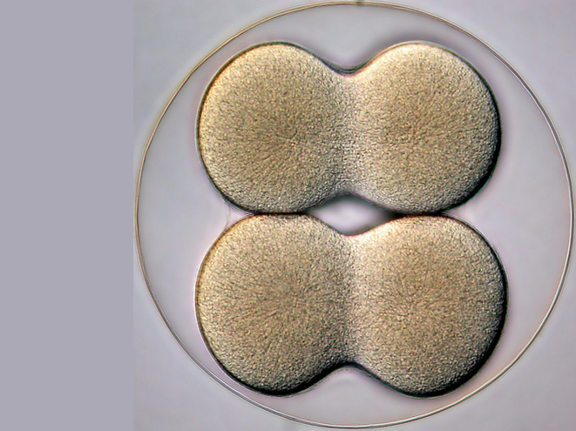
1.1.U1 According to the cell theory, living organisms are composed of cells.
Cells only arise from pre-existing cells:
Cells multiply through division
All life evolved from simpler ancestors
Mitosis results in genetically identical diploid daughter cells
Meiosis generates haploid gametes (sex cells)
4-cell stage of a sea biscuit by Bruno Vellutini on Flickr (CC) http://flic.kr/p/daWnnS

Slide 15
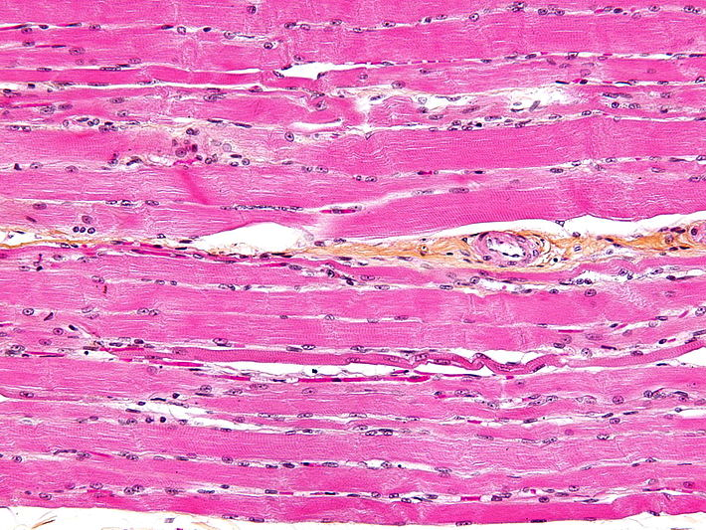
1.1.A1 Questioning the cell theory using atypical examples, including striated muscle, giant algae and aseptate fungal hyphae.
striated muscle
challenges the idea that a cell has one nucleus
Muscle cells have more than one nucleus per cell
Muscle Cells called fibres can be very long (300mm)
They are surrounded by a single plasma membrane but they are multi-nucleated (many nuclei).
This does not conform to the standard view of a small single nuclei within a cell
Source: http://en.wikipedia.org/wiki/File:Skeletal_striated_muscle.jpg

Slide 16
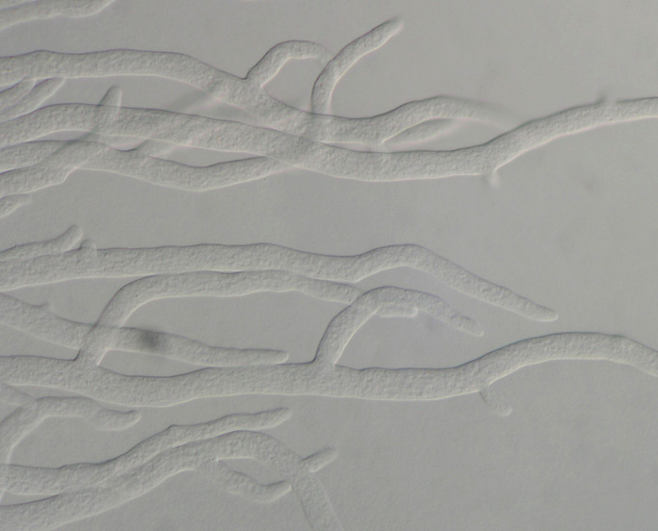
1.1.A1 Questioning the cell theory using atypical examples, including striated muscle, giant algae and aseptate fungal hyphae.
aseptate fungal hyphae
challenges the idea that a cell is a single unit.
Fungal hyphae are again very large with many nuclei and a continuous cytoplasm
The tubular system of hyphae form dense networks called mycelium
Like muscle cells they are multi-nucleated
They have cell walls composed of chitin
The cytoplasm is continuous along the hyphae with no end cell wall or membrane
Source: http://www.apsnet.org/edcenter/intropp/pathogengroups/pages/introfungi.aspx

Slide 17
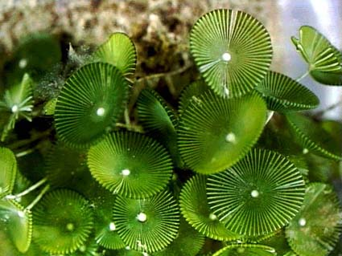
1.1.A1 Questioning the cell theory using atypical examples, including striated muscle, giant algae and aseptate fungal hyphae.
giant algae (Acetabularia)
Acetabularia is a single-celled organism that challenges both the idea that cells must be simple in structure and small in size
Gigantic in size (5 – 100mm)
Complex in form, it consists of three anatomical parts:
Bottom rhizoid (that resembles a set of short roots)
Long stalk
Top umbrella of branches that may fuse into a cap
The single nucleus is located in the rhizoid
Source: http://deptsec.ku.edu/~ifaaku/jpg/Inouye/Inouye_01.html

Slide 18
1.1.U2 Organisms consisting of only one cell carry out all functions of life in that cell.
You probably know:
In this course the functions are refined:
Movement
Reproduction
Sensitivity
Homeostasis
Growth
Respiration
Excretion
Nutrition
Metabolism - the web of all the enzyme-catalysed reactions in a cell or organism, e.g. respiration
Response - Living things can respond to and interact with the environment
Homeostasis - The maintenance and regulation of internal cell conditions, e.g. water and pH
Growth - Living things can grow or change size / shape
Excretion – the removal of metabolic waste
Reproduction - Living things produce offspring, either sexually or asexually
Nutrition – feeding by either the synthesis of organic molecules (e.g. photosynthesis) or the absorption of organic matter

Slide 19
1.1.U2 Organisms consisting of only one cell carry out all functions of life in that cell.
Remembering the functions of life
An easy way to remember Metabolism, Response, Homeostasis, Growth, Reproduction, Excretion and Nutrition is:
“MR H GREN”
(each letter is a function of life)
Source: http://www.dr-ralf-wagner.de/

Slide 20
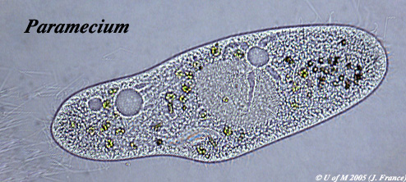
1.1.A2 Investigation of functions of life in Paramecium and one named photosynthetic unicellular organism.
How does this paramecium show the functions of life?
Source: http://umanitoba.ca/Biology/BIOL1030/Lab1/biolab1_3.html#Ciliophora

Slide 21
1.1.A2 Investigation of functions of life in Paramecium and one named photosynthetic unicellular organism.
Excretion – the plasma membrane control the entry and exit of substances including expulsion of metabolic waste
Homeostasis – contractile vacuole fill up with water and expel I through the plasma membrane to manage the water content
Response – the wave action of the cilia moves the paramecium in response to changes in the environment, e.g. towards food.
Metabolism – most metabolic pathways happen in the cytoplasm
Source: http://umanitoba.ca/Biology/BIOL1030/Lab1/biolab1_3.html#Ciliophora
Nutrition – food vacuoles contain organisms the parameium has consumed
Growth – after consuming and assimilating biomass from food the paramecium will get larger until it divides.
Reproduction – The nucleus can divide to support cell division by mitosis, reproduction is often asexual

Slide 22
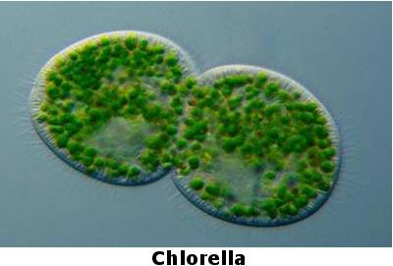
1.1.A2 Investigation of functions of life in Paramecium and one named photosynthetic unicellular organism.
How does this algae show the functions of life?
Source: http://www.algae.info/Algaecomplete.aspx

Slide 23
1.1.A2 Investigation of functions of life in Paramecium and one named photosynthetic unicellular organism.
Excretion – the plasma membrane control the entry and exit of substances including the difussion out of waste oxygen
Reproduction – The nucleus can divide to support cell division, by mitosis (these cells are undergoing cytokinesis)
Response – the wave action of the cilia moves the algae in response to changes in the environment, e.g. towards light.
Metabolism – most metabolic pathways happen in the cytoplasm
Homeostasis – contractile vacuole fill up with water and expel I through the plasma membrane to manage the water content
Nutrition – photosynthesis happens inside the chloroplasts to provide the algae with food
Source: http://www.algae.info/Algaecomplete.aspx
Growth – after consuming and assimilating biomass from food the algae will get larger until it divides.

Slide 24
1.1.U3 Surface area to volume ratio is important in the limitation of cell size.

Slide 25
1.1.U3 Surface area to volume ratio is important in the limitation of cell size.

Slide 26
1.1.U3 Surface area to volume ratio is important in the limitation of cell size.

Slide 27
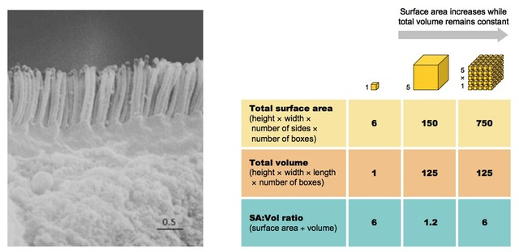
1.1.U3 Surface area to volume ratio is important in the limitation of cell size.
Cells and tissues specialised for gas or material exchange will increase their surface area to optimise the transfer of materials, e.g. microvilli (below) in the small intestine
The cell must consequently divide in order to restore a viable SA:Vol ratio and survive.
A represents a small single celled organism
B a large single celled organism
C multicellular organism
A
B
C

Slide 28
1.1.U3 Surface area to volume ratio is important in the limitation of cell size.
In summary:
The rate of metabolism of a cell is a function of its mass / volume
The rate of material exchange in and out of a cell is a function of its surface area
As the cell grows, volume increases faster than surface area (leading to a decreased SA:Vol ratio)
If the metabolic rate is greater than the rate of exchange of vital materials and wastes, the cell will eventually die
Hence the cell must consequently divide in order to restore a viable SA:Vol ratio and survive
Cells and tissues specialised for gas or material exchange (e.g. alveoli) will increase their surface area to optimise the transfer of materials
Extension: Can you think of any exceptions? See if you can find out about unusually large cells and how they are adapted to survive.

Slide 29
1.1.U4 Multicellular organisms have properties that emerge from the interaction of their cellular components.
Emergent properties arise from the interaction of component parts. The whole is greater than the sum of its parts. Multicellular organisms are capable of completing functions that individual cells could not undertake - this is due to the interaction between cells producing new functions.

Slide 30
1.1.U4 Multicellular organisms have properties that emerge from the interaction of their cellular components.
Science traditionally has been taken a reductionist approach to solving problems and developing theories. Systems Biology uses inductive thinking as it is realised the importance of emergent properties, whether it be the interaction of genes, enzymes working together in a metabolic pathway, or cells forming tissues, different tissues forming organs, in turn forming organ systems and then the organism itself. At each level emergent properties arise.

Slide 31
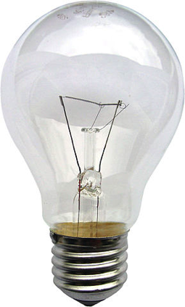
1.1.U4 Multicellular organisms have properties that emerge from the interaction of their cellular components.
As a model consider the electric light bulb. The bulb is the system and is composed of a filament made of tungsten, a metal cup, and a glass container. We can study the parts individually how they function and the properties they posses. These would be the properties of :
Tungsten
Metal cup
Glass container
When studied individually they do not allow the prediction of the properties of the light bulb. Only when we combine them to form the bulb can these properties be determined. There is nothing supernatural about the emergent properties rather it is simply the combination of the parts that results in new properties emerging.
Source: http://en.wikipedia.org/wiki/File:Gluehlampe_01_KMJ.jpg

Slide 32
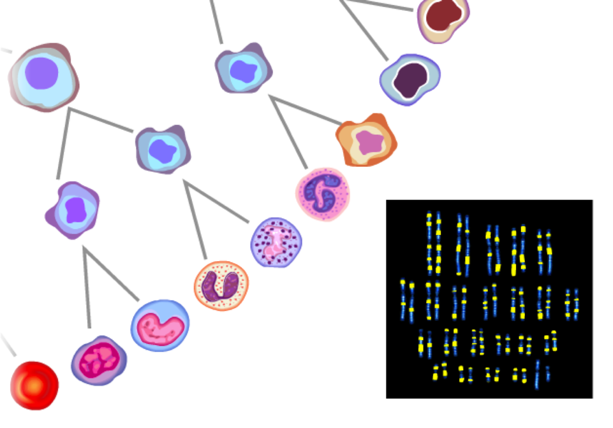
1.1.U6 Differentiation involves the expression of some genes and not others in a cell’s genome.
All (diploid) cells of an individual organisms share an identical genome - each cell contains the entire set of genetic instructions for that organism
BUT not all genes are expressed (activated) in all cells
In (totipotent) embryonic stem cells the entire genome is active
Newly formed cells receive signals which deactivate (or more rarely activate) genes, e.g. a skin cell does not need to be able to produce haemoglobin (the pigment in red blood cells that carries oxygen)
Screenshot from this excellent tutorial: http://www.ns.umich.edu/stemcells/022706_Intro.html

Slide 33
1.1.U6 Differentiation involves the expression of some genes and not others in a cell’s genome.
Extension: Active genes are usually packaged in an expanded and accessible form (euchromatin), while inactive genes are mainly packaged in a condensed form (heterochromatin)
The fewer active genes a cell possesses the more specialised it will become
As a result of gene expression cell differentiation begins: the cell’s metabolism and shape changes to carry out a specialised function.
Screenshot from this excellent tutorial: http://www.ns.umich.edu/stemcells/022706_Intro.html

Slide 34
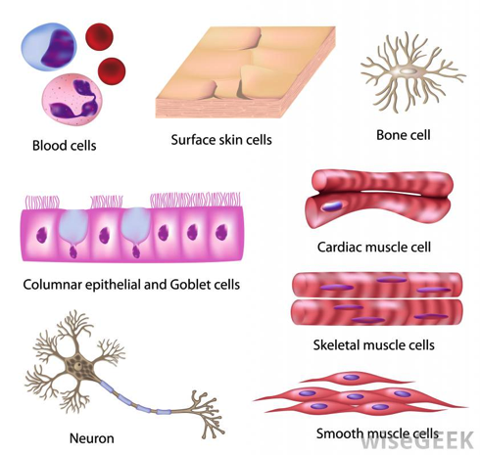
1.1.U5 Specialized tissues can develop by cell differentiation in multicellular organisms.
In humans 220 distinct highly specialised cell types have been recognised
All specialised cells and the organs constructed from them have developed as a result of differentiation
Source: http://images.wisegeek.com/types-of-human-cells.jpg

Slide 35
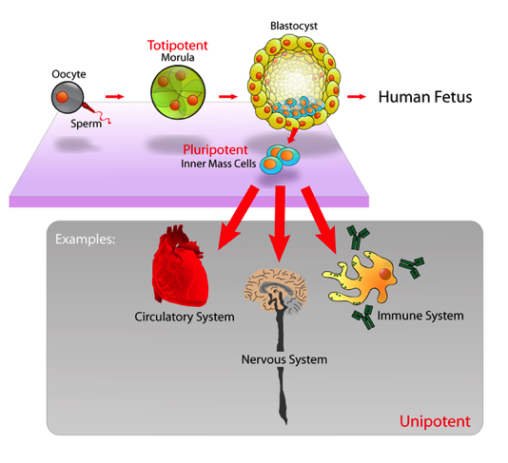
1.1.U7 The capacity of stem cells to divide and differentiate along different pathways is necessary in embryonic development and also makes stem cells suitable for therapeutic uses.
Stem cells are unspecialised cells that can:
Can continuously divide and replicate
Have the capacity to differentiate into specialised cell types
Totipotent
Can differentiate into any type of cell.
Pluripotent
Can differentiate into many
types of cell.
Multipotent
Can differentiate into a few closely-related types of cell.
Unipotent
Can regenerate but can only differentiate into their associated cell type
(e.g. liver stem cells can only make liver cells).
Image from: http://en.wikipedia.org/wiki/Stem_cell

Slide 36
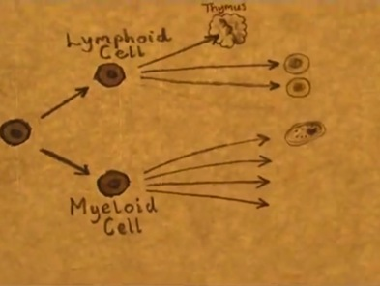
1.1.U7 The capacity of stem cells to divide and differentiate along different pathways is necessary in embryonic development and also makes stem cells suitable for therapeutic uses.
Learn about stem cells using the tutorials
http://ns.umich.edu/stemcells/022706_Intro.html
http://learn.genetics.utah.edu/content/stemcells/scintro/
A Stem Cell Story
http://www.youtube.com/watch?v=2-3J6JGN-_Y

Slide 37
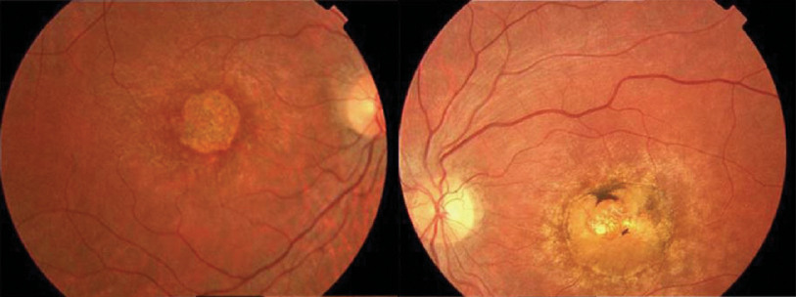
1.1.U7 Use of stem cells to treat Stargardt’s disease and one other named condition.
Stargardt's macular dystrophy
The problem | Affects around one in 10,000 children Recessive genetic (inherited) condition The mutation causes an active transport protein on photoreceptor cells to malfunction The photoreceptor cells degenerate the production of a dysfunctional protein that cannot perform energy transport that causes progressive, and eventually total, loss of central vision
The treatment | Embryonic stem cells are treated to divide and differntiate to become retinal cells The retinal cells are injected into the retina The retinal cells attach to the retina and become functional Central vision improves as a result of more functional retinal cells
The future | This treatment is still in at the stage of limited clinical trials, but will likely be in usage in the future

Slide 38
1.1.U7 Use of stem cells to treat Stargardt’s disease and one other named condition.
Learn about stem cell therapies using the tutorials
http://media.hhmi.org/biointeractive/click/Stem_Cell_Therapies/01.html

Slide 39
1.1.U7 Use of stem cells to treat Stargardt’s disease and one other named condition.
Leukemia
The problem | Cancer of the blood or bone marrow, resulting in abnormally high levels of poorly-functioning white blood cells.
The treatment | Hematopoetic Stem Cells (HSCs) are harvested from bone marrow, peripheral blood or umbilical cord blood Chemotherapy and radiotherapy used to destroy the diseased white blood cells New white blood cells need to be replaced with healthy cells. HSCs are transplanted back into the bone marrow HSCs differentiate to form new healthy white blood cells
The benefit | The use of a patient’s own HSCs means there is far less risk of immune rejection than with a traditional bone marrow transplant.

Slide 40
1.1.A4 Ethics of the therapeutic use of stem cells from specially created embryos, from the umbilical cord blood of a new-born baby and from an adult’s own tissues.
 | Comparison of stem cell sources
 | Embryo | Cord blood | Adult
Ease of extraction | Can be obtained from excess embryos generated by IVF programs. | Easily obtained and stored. Though limited quantities available | Difficult to obtain as there are very few and are buried deep in tissues
Ethics of the extraction | Can only be obtained by destruction of an embryo | Umbilical cord is removed at birth and discarded whether or not stem cells are harvested | Adult patient can give permission for cells to be extracted
Growth potential | Almost unlimited | Reduced potential (compared to embryonic cells)
Tumor risk | Higher risk of development | Lower risk of development

Slide 41
1.1.A4 Ethics of the therapeutic use of stem cells from specially created embryos, from the umbilical cord blood of a new-born baby and from an adult’s own tissues.
 | Comparison of stem cell sources
 | Embryo | Cord blood | Adult
Differentiation | Can differentiate into any cell type | Limited capacity to differentiate (without inducement only naturally divide into blood cells) | Limited capacity to differentiate (dependent on the source tissue)
Genetic damage | Less chance of genetic damage than adult cells |  | Due to accumulation of mutations through the life of the adult genetic damage can occur
Compatibility | Stem cells are not genetically identical to the patient | Fully compatible with the patient as the stem cells are genetically identical

Slide 42
1.1.A4 Ethics of the therapeutic use of stem cells from specially created embryos, from the umbilical cord blood of a new-born baby and from an adult’s own tissues.
Arguments for Therapeutic Cloning
Stem cell research may pave the way for future discoveries and beneficial technologies that would not have occurred if their use had been banned
May be used to cure serious diseases or disabilities with cell therapy (replacing bad cells with good ones)
Transplants are less likely to be rejected as they are cells which are genetically identical to the parent
Transplants do not require the death of another human
Stem cells can be taken from embryos that have stopped developing and would have died anyway (e.g. abortions)
Cells are taken at a stage when the embryo has no nervous system and can arguably feel no pain
Stem cells can be created without the need for fertilisation and destruction of ‘natural’ human embryos – induced pluripotent stem cells

Slide 43
1.1.A4 Ethics of the therapeutic use of stem cells from specially created embryos, from the umbilical cord blood of a new-born baby and from an adult’s own tissues.
Arguments Against Therapeutic Cloning
Involves the creation and destruction of human embryos (at what point do we afford the right to life?)
Embryonic stem cells are capable of continued division and may develop into cancerous cells and cause tumors
More embryos are generally produced than are needed, so excess embryos are killed
With additional cost and effort, alternative technologies may fulfill similar roles (e.g. nuclear reprogramming of differentiated cell lines)
Religious or moral objections due to the ‘playing God’ argument.
The embryo which is created could potentially be used in IVF and develop into a human fetus, so are we creating human life to destroy it?
Although cloning humans reproductively is illegal, this has not been ratified by all nations. Potential for a race to clone the first human.

Slide 44
1.1.A4 Ethics of the therapeutic use of stem cells from specially created embryos, from the umbilical cord blood of a new-born baby and from an adult’s own tissues.

Slide 45
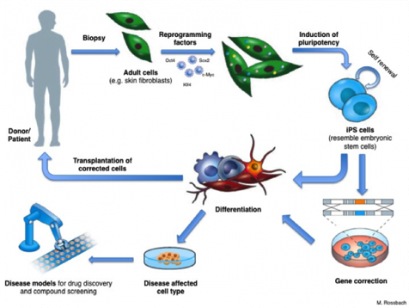
1.1.A4 Ethics of the therapeutic use of stem cells from specially created embryos, from the umbilical cord blood of a new-born baby and from an adult’s own tissues.
Check out the news – there are new stories on iPS all the time

Slide 46
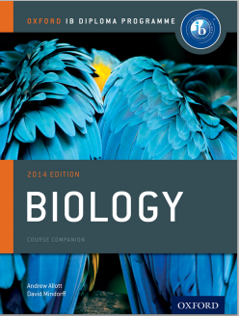
Bibliography / Acknowledgments
Jason de Nys

