Slide 1
8.1 Metabolism (AHL)
Essential idea: Metabolic reactions are regulated in response to the cell’s needs.
Many elements of the metabolism are controlled by negative feedback by end product inhibition. The end product acts as a non-competitive inhibitor binding the allosteric site on an enzyme which controls the production of an intermediate compound earlier in the pathway.
When the inhibitor binds to the enzyme this causes a change in the shape of the active site which prevents the substrate(s) binding. This results in the intermediate compound not being produced, which ultimately means no end product can be produced. The more end product there is the more it inhibits it's own production, this prevents an excess of unneeded compounds.
http://cnx.org/resources/44b414f98827125a5facb5f05c980dbd/Figure_04_01_10.jpg

Slide 2
Understandings, Applications and Skills
 | Statement | Guidance
8.1.U1 | Metabolic pathways consist of chains and cycles of enzyme-catalysed reactions.
8.1.U2 | Enzymes lower the activation energy of the chemical reactions that they catalyse.
8.1.U3 | Enzyme inhibitors can be competitive or non-competitive. | Enzyme inhibition should be studied using one specific example for competitive and non-competitive inhibition.
8.1.U4 | Metabolic pathways can be controlled by end-product inhibition.
8.1.A1 | End-product inhibition of the pathway that converts threonine to isoleucine.
8.1.A2 | Use of databases to identify potential new anti-malarial drugs.
8.1.S1 | Calculating and plotting rates of reaction from raw experimental results.
8.1.S2 | Distinguishing different types of inhibition from graphs at specified substrate concentration.

Slide 3
8.1.U1 Metabolic pathways consist of chains and cycles of enzyme-catalysed reactions.
Challenge: by changing just one letter at a time, get from ‘TREAD’ to ‘BLINK’. All intermediates must be real English words.
TREAD
_____
_____
_____
_____
_____
BLINK

Slide 4
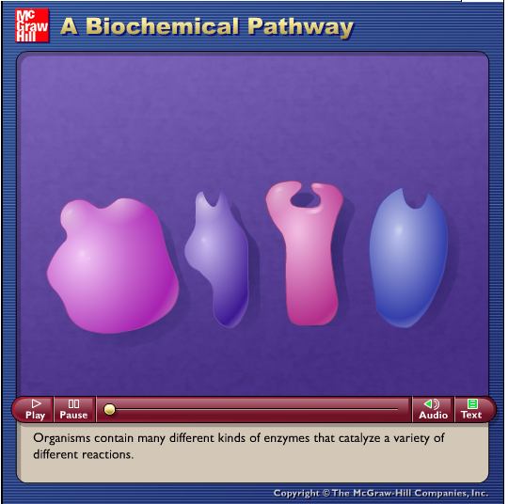
8.1.U1 Metabolic pathways consist of chains and cycles of enzyme-catalysed reactions.
Metabolism: the sum total of all chemical reactions that occur within an organism.
Metabolic pathways*: cycles or chains of enzyme catalysed reactions. The chemical change from one molecule to another often does not happen not in one large jump, but in a sequence of small steps. The small steps together form what is called a metabolic pathway.
* aka biochemical pathways
TREAD
Initial substrate
BREAD
BREED
BLEED
intermediates
BLEND
BLIND
BLINK
end product
http://highered.mheducation.com/sites/dl/free/0072437316/120070/bio09.swf

Slide 5
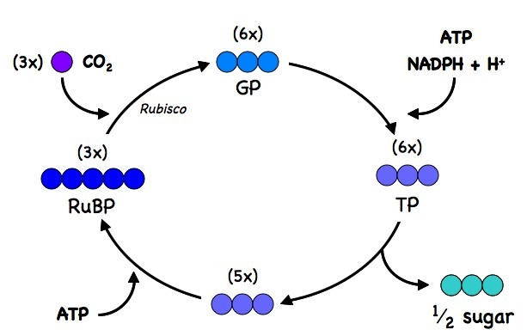
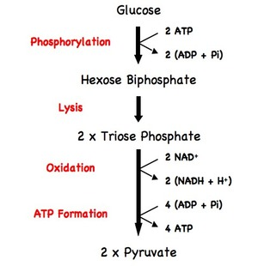
8.1.U1 Metabolic pathways consist of chains and cycles of enzyme-catalysed reactions.
Metabolic pathways*: cycles or chains of enzyme catalysed reactions.
Glycolysis, a part of respiration, is an example of a metabolic chain
The Calvin cycle, a part of photosynthesis, is an example of a metabolic cycle
http://www.ib.bioninja.com.au/higher-level/topic-8-cell-respiration/82-photosynthesis.html
http://www.ib.bioninja.com.au/higher-level/topic-8-cell-respiration/81-cell-respiration.html

Slide 6
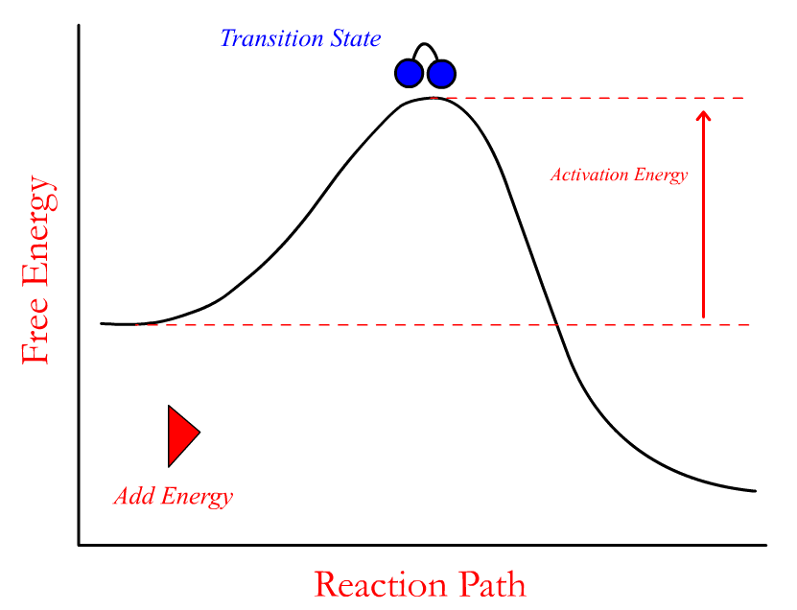
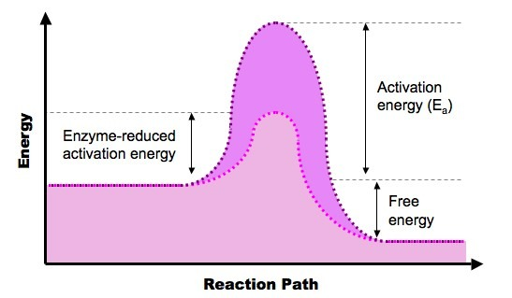
8.1.U2 Enzymes lower the activation energy of the chemical reactions that they catalyse.
Activation energy: the initial input of energy that is required to trigger a chemical reaction.
The key effect enzymes have upon reactions
http://www.stolaf.edu/people/giannini/flashanimat/enzymes/transition%20state.swf
un-catalysed reaction
catalaysed reaction
Enzymes benefit organisms by speeding up the rate at which reactions occur, they make them happen millions of times faster.
http://www.ib.bioninja.com.au/_Media/exergonic_reaction_med.jpeg

Slide 7
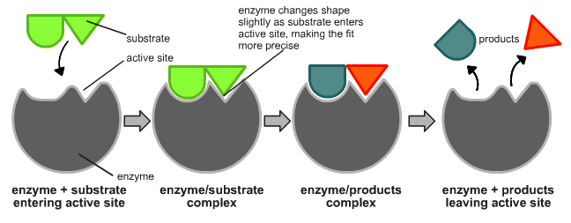
8.1.U2 Enzymes lower the activation energy of the chemical reactions that they catalyse.
How do enzymes lower the activation energy of a reaction?
The substrate binds to the enzymes’ active site and the active site is altered to reach the transition state.
Due to the binding the bonds in the substrate molecule are stressed/become less stable.
The binding lowers the overall energy level of the transition state.
The activation energy of the reaction is therefore reduced.
n.b. the net amount of energy released by the reaction is unchanged.
http://en.wikipedia.org/wiki/Image:Induced_fit_diagram.png

Slide 8
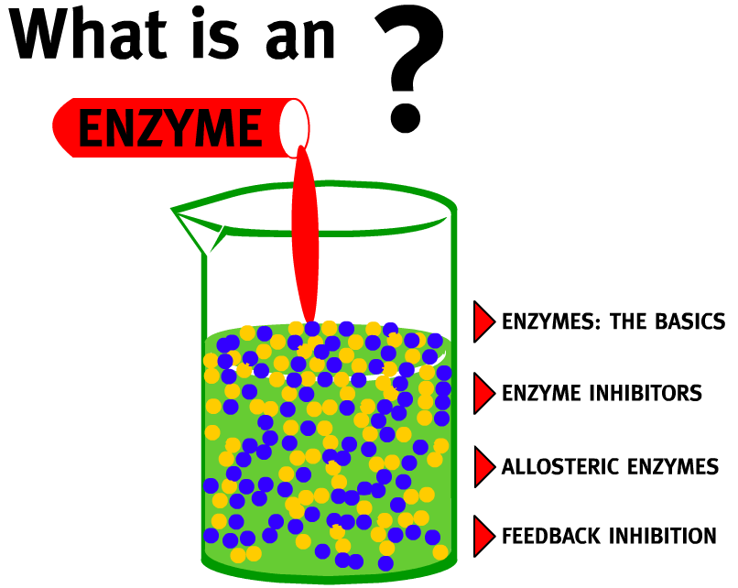
8.1.U3 Enzyme inhibitors can be competitive or non-competitive.
Inhibitor: a molecule that binds to an enzyme and slows down or stops the enzyme’s function.
Use the animation to find out more about inhibitors.
A good alternative is Enzyme Inhibition from Wiley
http://www.northland.cc.mn.us/biology/biology1111/animations/enzyme.swf

Slide 9
8.1.U3 Enzyme inhibitors can be competitive or non-competitive.
http://www.northland.cc.mn.us/biology/biology1111/animations/enzyme.swf

Slide 10
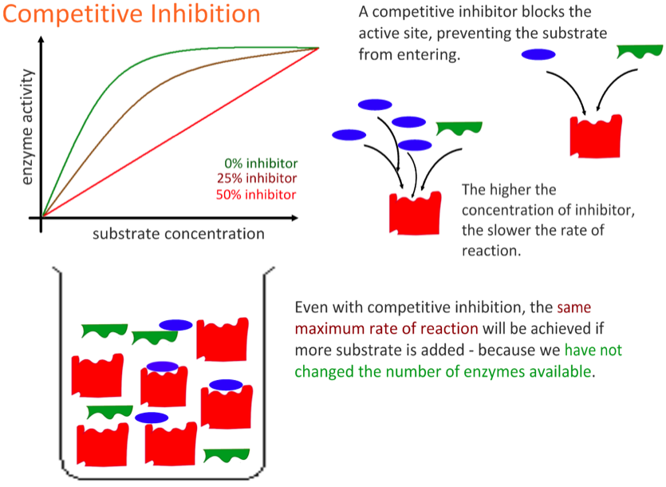
8.1.U3 Enzyme inhibitors can be competitive or non-competitive.

Slide 11
8.1.U3 Enzyme inhibitors can be competitive or non-competitive.

Slide 12
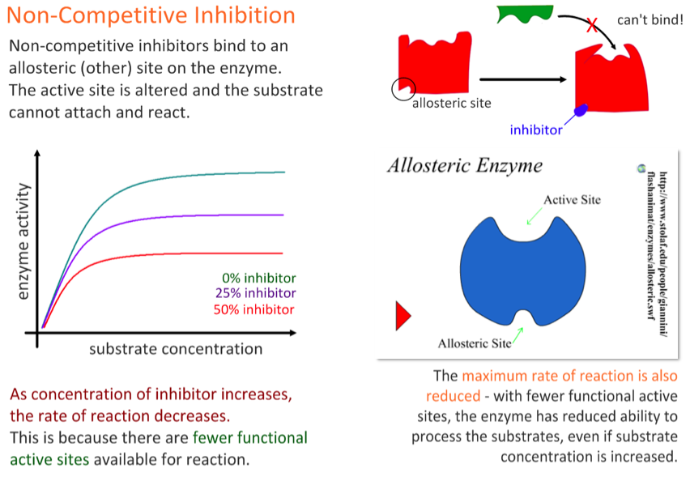
8.1.U3 Enzyme inhibitors can be competitive or non-competitive.

Slide 13
8.1.U3 Enzyme inhibitors can be competitive or non-competitive.

Slide 14
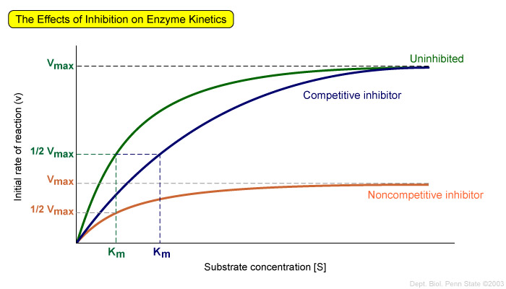
8.1.S2 Distinguishing different types of inhibition from graphs at specified substrate concentration.
Features of competitive inhibitors
Rate of reaction is reduced
When the concentration of substrate begins to exceed the amount of inhibitor, the maximum rate of the uninhibited enzyme can be achieved. However, it takes a much higher concentration of substrate to achieve this maximum rate.
https://wikispaces.psu.edu/download/attachments/46924781/image-6.jpg

Slide 15
8.1.S2 Distinguishing different types of inhibition from graphs at specified substrate concentration.
Features of non-competitive inhibitors
Rate of reaction is reduced
It takes approximately the same concentration of enzyme to reach the maximum rate, but the maximum rate is lower than the uninhibited enzyme.
The binding of the non-competitive inhibitor prevents some of the enzymes from being able to react regardless of substrate concentration.
Those enzymes that do not bind inhibitors follow the same pattern as the normal enzyme.
https://wikispaces.psu.edu/download/attachments/46924781/image-6.jpg

Slide 16
8.1.U3 Enzyme inhibitors can be competitive or non-competitive.
http://highered.mheducation.com/sites/dl/free/0072437316/120070/bio10.swf

Slide 17
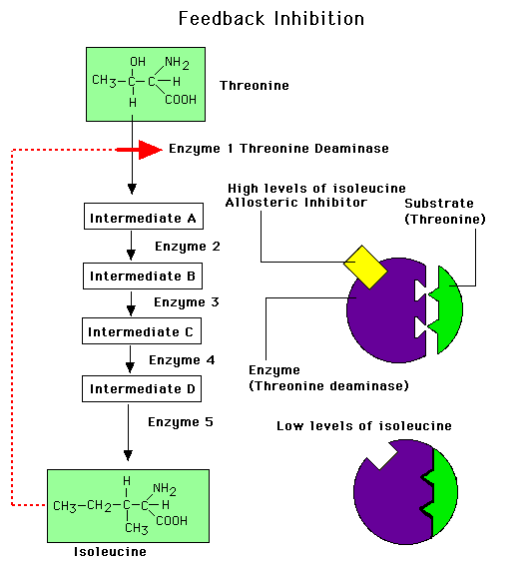
8.1.A1 End-product inhibition of the pathway that converts threonine to isoleucine.
Isoleucine is an essential amino acid*
Bacteria synthesize isoleucine from threonine in a series of five enzyme-catalysed steps
As the concentration of isoleucine increases, some of it binds to the allosteric site of threonine deaminase
Isoleucine acts as a non-competitive inhibitor to threonine deaminase
The pathway is then turned off, regulating isoleucine production.
If the concentration of isoleucine later falls (as a result of its use) then the allosteric sites of threonine deaminase are emptied and the enzymes recommences the conversion of threonine to isoleucine takes place.
*Essential amino acids cannot be made by the body, therefore they must come from food.
http://www.uic.edu/classes/bios/bios100/lecturesf04am/feedback-inh.gif

Slide 18
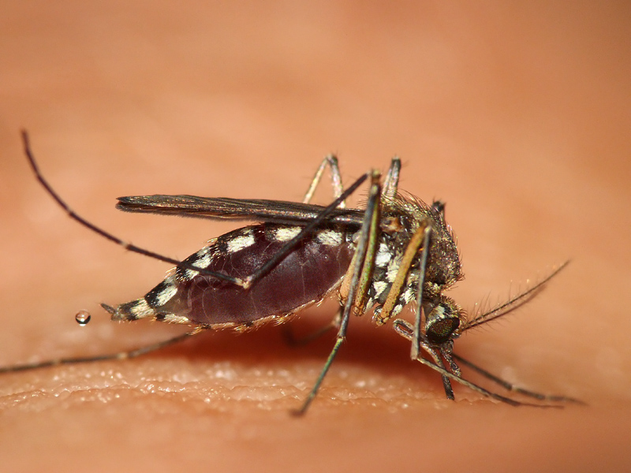
8.1.A2 Use of databases to identify potential new anti-malarial drugs.
Bioinformatics is an approach whereby multiple research groups can add information to a database enabling other groups to query the database.
Bioinformatics has facilitated research into metabolic pathways is referred to as chemogenomics.
Sometimes when a chemical binds to a target site, it can significantly alter metabolic activity.
Massive libraries of chemicals are tested individually on a range of related organisms.
For each organism a range of target sites are identified.
A range of chemicals which are known to work on those sites are tested.
http://upload.wikimedia.org/wikipedia/commons/0/02/Mosquito_bite4.jpg

Slide 19
8.1.A2 Use of databases to identify potential new anti-malarial drugs.
Malaria is a disease caused by the pathogen Plasmodium falciparum.
This protozoan uses mosquitoes as a host as well as humans and hence can be passed on by mosquito bites
Increasing drug resistance to anti-malarial drugs has lead to the use of bioinformatics and chemogenomics to try and identify new drugs.
In one study, approx. 300,000 chemicals were screened against a chloroquine-sensitive 3D7 strain and the chloroquine-resistant K1 strain of P. falciparum.
Other related and unrelated organisms, including human cell lines, were also screened.
(19) new chemicals that inhibit the enzymes normally targeted by anti-malarial drugs were identified
Additionally (15) chemicals that bind to malarial proteins were identified – this can help in the location of P. falciparum
These results indicate possible new directions for drug research.
http://upload.wikimedia.org/wikipedia/commons/0/02/Mosquito_bite4.jpg

Slide 20
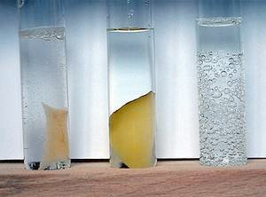
8.1.S1 Calculating and plotting rates of reaction from raw experimental results.
Remember this lab?
2.5.S2 Experimental investigation of a factor affecting enzyme activity. (Practical 3)
Enzyme inhibition can be investigated using these two outlines by Science & Plants for Schools:
The effect of end product, phosphate, upon the enzyme phosphatase
The inhibition of catechol oxidase by lead
Use the results from it or data from one of your enzyme inhibition labs to calculate the rate of reaction.
The rate of reaction can be calculated using the formula:
Rate of reaction (s⁻¹) = 1 / time taken (s)
Time taken in enzyme experiments this is commonly the time to reach a measurable end point or when a standard event, caused by the enzyme reaction, has come to pass. This is usually measured by the effects of the accumulation of product, but can as easily be measured by the disappearance of substrates.
http://www.scienceexperimentsforkids.us/wp-content/uploads/2011/08/hydrogen-experiments-for-kids-3-img.jpg

Slide 21
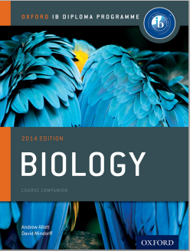
Bibliography / Acknowledgments
Jason de Nys

