Slide 1
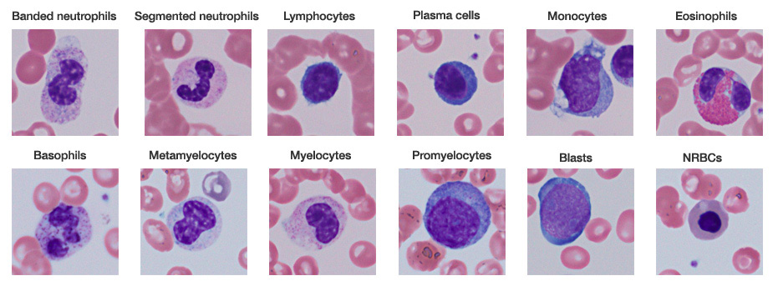
6.3 Defense against infectious disease
Essential idea: The human body has structures and processes that resist the continuous threat of invasion by pathogens.
Leukocytes are very varied in their structure and function. Beyond leukocytes the body has other mechanisms such mucous membranes and barriers, e.g. the skin which help resist the invasion of pathogens.
By Chris Paine
https://bioknowledgy.weebly.com/
http://www.tissuegnostics.com/images/hemoquest_software/bloodcellsclases.jpg

Slide 2
Understandings
 | Statement | Guidance
6.3.U1 | The skin and mucous membranes form a primary defence against pathogens that cause infectious disease. | Diagrams of skin are not required.
6.3.U2 | Cuts in the skin are sealed by blood clotting.
6.3.U3 | Clotting factors are released from platelets.
6.3.U4 | The cascade results in the rapid conversion of fibrinogen to fibrin by thrombin.
6.3.U5 | Ingestion of pathogens by phagocytic white blood cells gives non-specific immunity to diseases. | Subgroups of phagocyte are not required
6.3.U6 | Production of antibodies by lymphocytes in response to particular pathogens gives specific immunity. | Subgroups of lymphocyte are not required but students should be aware that some lymphocytes act as memory cells and can quickly reproduce to form a clone of plasma cells if a pathogen carrying a specific antigen is re-encountered.
6.3.U7 | Antibiotics block processes that occur in prokaryotic cells but not in eukaryotic cells.
6.3.U8 | Viruses lack a metabolism and cannot therefore be treated with antibiotics. Some strains of bacteria have evolved with genes that confer resistance to antibiotics and some strains of bacteria have multiple resistance.

Slide 3
Applications and Skills
 | Statement | Guidance
6.3.A1 | Causes and consequences of blood clot formation in coronary arteries.
6.3.A2 | Florey and Chain’s experiments to test penicillin on bacterial infections in mice.
6.3.A3 | Effects of HIV on the immune system and methods of transmission. | The effects of HIV on the immune system should be limited to a reduction in the number of active lymphocytes and a loss of the ability to produce antibodies, leading to the development of AIDS.

Slide 5
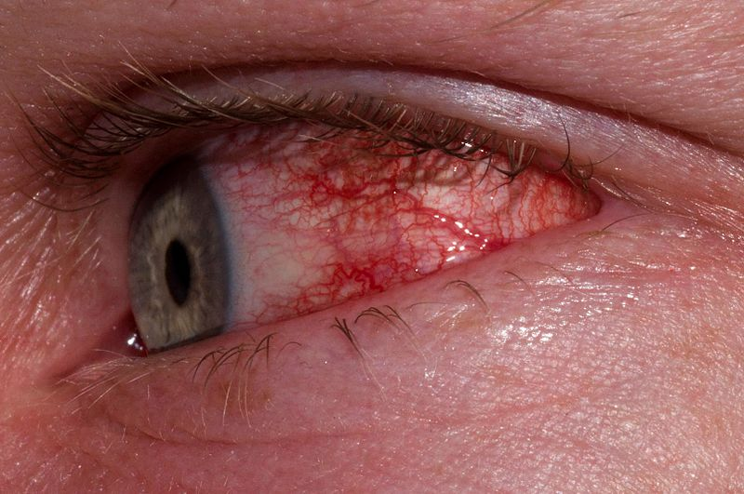
Bacteria
Prokaryotes (no real nucleus)
Divide by binary fission
Can cause:
Food poisoning (e.g. Salmonella)
Ear and eye infections
Cholera, diarrhea
http://en.wikipedia.org/wiki/File:Ericson_Type_II_Conjunctivitis.JPG

Slide 6
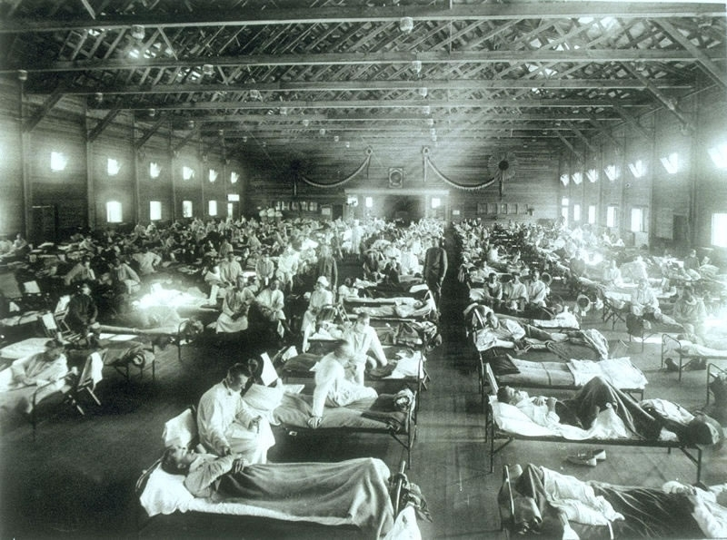
Viruses
Acellular (non-living?)
Need a ‘host’ cell to carry out functions of life, including reproduction
Can have DNA or RNA
Mutate, evolve and recombine quickly
Cause:
Flu, HIV/AIDS, smallpox, measles, common cold, herpes, ebola
The 1918 flu epidemic killed between 50 and 130 million people. http://en.wikipedia.org/wiki/1918_flu_pandemic

Slide 7
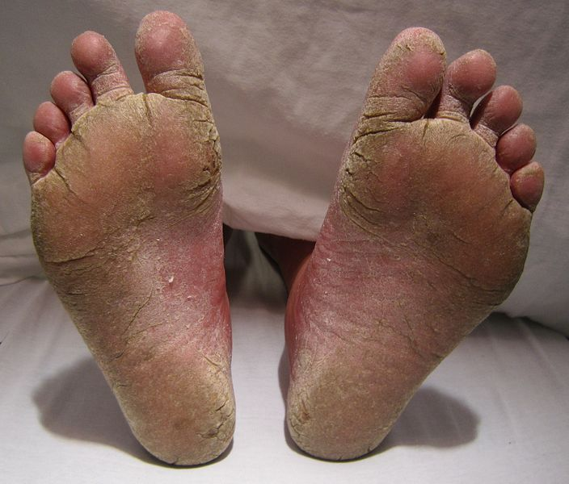
Fungi
Eukaryotes, reproduce with spores
Cause:
Athlete’s foot, mould, ringworm
Allergic reactions and respiratory problems
Image from: http://en.wikipedia.org/wiki/Athlete's_foot

Slide 8
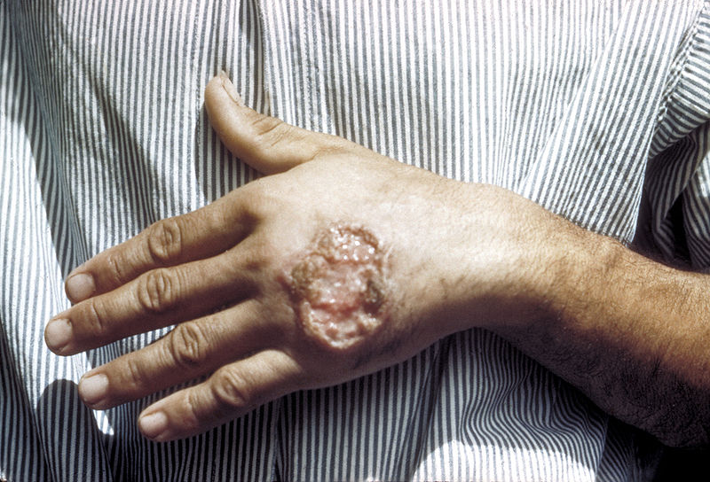
Protozoa
Simple parasites
Cause:
Malaria
Leishmaniasis
Toxoplasmosis
Leishmaniasis image from:
http://en.wikipedia.org/wiki/Leishmaniasis

Slide 10
6.3.U1 The skin and mucous membranes form a primary defence against pathogens that cause infectious disease.

Slide 11
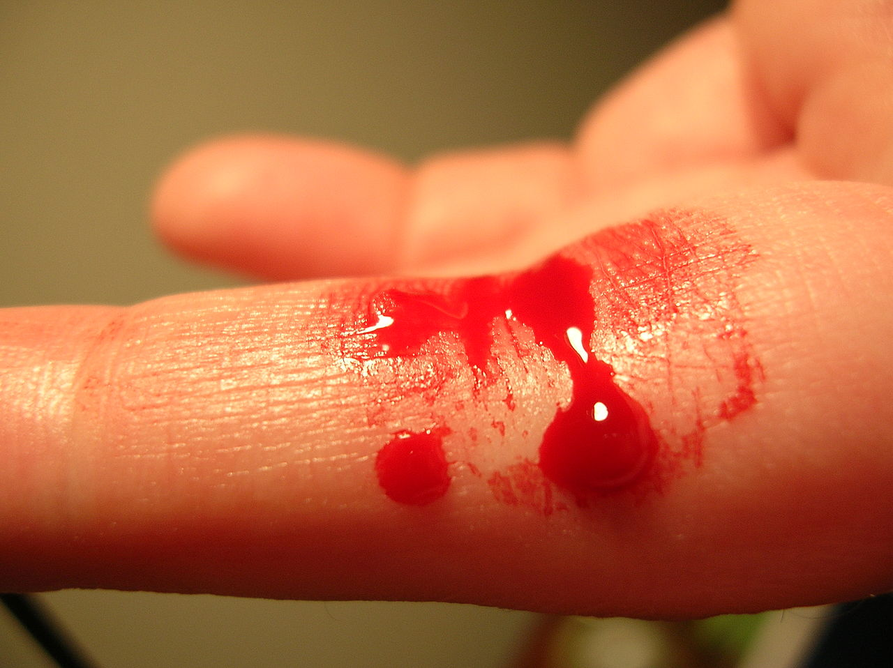
6.3.U2 Cuts in the skin are sealed by blood clotting. AND 6.3.U3 Clotting factors are released from platelets.
Wounds such as cuts to the skin causes opening through which pathogens can potentially enter the body
Blood clots at the site of a wound to prevent blood loss and the entry of pathogens.
Platelets (small cell fragments) along with damaged tissue release clotting factors in response to a wound.
Clotting factors cause a series of reactions which end with fibrin (a protein) fibres forming a mesh across the wound site.
The fibrin fibres capture blood cells and platelets forming a clot. In the presence of air the clot dries to form a scab with shields the healing tissues underneath
https://commons.wikimedia.org/wiki/File:Bleeding_finger.jpg

Slide 12
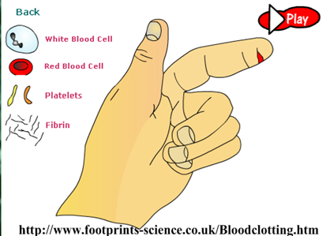
6.3.U4 The cascade results in the rapid conversion of fibrinogen to fibrin by thrombin.
http://www.footprints-science.com/flash/Blood%20clotting.swf

Slide 13
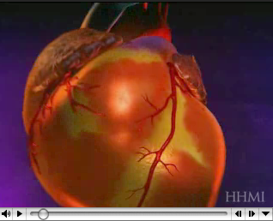
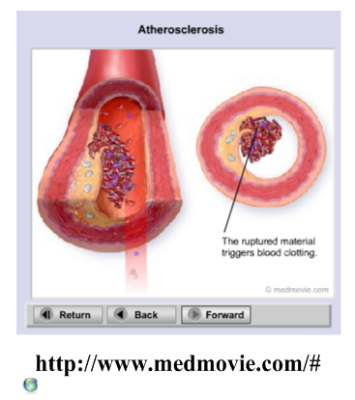
6.3.A1 Causes and consequences of blood clot formation in coronary arteries AND Review: 6.2.A3 Causes and consequences of occlusion of the coronary arteries.
http://www.hhmi.org/biointeractive/obesity/heart_attack.html

Slide 14
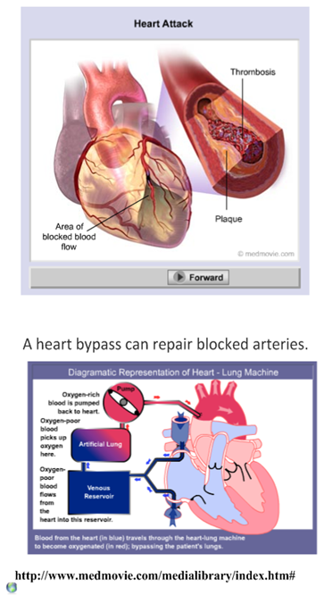
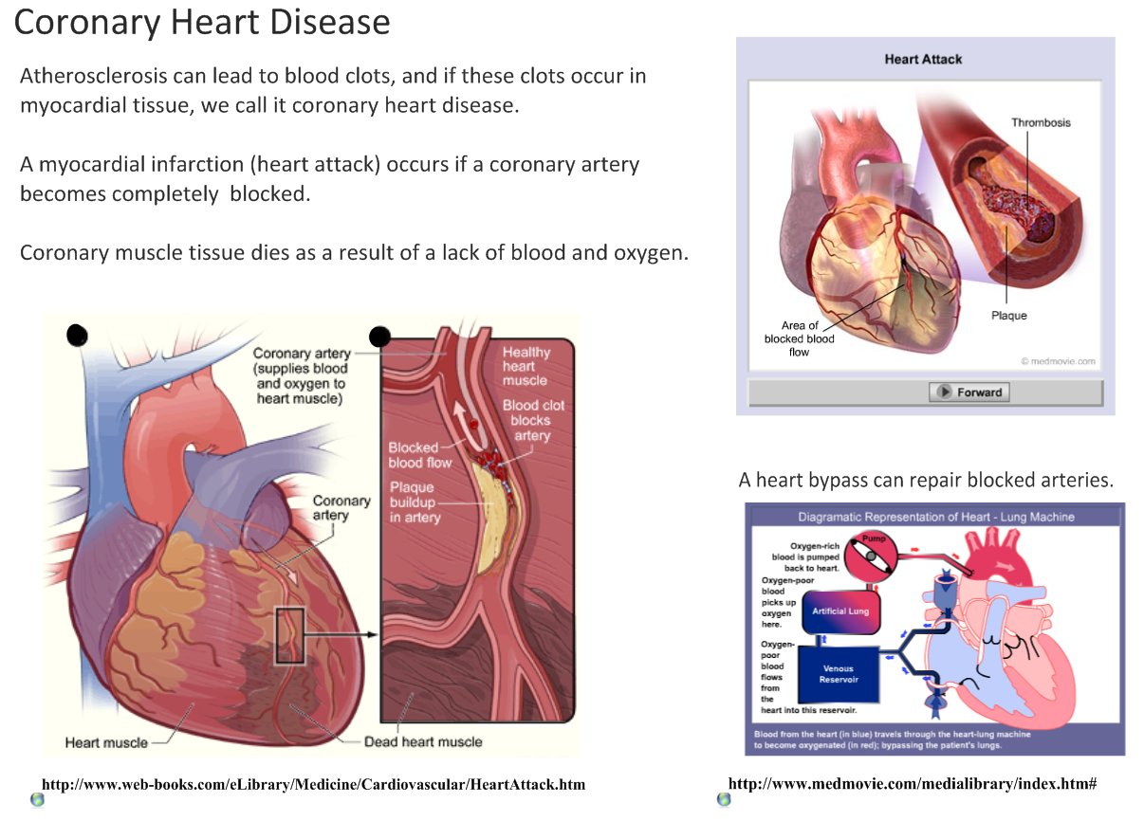
6.3.A1 Causes and consequences of blood clot formation in coronary arteries AND Review: 6.2.A3 Causes and consequences of occlusion of the coronary arteries.

Slide 15
6.3.A1 Causes and consequences of blood clot formation in coronary arteries AND Review: 6.2.A3 Causes and consequences of occlusion of the coronary arteries.

Slide 16
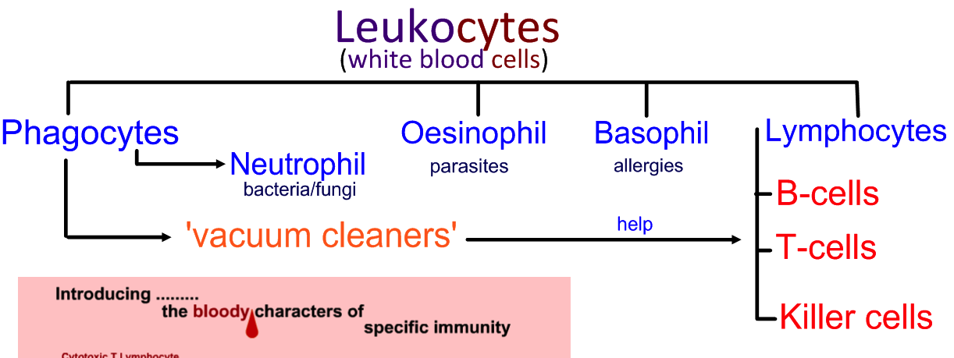
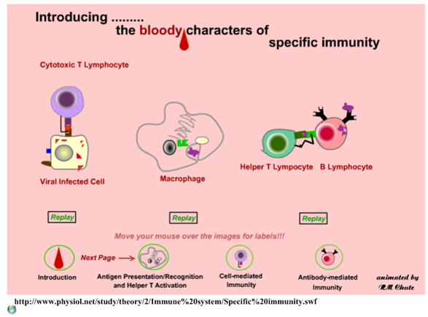
For this topic you only need to be aware of Phagocytes and Lymphocytes
http://apchute.com/lymphatic/inflam.html

Slide 17
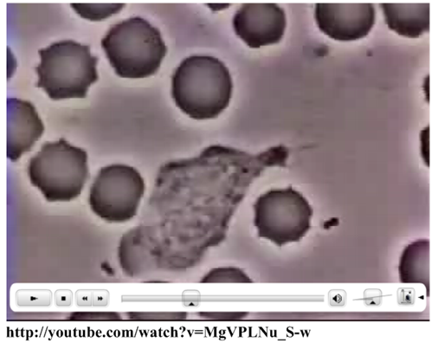
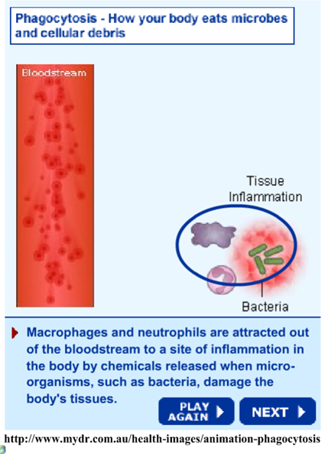
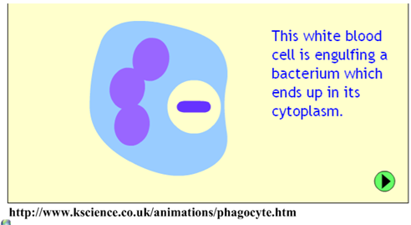
6.3.U5 Ingestion of pathogens by phagocytic white blood cells gives non-specific immunity to diseases.
http://youtube.com/watch?v=MgVPLNu_S-w
http://www.mydr.com.au/health-images/animation-phagocytosis
http://www.kscience.co.uk/animations/phagocyte.htm

Slide 18
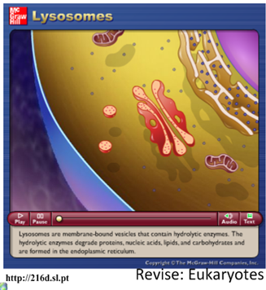
6.3.U5 Ingestion of pathogens by phagocytic white blood cells gives non-specific immunity to diseases.
Phagocytic Leucocytes
“eating cell”
“white blood cells”
Chemotaxis (movement in response to chemicals) attracts the phagocytes to the area of invasion as response to:
proteins produced by the pathogen
phospholipids released by damaged cells
The phagocyte attaches to the pathogen’s cell surface proteins and then engulfs it. The fluid nature of the plasma membrane allows this to happen.
A phagosome forms. This is a vesicle that contains the pathogen. Lysosomes – vesicles of digestive enzymes – deposit the enzymes into the phagosome.
The digestive enzymes break down the pathogen and the waste products are expelled from the cell by exocytosis.
http://216c.sl.pt/
Review opportunity:
Plasma membranes and vesicles
Membrane fluidity and fusion
Endo- and exo-cytosis
http://216d.sl.pt/

Slide 19
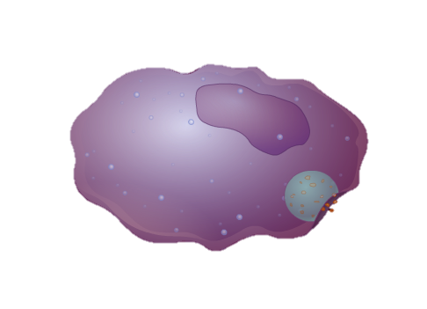
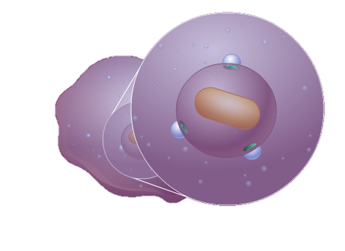
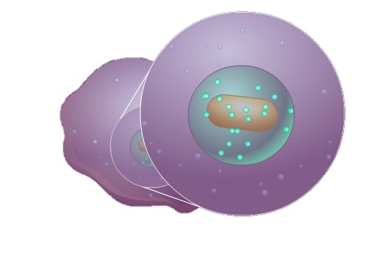
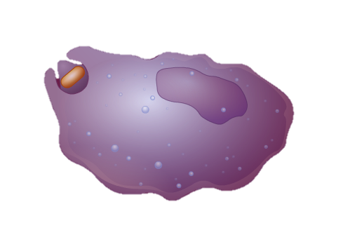
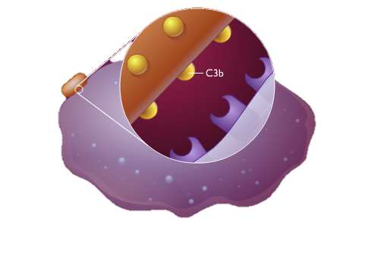
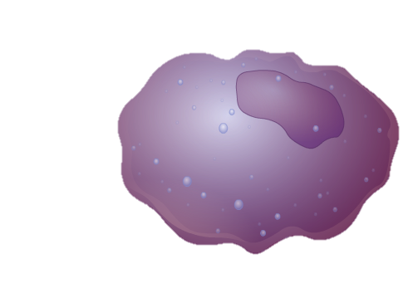
6.3.U5 Ingestion of pathogens by phagocytic white blood cells gives non-specific immunity to diseases.
Phagocytic Leucocytes
card sort game: order the images
& outline the processes
Images from: http://highered.mcgraw-hill.com/sites/0072495855/student_view0/chapter2/animation__phagocytosis.html

Slide 20
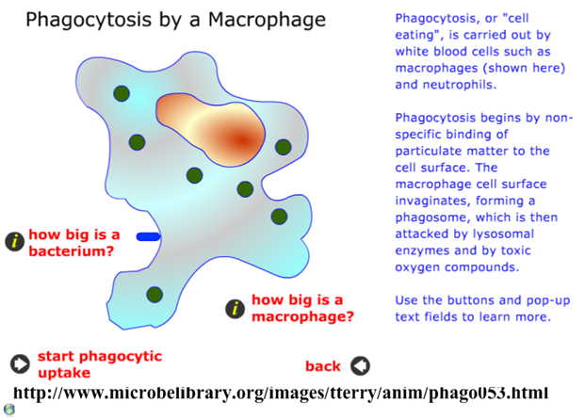
6.3.U5 Ingestion of pathogens by phagocytic white blood cells gives non-specific immunity to diseases.
Phagocytic Leucocytes
Q – can you suggest how phagocytes expelling the digested foreign material benefits humans?
“eating cell”
“white blood cells”
In summary phagocytosis involves a phagocyte:
Detecting and moving towards a foreign material* using chemotaxis
The foreign material is ingested by endocytosis
Lysosomes attach to the ingested vesicle (which encloses the foreign material) and release enzymes into it
The enzymes digest/breakdown the foreign material
The remains of the foreign material are expelled from the phagocyte
*foreign material is commonly a pathogen but can be other things such as dust, dirt, pollen and other allergens
http://www.microbelibrary.org/images/tterry/anim/phago053.html
Edited from: http://www.slideshare.net/gurustip/defense-against-infectious-disease-core-presentation

Slide 21
6.3.U5 Ingestion of pathogens by phagocytic white blood cells gives non-specific immunity to diseases.
Phagocytic Leucocytes
Q – can you suggest how phagocytes expelling the digested foreign material benefits humans?
“eating cell”
“white blood cells”
In summary phagocytosis involves a phagocyte:
Detecting and moving towards a foreign material* using chemotaxis
The foreign material is ingested by endocytosis
Lysosomes attach to the ingested vesicle (which encloses the foreign material) and release enzymes into it
The enzymes digest/breakdown the foreign material
The remains of the foreign material are expelled from the phagocyte
Phagocytes provide the body with a non-specific immune response to any material judged to be foreign. If the response is not enough and infection becomes widespread then lymphocytes, which control the specific immune response, are called into action – this is dealt with next
*foreign material is commonly a pathogen but can be other things such as dust, dirt, pollen and other allergens
http://www.microbelibrary.org/images/tterry/anim/phago053.html
Edited from: http://www.slideshare.net/gurustip/defense-against-infectious-disease-core-presentation

Slide 22
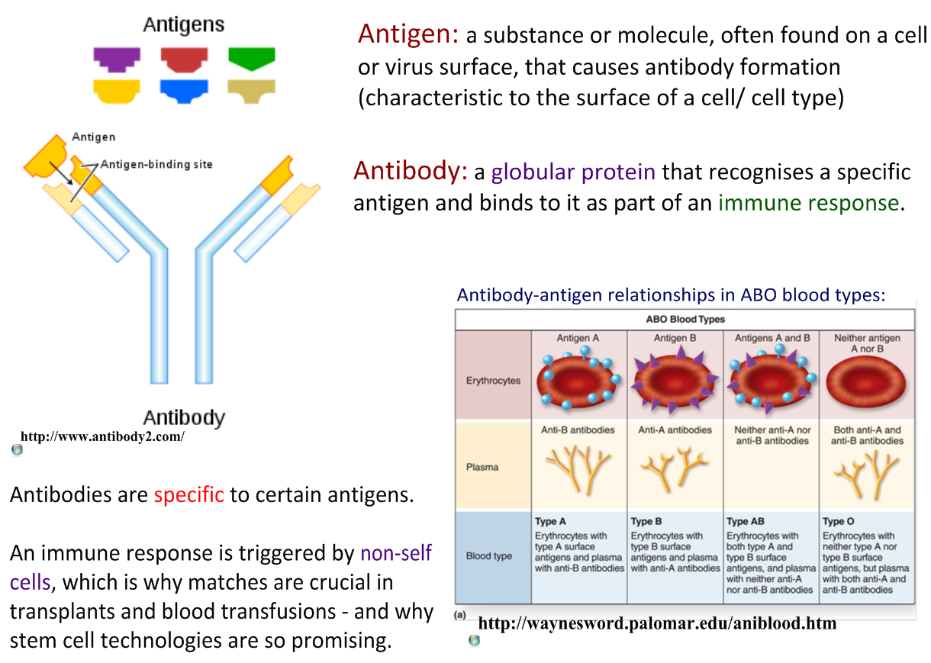
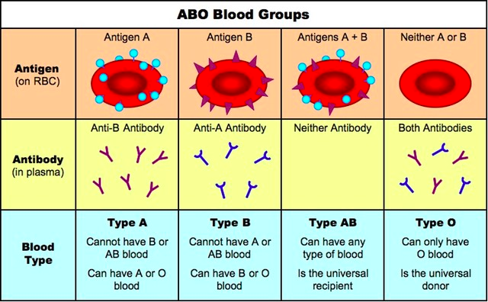
6.3.U6 Production of antibodies by lymphocytes in response to particular pathogens gives specific immunity.
http://www.ib.bioninja.com.au/_Media/abo_blood_groups_med.jpeg
Edited from: http://www.slideshare.net/gurustip/defense-against-infectious-disease-core-presentation

Slide 23
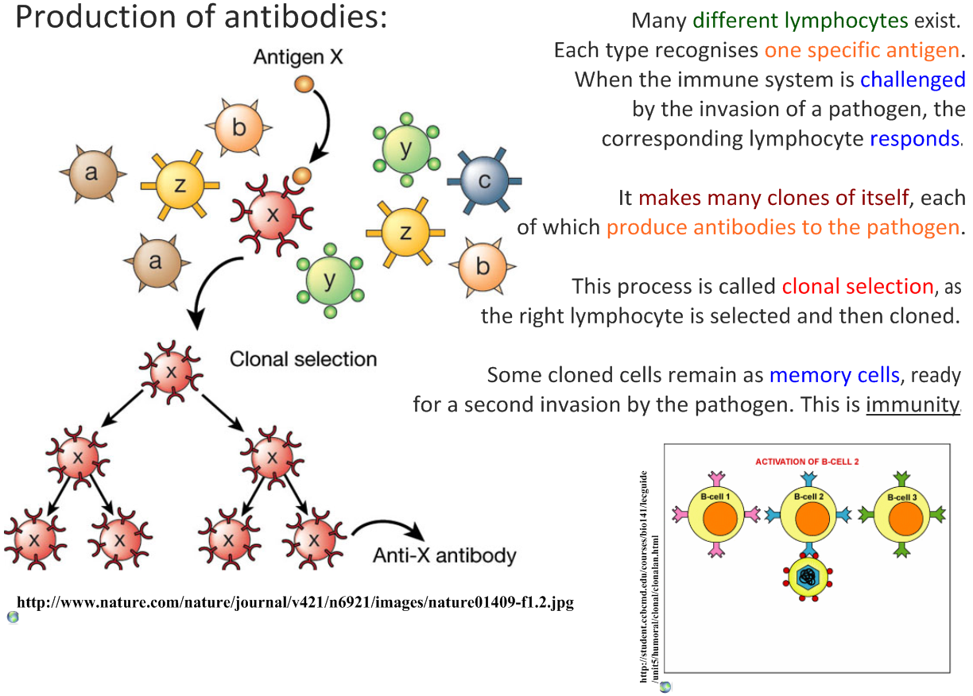
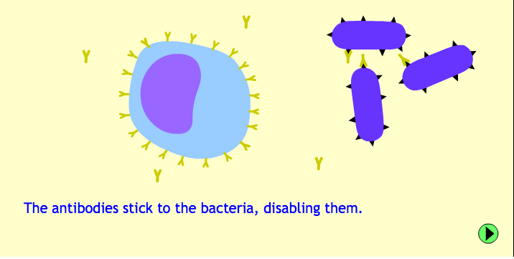
6.3.U6 Production of antibodies by lymphocytes in response to particular pathogens gives specific immunity.
http://www.kscience.co.uk/animations/lymphocyte.htm
Edited from: http://www.slideshare.net/gurustip/defense-against-infectious-disease-core-presentation

Slide 24
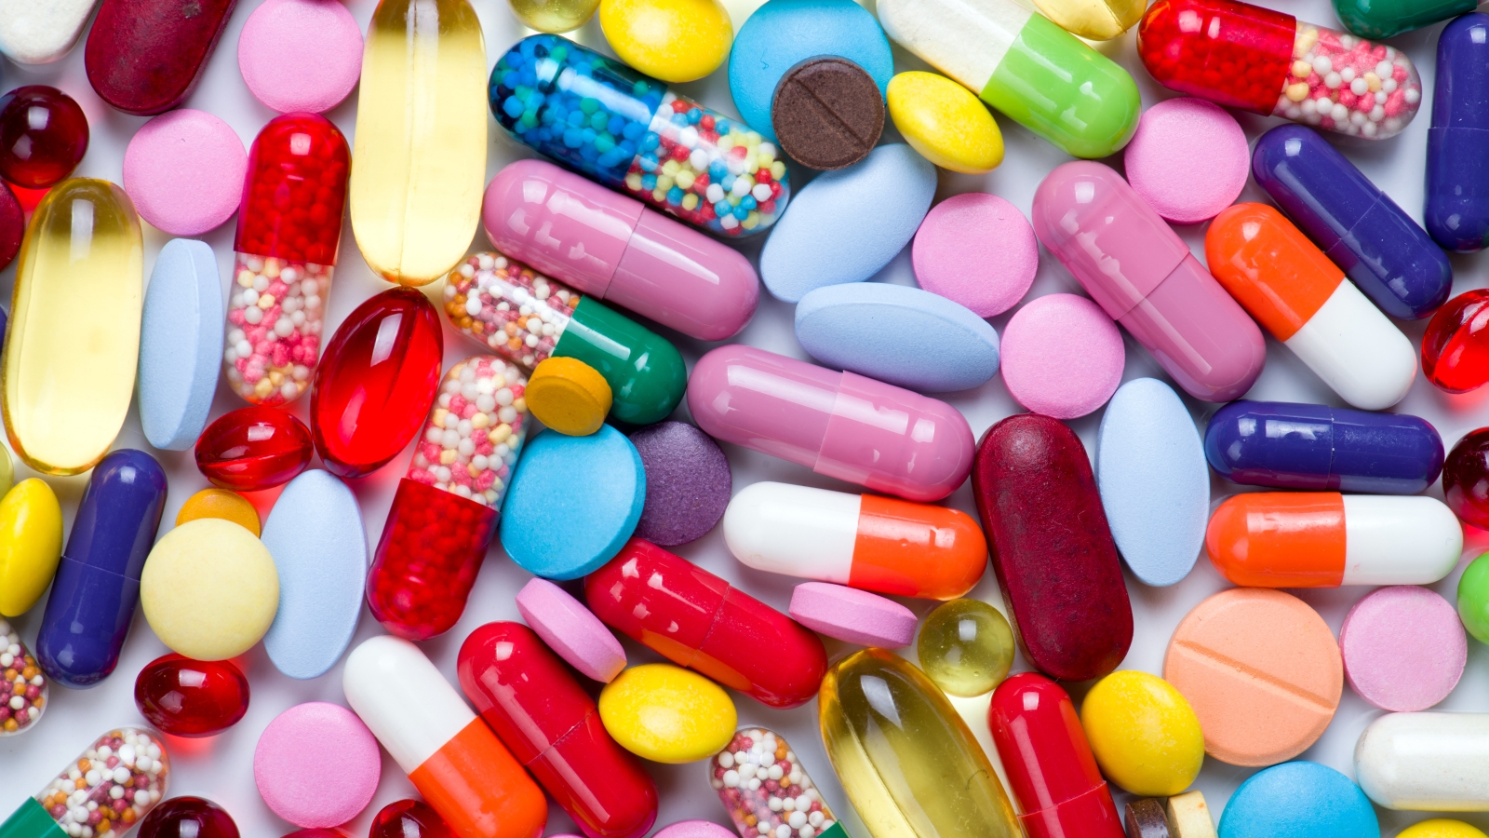
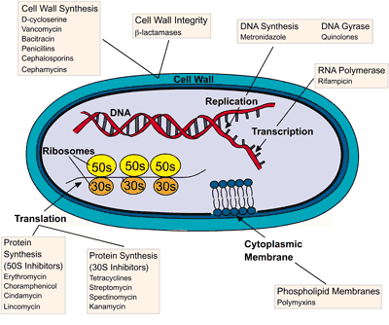
6.5.U7 Antibiotics block processes that occur in prokaryotic cells but not in eukaryotic cells. AND 6.3.U8 Viruses lack a metabolism and cannot therefore be treated with antibiotics.
Antibiotics are drugs used in the treatment and prevention of prokaryotic bacteria
Antibiotics are designed to disrupt structures or metabolic pathways in bacteria and fungi:
cell walls and membranes
Protein synthesis (translation)
DNA/RNA synthesis
Other metabolic processes (e.g. enzyme function)
These do not exist, or are very different, in viruses so antibiotics have no effect upon them.
Eukaryote (e.g. human) cells are also very different in structure and function to prokaryotes. Therefore drugs that inhibit prokaryotes often have little or no effect on eukaryotes
http://edge.alluremedia.com.au/m/l/2015/04/Pills.jpg
http://www.wiley.com/college/pratt/0471393878/instructor/activities/bacterial_drug_resistance/antibiotic_targets_web.gif

Slide 25
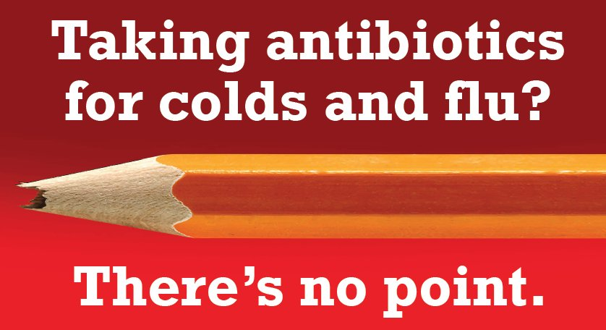
6.3.U8 Viruses lack a metabolism and cannot therefore be treated with antibiotics. Some strains of bacteria have evolved with genes that confer resistance to antibiotics and some strains of bacteria have multiple resistance.
Viruses use the (eukaryotic) host cell metabolism
Viruses are protected by the host cell structure
Viruses have a very different structure to prokaryote, just a protein capsid and genetic material - no cell wall or membrane to attack
http://www.hse.ie/images_upload/portal/eng/services/healthpromotion/AntibioticAwareness/nopoint.jpg

Slide 26
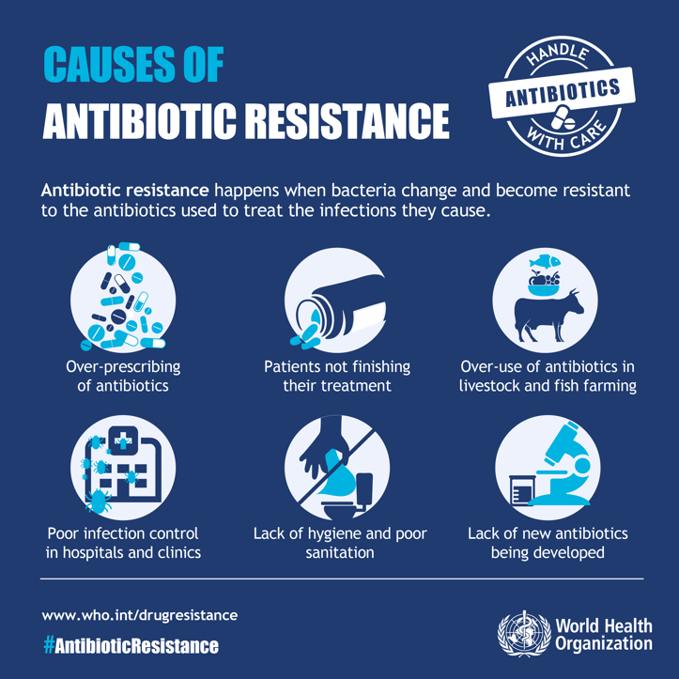
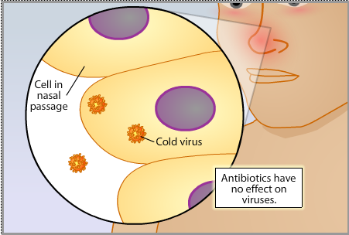
6.3.U8 Viruses lack a metabolism and cannot therefore be treated with antibiotics. Some strains of bacteria have evolved with genes that confer resistance to antibiotics and some strains of bacteria have multiple resistance.
Indiscriminate use of antibiotics is leading to antibiotic resistance in bacteria
An example of evolution by natural selection
Bacteria mutate and resistance to an antibiotic naturally arises
Bacteria divide rapidly therefore a resistant strain of bacteria can quickly proliferate
Over time strains of bacteria can become resistant to multiple strains of bacteria
http://outreach.mcb.harvard.edu/animations/resistance7.swf
http://www.sumanasinc.com/scienceinfocus/antibiotics/antibiotics_fla.html
http://www.who.int/mediacentre/events/2015/world-antibiotic-awareness-week/infographic-causes.jpg?ua=1

Slide 27
Review: 5.2.A2 Evolution of antibiotic resistance in bacteria.
http://www.sumanasinc.com/scienceinfocus/antibiotics/antibiotics_fla.html

Slide 28
6.3.U8 Viruses lack a metabolism and cannot therefore be treated with antibiotics. Some strains of bacteria have evolved with genes that confer resistance to antibiotics and some strains of bacteria have multiple resistance.
Do you take antibiotics for granted?
https://iappe.files.wordpress.com/2015/09/1utoyp8uaxogawyqvmjq8_a.jpg
http://www.cdc.gov/drugresistance/images/3-tuberculosis.png

Slide 29
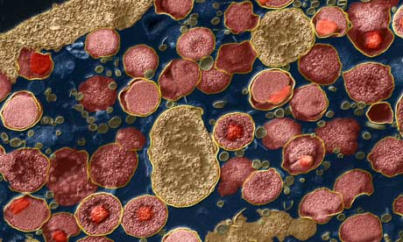
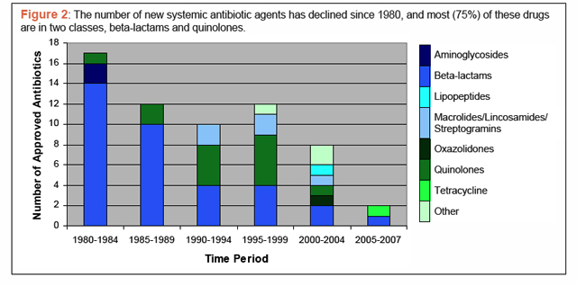
Antibiotics are ineffective against viruses!
Analyse the graph below. Over time, outline what has happened to:
The number of new approved antibiotics
The diversity of new approved antibiotics
Suggest reasons for your answers. Use the graph to write your own DBQ practice questions.
Chlamydia trachomatis bacteria. Are you ready for the end of antibiotics? Guardian: http://gu.com/p/2jxgj
The scariest graph you’ll ever see. Read the article by Maryn McKenna:
http://www.wired.com/wiredscience/2011/02/not-many-antibiotics/

Slide 30
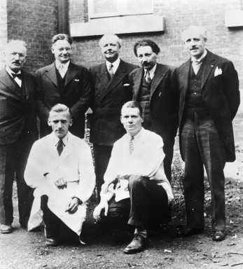
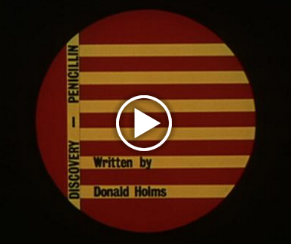
6.3.A2 Florey and Chain’s experiments to test penicillin on bacterial infections in mice. AND Nature of science: Risks associated with scientific research - Florey and Chain’s tests on the safety of penicillin would not be compliant with current protocol on testing. (4.8)
For their work on penicillin Fleming, Florey and Chain were awarded the Nobel prize for medicine in 1945
The discovery of penicillin.
Florey and Chain
http://www.chemheritage.org/
http://www.sciencemuseum.org.uk/hommedia.ashx?id=10271&size=Small
The real story behind penicillin
http://www.pbs.org/newshour/rundown/the-real-story-behind-the-worlds-first-antibiotic/
http://wellcomelibrary.org/player/b16778868#?asi=0&ai=0
An outline of the modern process of drug testing and clinical trials
Years of extensive laboratory research on animals and human cells to determine usefulness, likely dosage and possible side-effects
Assess the safety of the drug and the impact of side-effects on a small group of healthy volunteers – starting with a small dosage which is slowly increased
Test the effectiveness of the drug against a control on a small group of affected volunteers
Randomised and blind testing on a large group of affected volunteers against a placebo and competing drugs
Discuss the ways in which Florey and Chain’s work is accord with and breaches the modern practices of drug testing.

Slide 31
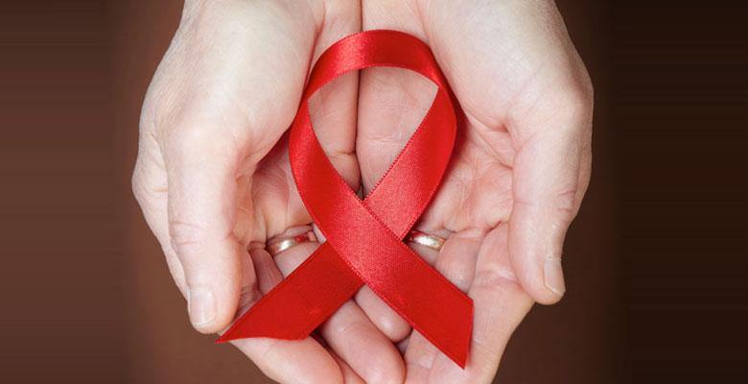
6.3.A3 Effects of HIV on the immune system and methods of transmission.
What are HIV and AIDS?
Human Immunodeficiency Virus (HIV) gradually attacks the immune system, which is our body’s natural defence against illness. If a person becomes infected with HIV, they will find it harder to fight off infections and diseases.
AIDS is a syndrome caused by HIV. It is when a person’s immune system is too weak to fight off infections, and develops when the HIV is advanced. This is the last stage of HIV where the body can no longer defend itself and may develop various diseases and if left untreated, death.
There is currently no cure for HIV. However, with the right treatment and support, people can live long and healthy lives.
See more at: http://www.avert.org/

Slide 32
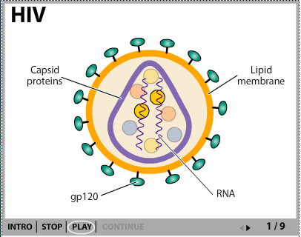
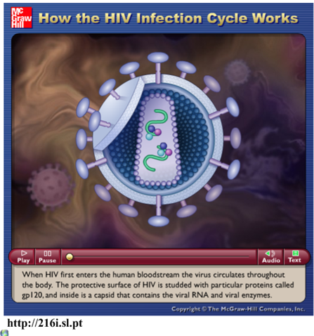
6.3.A3 Effects of HIV on the immune system and methods of transmission.
http://www.sumanasinc.com/webcontent/animations/content/lifecyclehiv.html
http://highered.mheducation.com/sites/0072495855/student_view0/chapter24/animation__how_the_hiv_infection_cycle_works.html

Slide 33
6.3.A3 Effects of HIV on the immune system and methods of transmission.

Slide 34
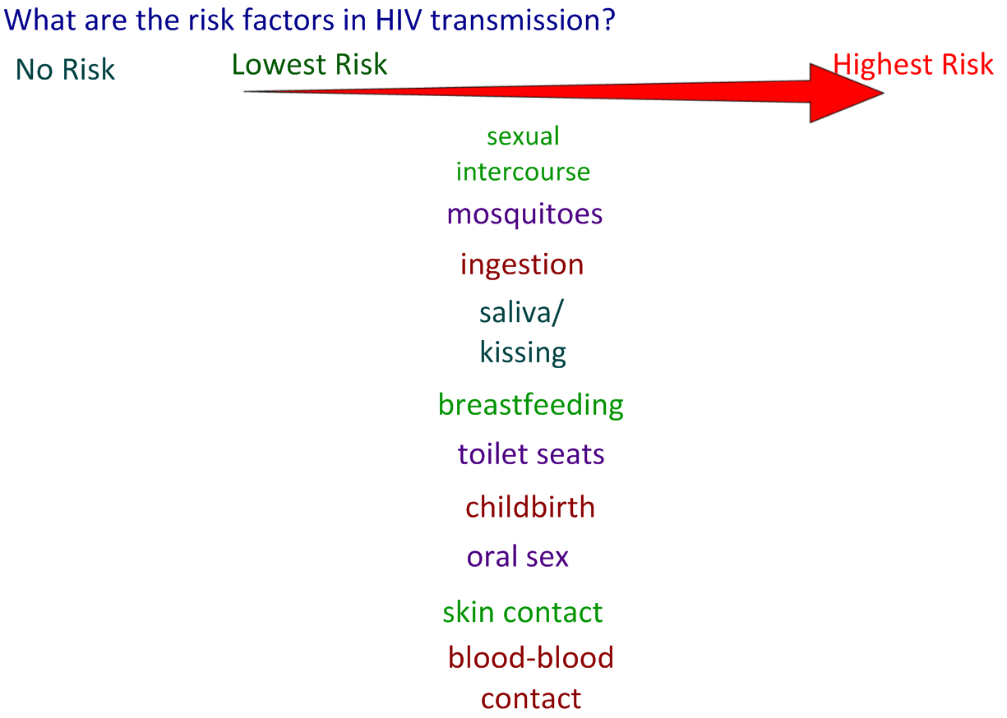
6.3.A3 Effects of HIV on the immune system and methods of transmission.

Slide 35
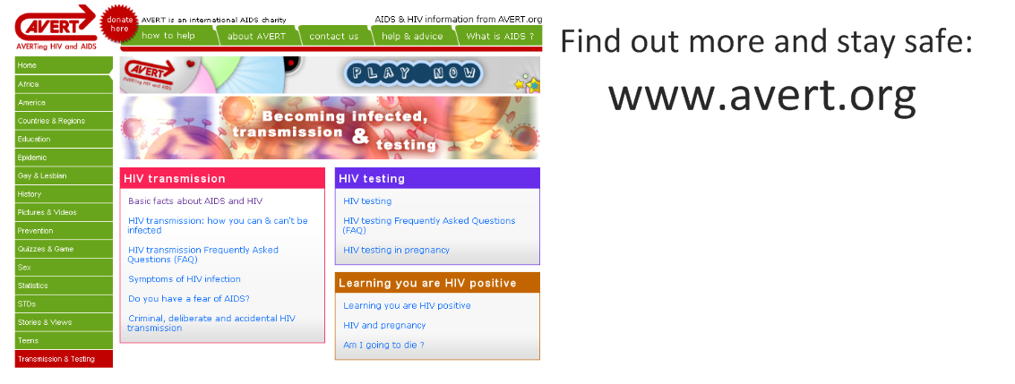
6.3.A3 Effects of HIV on the immune system and methods of transmission.
http://www.avert.org/

Slide 36
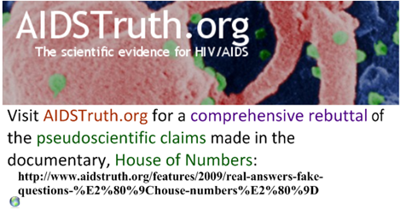
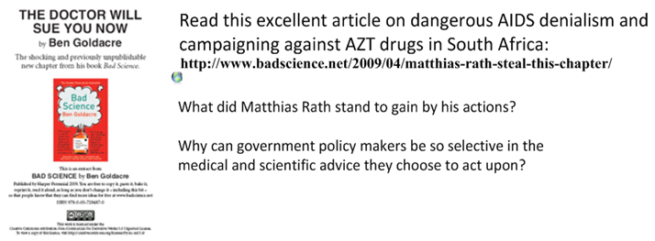
House of numbers: bad science and the popular media
https://www.aidstruth.org/2009/11/26/constantine-and-weiss-pinpoint-misrepresentations/
https://youtu.be/X_N4zgjF0K0
http://www.badscience.net/2009/10/aids-denialism-at-the-spectator/
http://www.badscience.net/2009/04/matthias-rath-steal-this-chapter/

Slide 37
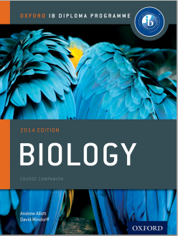
Bibliography / Acknowledgments

