Slide 1
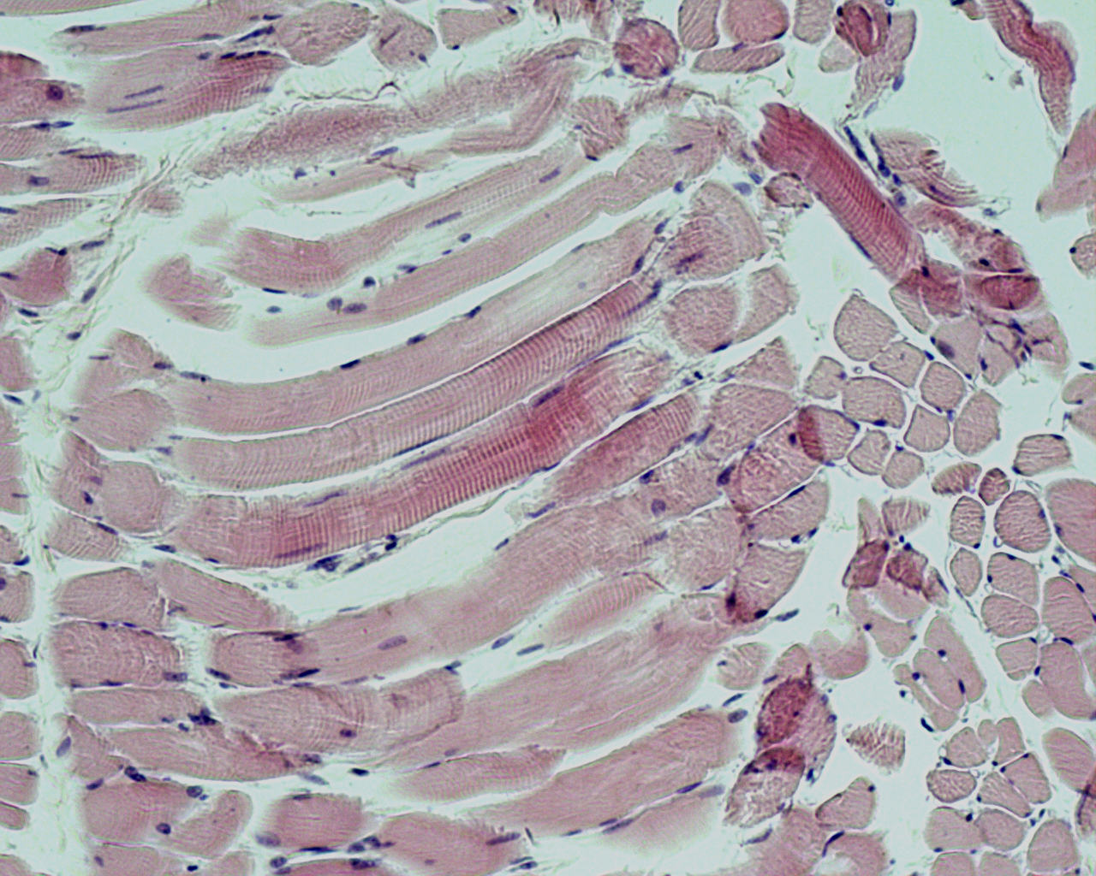
6.4 Gas exchange
Essential idea: The lungs are actively ventilated to ensure that gas exchange can occur passively.
Two processes maintain the concentration gradients between the blood and the alveolar air to ensure that diffusion of both oxygen and carbon dioxide can occur: firstly circulation of the blood brings a constant supply of high carbon dioxide, deoxygenated blood to the alveoli. Secondly the diaphragm (micrograph image) and intercostal muscles constantly increase and decrease the volume of the lungs to cause ventilation to occur, this is turn ensures a supply of high oxygen, low carbon dioxide air to the alveoli. The muscles cause the lungs to increase and decrease in volume by contractions. You can clearly see the striations in the diaphragm muscle tissue above. The striations help the muscle tissue to contract and relax.
By Chris Paine
https://bioknowledgy.weebly.com/
http://napavalley.edu/people/bmoore/PublishingImages/Pages/Histology-Page/Diaphragm%20100X.bmp

Slide 2
Understandings
 | Statement | Guidance
6.4.U1 | Ventilation maintains concentration gradients of oxygen and carbon dioxide between air in alveoli and blood flowing in adjacent capillaries.
6.4.U2 | Type I pneumocytes are extremely thin alveolar cells that are adapted to carry out gas exchange.
6.4.U3 | Type II pneumocytes secrete a solution containing surfactant that creates a moist surface inside the alveoli to prevent the sides of the alveolus adhering to each other by reducing surface tension.
6.4.U4 | Air is carried to the lungs in the trachea and bronchi and then to the alveoli in bronchioles. | Students should be able to draw a diagram to show the structure of an alveolus and an adjacent capillary.
6.4.U5 | Muscle contractions cause the pressure changes inside the thorax that force air in and out of the lungs to ventilate them.
6.4.U6 | Different muscles are required for inspiration and expiration because muscles only do work when they contract.

Slide 3
Applications and Skills
 | Statement | Guidance
6.4.A1 | Causes and consequences of lung cancer.
6.4.A2 | Causes and consequences of emphysema.
6.4.A3 | External and internal intercostal muscles, and diaphragm and abdominal muscles as examples of antagonistic muscle action.
6.4.S1 | Monitoring of ventilation in humans at rest and after mild and vigorous exercise. (Practical 6) | Ventilation can either be monitored by simple observation and simple apparatus or by data logging with a spirometer or chest belt and pressure meter. Ventilation rate and tidal volume should be measured, but the terms vital capacity and residual volume are not expected.

Slide 6
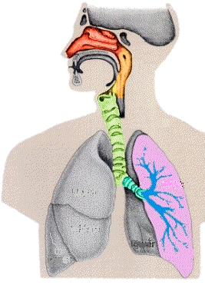
Why do we need a ventilation system?
We are large organisms. Oxygen cannot diffuse into all our
cells directly from the air, nor can waste products be directly
ejected from the body. We have specialised organ systems,
which are efficient, but need delivery of nutrients and
removal of waste. The ventilation system ensures the blood
can be the medium for this.
We are land-borne. Gases need moist surfaces (membranes) in
order to diffuse. Our lungs are moist membranes, allowing
oxygen to diffuse into the blood and carbon dioxide
to diffuse out.
The ventilation system maintains a large
concentration gradient between the alveoli and
the blood. The constant flow of past the alveoli brings
blood with a high CO₂ concentration and low O₂
concentration. Breathing out keeps the CO₂ concentration
in the alveoli low, so it diffuses out of the blood.
Breathing in keeps O₂ concentration in the alveoli high,
so it diffuses into the blood.
Diagram from: http://www.sciencequiz.net/jcscience/jcbiology/gapfilling/breathingsystem.htm

Slide 7
http://www.wisc-online.com/objects/ViewObject.aspx?ID=AP15104

Slide 8
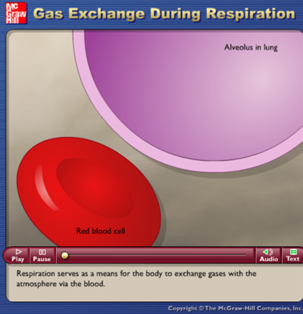
6.4.U1 Ventilation maintains concentration gradients of oxygen and carbon dioxide between air in alveoli and blood flowing in adjacent capillaries.
http://highered.mheducation.com/sites/0072495855/student_view0/chapter25/animation__gas_exchange_during_respiration.html

Slide 9
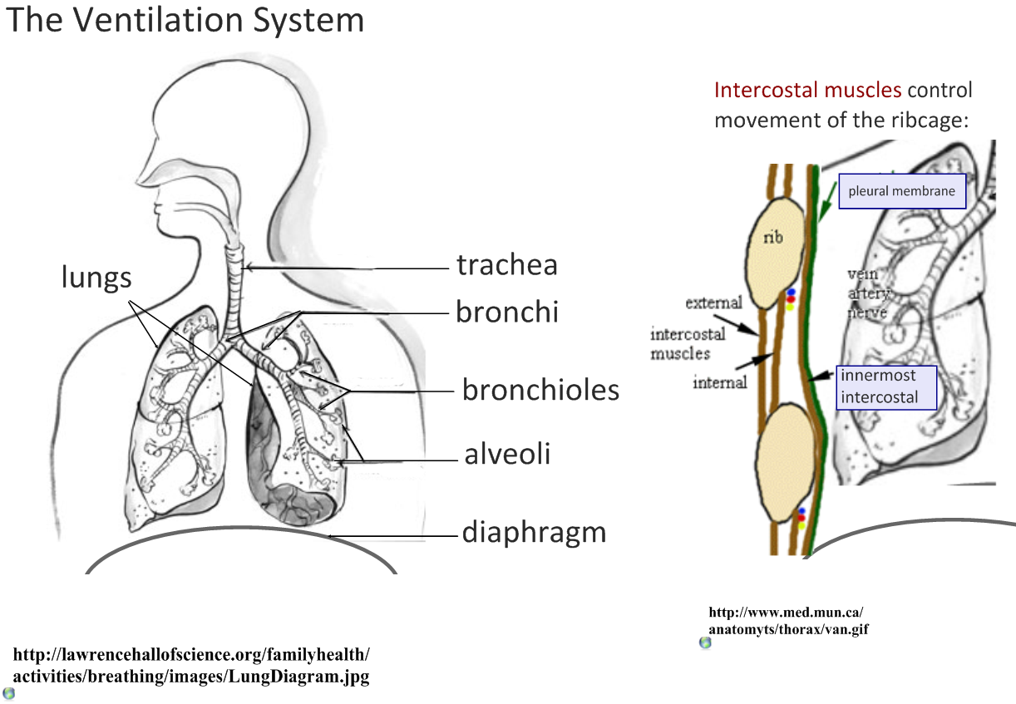
6.4.U4 Air is carried to the lungs in the trachea and bronchi and then to the alveoli in bronchioles.
Can you use the diagram to produce a flow chart to show the passage of air into the lungs?

Slide 10
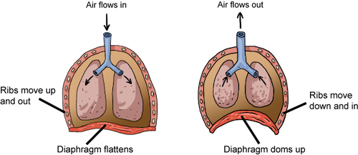
6.4.A3 External and internal intercostal muscles, and diaphragm and abdominal muscles as examples of antagonistic muscle action. AND 6.4.U5 Muscle contractions cause the pressure changes inside the thorax that force air in and out of the lungs to ventilate them.
Summary of the mechanics of ventilation
 | Inspiration | Expiration
pressure change | decrease in pressure (draws air inwards) | increase in pressure (pushes air outwards)
volume change | increase | decrease
ribcage movement | up and outward | down and inward
external intercostal muscles | contract | relax
internal intercostal muscles | relax | contract
diaphragm | contract (flattens, moves downwards) | relax
abdominal muscles | relax | contract (pushes the diaphragm up)
diagrams
causes
causes
http://media1.shmoop.com/images/biology/biobook_animalmovement_graphik_36.png

Slide 11
6.4.A3 External and internal intercostal muscles, and diaphragm and abdominal muscles as examples of antagonistic muscle action. AND 6.4.U5 Muscle contractions cause the pressure changes inside the thorax that force air in and out of the lungs to ventilate them.
Summary of the mechanics of ventilation
 | Inspiration | Expiration
pressure change | decrease in pressure (draws air inwards) | increase in pressure (pushes air outwards)
volume change | increase | decrease
ribcage movement | up and outward | down and inward
external intercostal muscles | contract | relax
internal intercostal muscles | relax | contract
diaphragm | contract (flattens, moves downwards) | relax
abdominal muscles | relax | contract (pushes the diaphragm up)
diagrams
causes
causes
causes
6.4.U6 Different muscles are required for inspiration and expiration because muscles only do work when they contract.
The external and internal intercostal muscles work together antagonistically. The diaphragm and abdominal muscles are also antagonistic to each other. Antagonist muscles oppose a specific movement to help to control a motion. Antagonistic muscles occur often in pairs where one muscle contracts whilst the other relaxes, the second muscle group causes movement in the opposite direction of the other. This is needed as relaxation is a passive process, relaxing of a muscle group is aided by the contraction of the other.

Slide 15
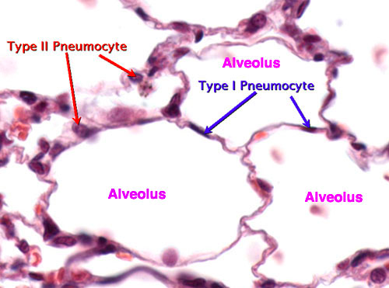
Micrograph of the lungs – what structures can you identify?
Name this structure
Identify this cell type
http://neurobio.drexelmed.edu/education/pil/microanatomy/Cases/01_Quintana/4_Epithelium/Images/alveolarepithelium.jpg

Slide 16
Micrograph of the lungs – what structures can you identify?
capillary
erythrocytes
(Red blood cells)
http://neurobio.drexelmed.edu/education/pil/microanatomy/Cases/01_Quintana/4_Epithelium/Images/alveolarepithelium.jpg

Slide 17
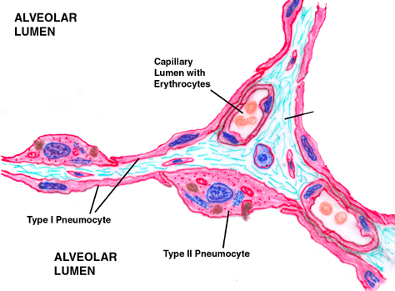
6.4.U2 Type I pneumocytes are extremely thin alveolar cells that are adapted to carry out gas exchange. AND 6.4.U3 Type II pneumocytes secrete a solution containing surfactant that creates a moist surface inside the alveoli to prevent the sides of the alveolus adhering to each other by reducing surface tension.
Alveoli walls and gas exchange
Connective
tissue
Type I pneumocytes
A Single layer of cells form the walls of an alveolus
Extremely thin – short diffusion distance
Permeable – aids diffusion
Type II pneumocytes
Secrete fluid to moisten the inner surface of the alveolus
Fluid aids diffusion of gases
Fluid contains surfactant to prevent the walls sticking together – maintains the lumen
Can divide to form Type I pneumocytes – repair damage
Edited from: https://beyondthedish.files.wordpress.com/2011/11/gas-barrier-small.jpg
http://neurobio.drexelmed.edu/education/pil/microanatomy/Cases/01_Quintana/4_Epithelium/Images/alveolarepithelium.jpg

Slide 18
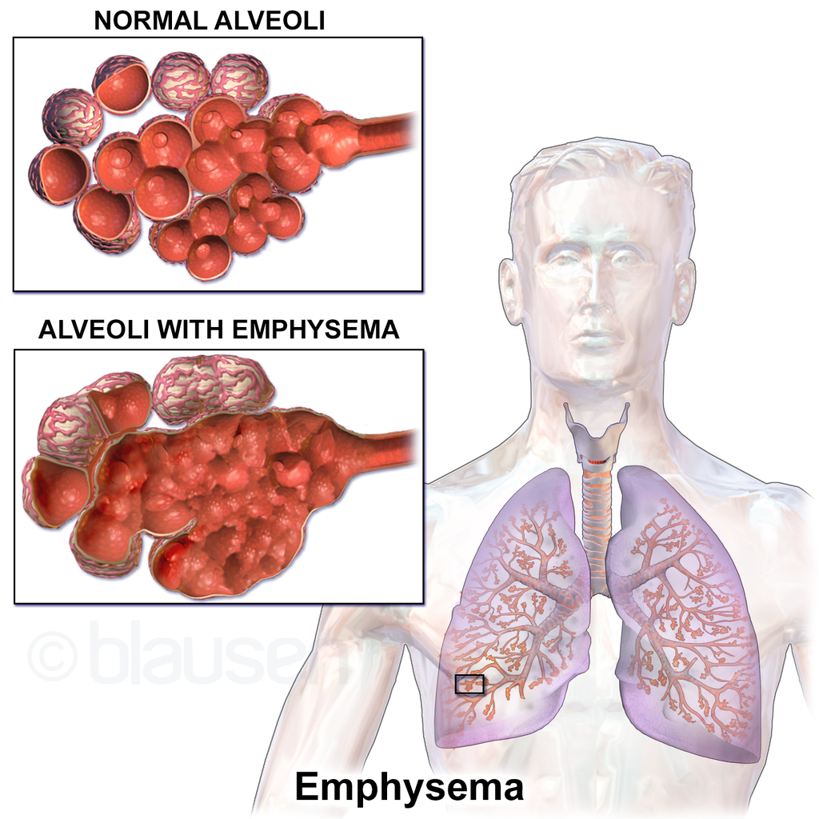
6.4.A2 Causes and consequences of emphysema.
Emphysema
The main cause of emphysema is smoking but it can also develop in people with a long history of chest infections. emphysema can also be caused by air pollution. All of which cause an inflammatory response in the lungs.
Protease is released by leukocytes (white blood cells) and inflamed lung tissue. The protease breaks down the connective tissue, such as elastin) of the lungs. This results in the destruction of small airways and alveoli. This results in the formation of large air pockets and the breakdown of capillaries.
Consequently large air pockets have a much lower surface area to volume ratio than the alveoli which causes insufficient ventilation. When combined with the reduced blood supply this in turn means inefficient gas exchange and hence low blood oxygen levels.
Symptoms include:
Difficulty breathing
Cough
Loss of appetite
Weight loss
Emphysema is not curable, but there are treatments that can help you manage the disease
https://commons.wikimedia.org/wiki/File:Blausen_0343_Emphysema.png

Slide 19
Review: 1.6.U6 Mutagens, oncogenes and metastasis are involved in the development of primary and secondary tumours.
Tumours are abnormal growth of tissue that develop at any stage of life in any part of the body. A cancer is a malignant tumour and is named after the part of the body where the cancer (primary tumour) first develops. Use the links to find out:
most common types of cancer
what causes cancer and associated risk factors
how cancer can be treated
http://youtu.be/8BJ8_5Gyhg8
http://www.e-learningforkids.org/health/lesson/cancer/
What causes cancer?
http://www.cancerresearchuk.org/cancer-info/cancerandresearch/all-about-cancer/what-is-cancer/
http://www.cancer.gov/cancertopics/types/commoncancers

Slide 20
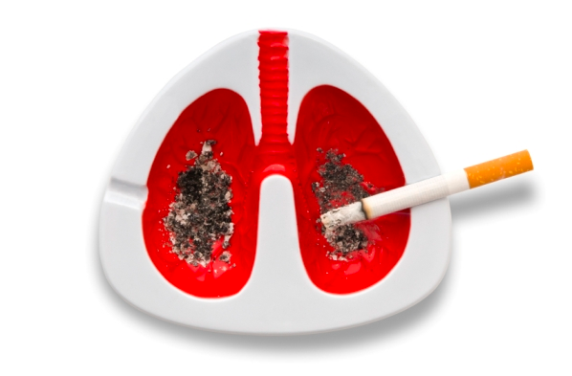
6.4.A1 Causes and consequences of lung cancer.
“Lung cancer is the leading cause of death from cancer in the U.S.”
http://www.cancer.gov/types/lung
Lung cancer is cancer that starts in the windpipe (trachea), the main airway (bronchus) or the lung tissue.
By far the biggest cause of lung cancer is smoking. It causes more than 8 out of 10 cases (86%) including a small proportion caused by exposure to second hand smoke in non smokers (passive smoking).
Some other things increase lung cancer risk by a small amount:
Exposure to radon (a radioactive) gas
Air pollution
Previous lung disease
A family history of lung cancer
Past cancer treatment
Previous smoking related cancers
Lowered immunity
Like most cancers lung cancer, if untreated, will end with death. Because detection of lung cancer is difficult it is often only diagnosed in the later stages. As a consequence only 10% of those diagnosed will survive for 5 years.
The symptoms of lung cancer may include:
Being short of breath
Having a cough most of the time
Coughing up phlegm with blood
An ache or pain in the chest or shoulder
Loss of appetite
Tiredness/fatigue
Losing weight
http://spacecoastdaily.com/wp-content/uploads/2014/01/Cigarette-Smoking-is-Mainly-Causes-of-Lung-Cancer.jpg
Source: http://www.cancerresearchuk.org/about-cancer/type/lung-cancer/

Slide 21
Nature of science: Obtain evidence for theories - epidemiological studies have contributed to our understanding of the causes of lung cancer. (1.8)
“Epidemiology is the study of the distribution and determinants of health-related states or events (including disease), and the application of this study to the control of diseases and other health problems.”
http://www.who.int/topics/epidemiology/en/
Surveillance/observation and descriptive studies can be used to study distribution.
However analytical (statistical) studies are used to study causes.
There are however limitations to epidemiology as an identified correlation does not always indicate causation:
“overweight and obesity are protective factors against lung cancer, especially in current and former smokers”
Nicotine in tobacco suppresses appetite
Vs.
http://www.npr.org/2011/06/09/137085989/the-skinny-on-smoking-why-nicotine-curbs-appetite
http://www.ncbi.nlm.nih.gov/pubmed/22777722
Until lab studies indicate a link it is possible that weight is negatively correlated with tobacco intake.
http://www.umweltbundesamt.de/sites/default/files/medien/376/bilder/gruppe_c_4designersart_fotolia_53367840_m.jpg

Slide 22
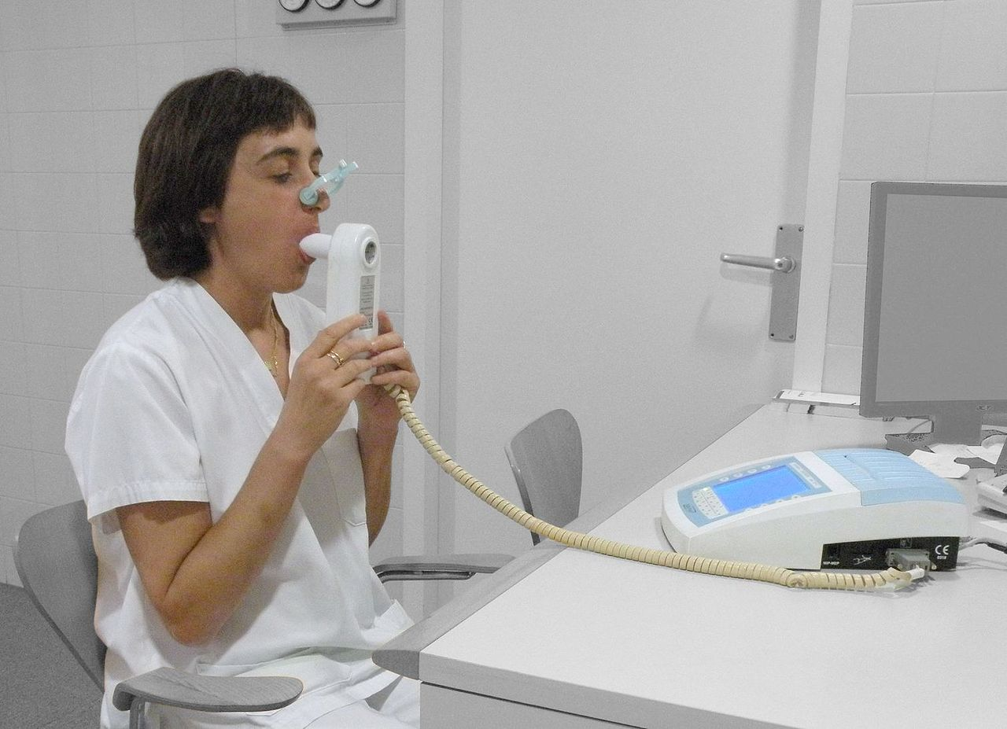
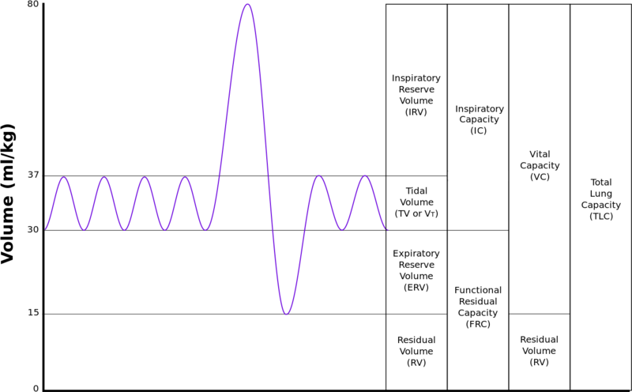
6.4.S1 Monitoring of ventilation in humans at rest and after mild and vigorous exercise. (Practical 6)
Monitoring ventilation
: design an investigation, collect and analyse the data
Independent variable: the intensity of exercise
What type of exercise? For how long? How will you make sure that individuals exercise similarly?
https://en.wikipedia.org/wiki/File:Lungvolumes_Updated.png
Dependent variable: What measure(s) are you using for ventilation?
Data analysis: you should be calculating a rate. For example the count of breaths or tidal volume per unit time (s or min)
Frequency of breaths? Spirometer data showing tidal volumes?
Ethical and safety concerns: how are you making sure that the experiment is safe? Are participants aware of the risks? Are you seeking written permission from participants?
Controlled variables: what are the key factors that need to be measured and kept constant to ensure a fair test?
https://commons.wikimedia.org/wiki/File:DoingSpirometry.JPG

Slide 23
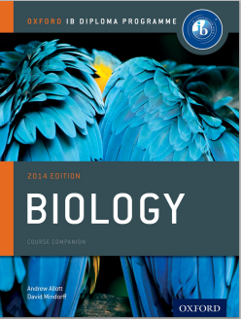
Bibliography / Acknowledgments
Bob Smullen

