Slide 1
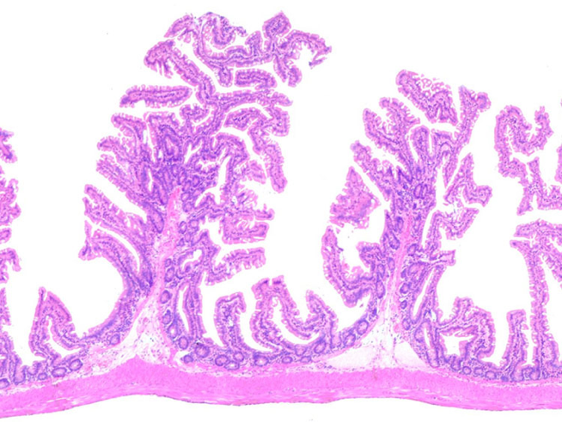
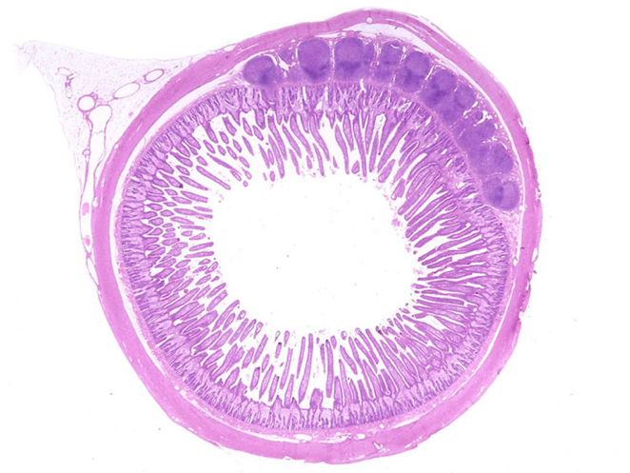
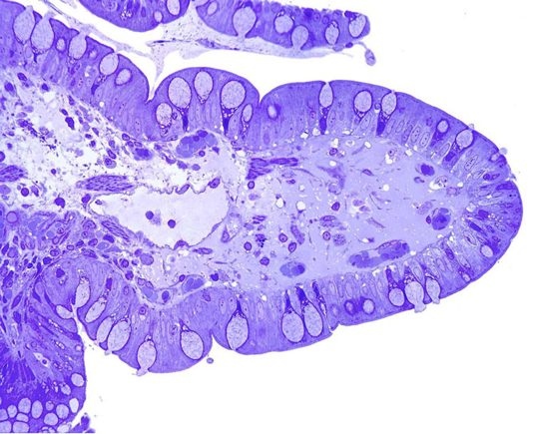
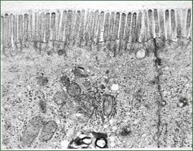
6.1 Digestion and absorption
1. Low power light microscope image: cross section of the ileum shows both the folded nature of the inner wall and the outer muscular layers helping to food along and increasing the surface area in contact with digested food.
2. Magnification increased: intricate folded nature of the walls becomes clear.
http://medcell.med.yale.edu/systems_cell_biology_old/gi/images/small_intestine.jpg
3. Magnification increased further: an individual villus can be distinguished. The specialised cells are key in both the processes of digestion and absorption, e.g. goblet cells secrete enzymes into the lumen.
http://medcell.med.yale.edu/systems_cell_biology_old/gi/images/ileum.jpg
Essential idea: The structure of the wall of the small intestine allows it to move, digest and absorb food.
4. An electron micrograph at very higher magnification: the microvilli on the surface of a single villus can be seen, they further increase the surface area available for absorption.
http://medcell.med.yale.edu/systems_cell_biology_old/gi/images/villus.jpg
By Chris Paine
https://bioknowledgy.weebly.com/
http://www.cals.ncsu.edu/course/zo250/brush_border.gif

Slide 2
Understandings
 | Statement | Guidance
6.1.U1 | The contraction of circular and longitudinal muscle of the small intestine mixes the food with enzymes and moves it along the gut.
6.1.U2 | The pancreas secretes enzymes into the lumen of the small intestine. | Students should know that amylase, lipase and an endopeptidase are secreted by the pancreas. The name trypsin and the method used to activate it are not required.
6.1.U3 | Enzymes digest most macromolecules in food into monomers in the small intestine. | Students should know that starch, glycogen, lipids and nucleic acids are digested into monomers and that cellulose remains undigested.
6.1.U4 | Villi increase the surface area of epithelium over which absorption is carried out.
6.1.U5 | Villi absorb monomers formed by digestion as well as mineral ions and vitamins.
6.1.U6 | Different methods of membrane transport are required to absorb different nutrients.

Slide 3
Applications and Skills
 | Statement | Guidance
6.1.A1 | Processes occurring in the small intestine that result in the digestion of starch and transport of the products of digestion to the liver.
6.1.A2 | Use of dialysis tubing to model absorption of digested food in the intestine.
6.1.S1 | Production of an annotated diagram of the digestive system.
6.1.S2 | Identification of tissue layers in transverse sections of the small intestine viewed with a microscope or in a micrograph. | Tissue layers should include longitudinal and circular muscles, mucosa and epithelium.

Slide 4
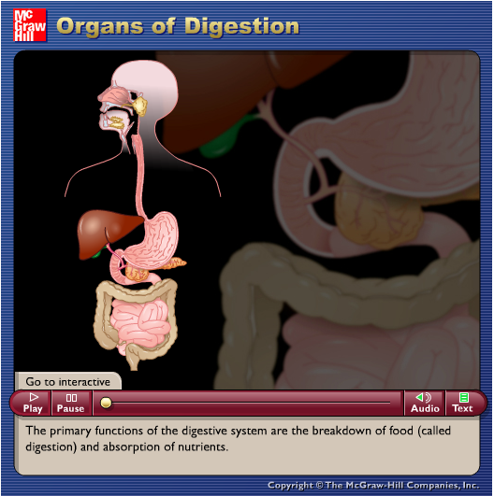
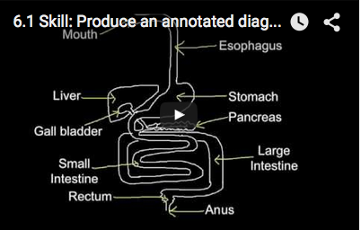
6.1.S1 Production of an annotated diagram of the digestive system.
Use the animation and video to learn about the digestive system and how to draw it.
https://youtu.be/Nm-pT7fk6gs
http://highered.mheducation.com/sites/0072495855/student_view0/chapter26/animation__organs_of_digestion.html

Slide 5
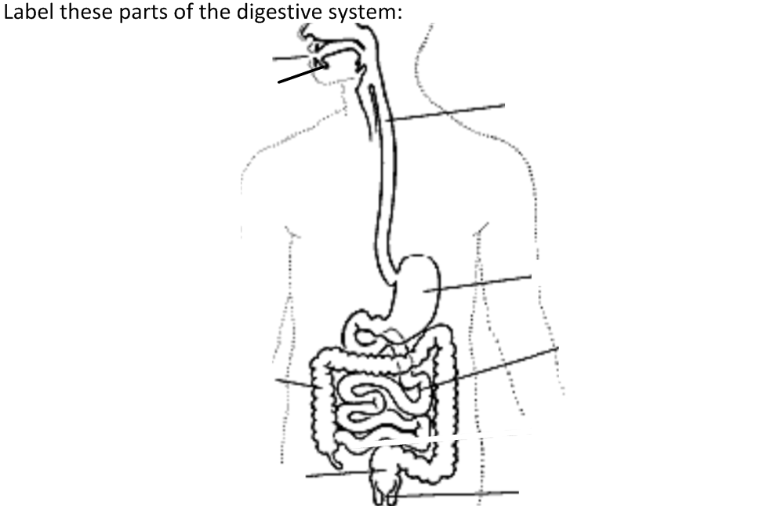
6.1.S1 Production of an annotated diagram of the digestive system.
Plus add in the accessory organs: the gall bladder, liver and pancreas.

Slide 6
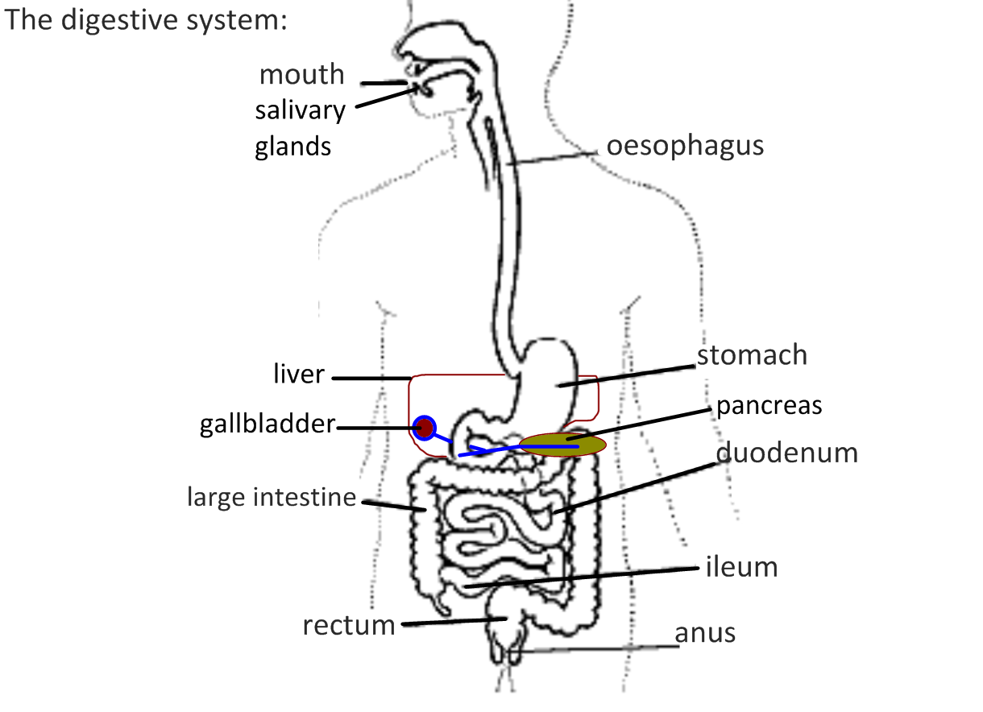
6.1.S1 Production of an annotated diagram of the digestive system.

Slide 7
6.1.S1 Production of an annotated diagram of the digestive system.
Now add the annotations to show what happens in digestion.

Slide 8
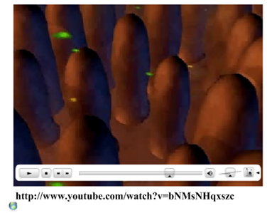

Slide 9
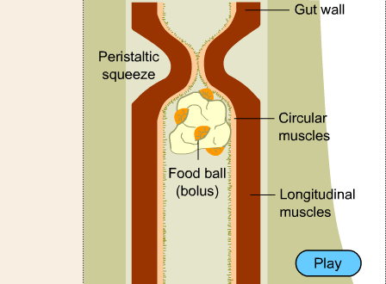
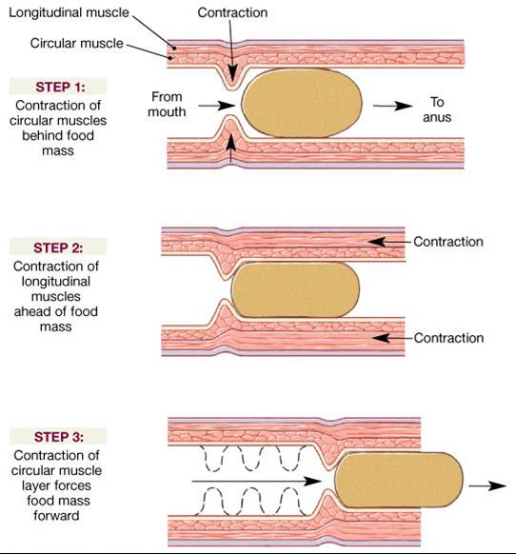
6.1.U1 The contraction of circular and longitudinal muscle of the small intestine mixes the food with enzymes and moves it along the gut.
Peristalsis moves food through the alimentary canal
Contraction of longitudinal muscle expand the lumen in front of the food giving it space to move into.
Contraction of circular muscles behind the food propels it forwards.
http://www.bbc.co.uk/schools/gcsebitesize/science/add_edexcel/common_systems/digestionrev2.shtml
In the small intestine peristalsis also mixes food with enzymes and forces the products of digesiton into contact with the wall of the intestine
Therefore in the intestines the food is moved very slowly to allow time for digestion.
n.b. The contractions are controlled unconsciously by the enteric nervous system
http://www.austincc.edu/rfofi/NursingRvw/NursingPics/DigestivePics/Picture4.jpg

Slide 10
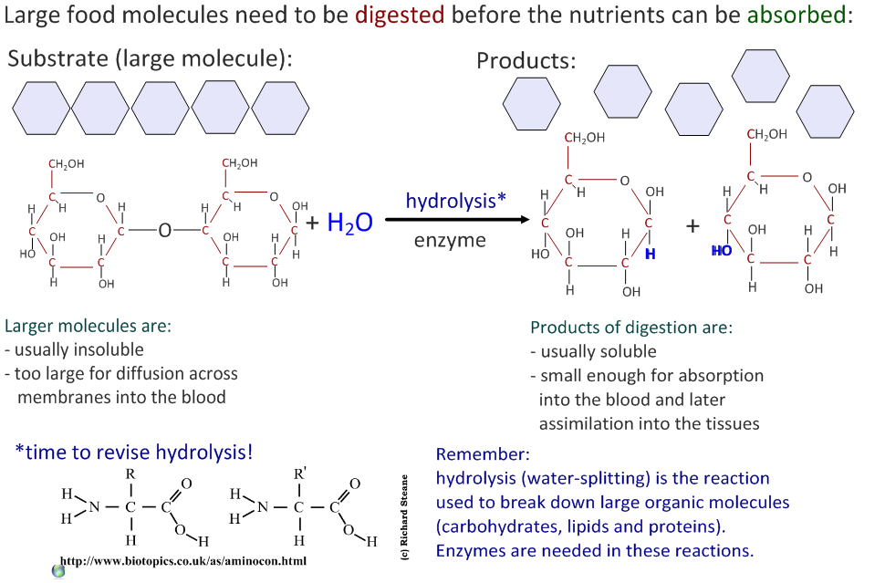
6.1.U3 Enzymes digest most macromolecules in food into monomers in the small intestine.

Slide 11
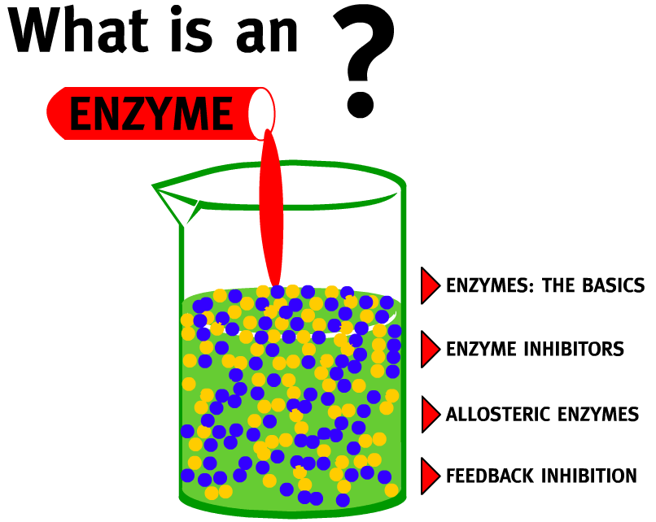
Review: 2.5.U1 Enzymes have an active site to which specific substrates bind. AND 2.5.U2 Enzyme catalysis involves molecular motion and the collision of substrates with the active site.
Enzyme: A globular protein that increases the rate of a biochemical reaction by lowering the activation energy threshold (i.e. a biological catalyst)
Use the animation to find out more about enzymes and how they work.
A good alternative is How Enzymes Work from McGraw and Hill
http://highered.mheducation.com/sites/0072495855/student_view0/chapter2/animation__how_enzymes_work.html
http://www.northland.cc.mn.us/biology/biology1111/animations/enzyme.swf

Slide 12
6.1.U3 Enzymes digest most macromolecules in food into monomers in the small intestine.

Slide 13
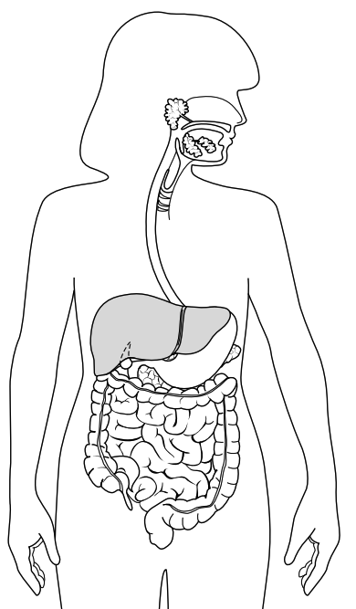
6.1.U3 Enzymes digest most macromolecules in food into monomers in the small intestine.
Human Digestive Enzymes
Remember: enzymes are specific to their substrates and each enzyme has its own optimum pH.
Three main types of enzymes in human digestion:
Amylases break down carbohydrates
Example: salivary amylase
Substrate: starch Product: maltose
Source: mouth (salivary glands)
Optimum pH: 7-7.8
Proteases break down polypeptides
Example: pepsin
Substrate: polypeptides Product: amino acids
Source: stomach
Optimum pH: 2
Lipases break down fats and lipids
Example: pancreatic lipase
Substrate: triglycerides Product: fatty acids & glycerol
Source: pancreas, delivered into small intestine
Optimum pH: 7.2 - 7.5
diagram from: http://www.teachervision.fen.com/digestive-system/printable/57730.html

Slide 14
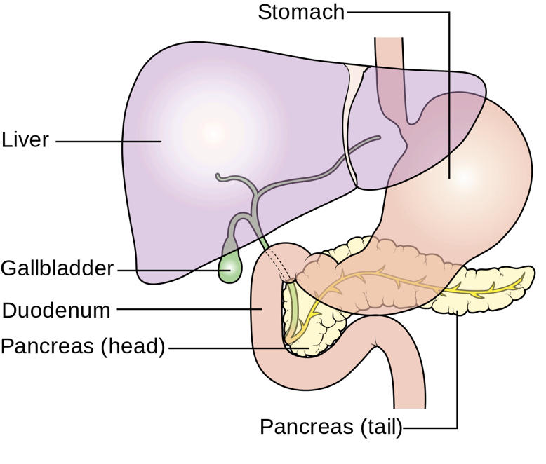
6.1.U2 The pancreas secretes enzymes into the lumen of the small intestine.
The pancreas synthesises the three main types of digestive enzyme:
amylase to digest carbohydrates, e.g. starch
lipases to digest lipids, e.g. triglycerides
proteases to digest polypeptides
Pancreatic juice containing the enzymes is released into the upper region of the small intestine (duodenum) via the pancreatic duct
The small intestine is where the final stages of digestion occur.
https://commons.wikimedia.org/wiki/File:Diagram_showing_the_position_of_the_pancreas_CRUK_356.svg

Slide 15
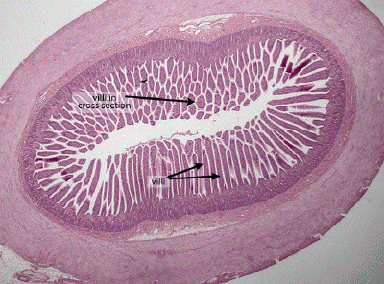
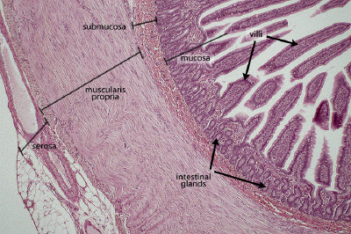
6.1.S2 Identification of tissue layers in transverse sections of the small intestine viewed with a microscope or in a micrograph.
The small intestine contains four distinct tissue layers from the lumen
Mucosa – inner lining, includes villi
Submucosa – connective tissue (between the mucosa and muscle)
Muscular layer – inner circular and outer longitudinal muscle perform peristalsis
Serosa – protective outer layer
Epithelial cells – single outer layer of cells on each villus (see 6.1.U4)
Muscular layer
circular
longitudinal
http://www.dartmouth.edu/~anatomy/Histo/lab_5/GI/DMS132/popup.html

Slide 16
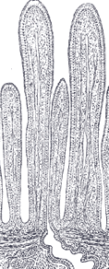
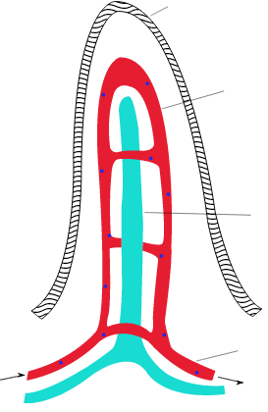
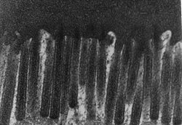
6.1.U4 Villi increase the surface area of epithelium over which absorption is carried out.
Adaptations to Absorption
Getting digested food molecules into the blood from the lumen of the ileum.
Many villi protrude into the lumen, greatly increasing the surface area for absorption.
Single-cell layer of epithelial cells
Short path for diffusion.
Microvilli on the surface of each cell increase surface area even further.
Lacteals (lymph vessels)
Allow for rapid absorption and transport of lipids.
Capillaries close to epithelium
Short path for diffusion, rich supply of blood.
Rich blood supply
Maintains concentration gradients between lumen and blood.
Images from: http://en.wikipedia.org/wiki/Intestinal_villi

Slide 17
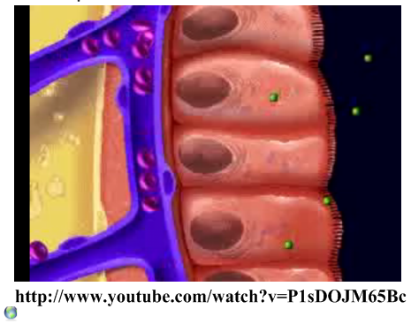
6.1.U5 Villi absorb monomers formed by digestion as well as mineral ions and vitamins.
https://youtu.be/P1sDOJM65Bc
Along with vitamins and minerals all products of digestion (monosaccharides,
amino acids, fatty acids & glycerol)
are absorbed by the villi

Slide 18
6.1.U6 Different methods of membrane transport are required to absorb different nutrients.
How is membrane transport involved in absorption of nutrients from the small intestine?
Method of transport | Nutrients | Outline
Simple diffusion | Lipids
 | Fructose, vitamins | Water-soluble (hydrophilic) molecules use channel proteins to pass phospholipid bilayer and enter the epithelial cells (down the concentration gradient)
Active Transport
Endocytosis (Pinocytosis) | Antibodies from breast milk

Slide 19
6.1.U6 Different methods of membrane transport are required to absorb different nutrients.
How is membrane transport involved in absorption of nutrients from the small intestine?
Method of transport | Nutrients | Outline
Simple diffusion | Lipids | Lipids are non-polar and therefore can pass freely through hydrophobic core of the plasma membrane into the epithelial cells (down the concentration gradient )
Facilitated Diffusion | Fructose, vitamins | Water-soluble (hydrophilic) molecules use channel proteins to pass phospholipid bilayer and enter the epithelial cells (down the concentration gradient)
Active Transport | Glucose, amino acids and mineral ions | Protein pumps use ATP to move molecules against the concentration gradient into the epithelial cells
Endocytosis (Pinocytosis) | Antibodies from breast milk | The plasma membrane folds inward to form vesicles to absorb larger molecules without digesting them

Slide 20
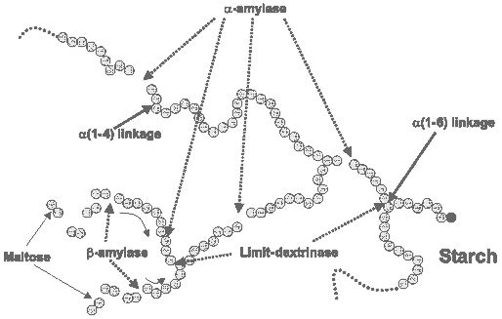
6.1.A1 Processes occurring in the small intestine that result in the digestion of starch and transport of the products of digestion to the liver.
Starch consists of amylose (by 1,4 bonds) and amylopectin (by 1,4 bonds and occasional by 1,6 bonds)
Amylase breaks 1,4 bonds in chains of four or more monomers producing maltose
Maltase digests maltose into glucose monomers
Dextrinase breaks the 1,6 bonds that amylase cannot deal with forming glucose monomers
http://etravelweek.com/hmattachments/1_200907180843167cXQr.gif

Slide 21
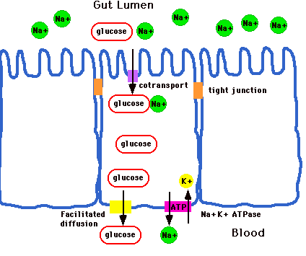
6.1.A1 Processes occurring in the small intestine that result in the digestion of starch and transport of the products of digestion to the liver.
The digested glucose is absorbed and then transported to various body tissues
Glucose is co-transported* with sodium ions into the epithelial cells (of the villus).
Glucose moves by facilitated diffusion into the lumen of the villus.
Glucose then diffuses a short distance into the adjacent capillaries where it dissolves into the blood plasma.
Blood in the capillaries moves to to venules then to the hepatic portal vein which transports the glucose to the liver.
The liver absorbs excess glucose which it converts to glycogen for storage.
Extension: co-transport of glucose is a form of active transport. Explain why using the diagram above.
http://www.rpi.edu/dept/chem-eng/Biotech-Environ/Membranes/bauerp/co.gif

Slide 22
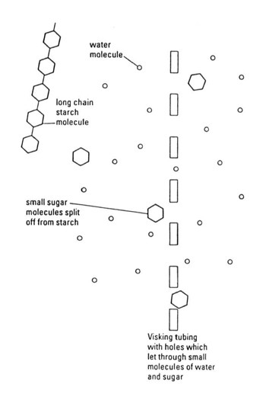
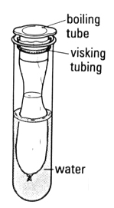
6.1.A2 Use of dialysis tubing to model absorption of digested food in the intestine.
Dialysis (visking) tubing can be used to model absorption
The tubing is semi-permeable and contains pores typically ranging 1 – 10 nm in diameter
Predict what will happen to the glucose and starch after 15 minutes.
Initially contains a mixture of starch and glucose
Test the solutions inside and outside the dialysis tubing for starch and glucose before and after at least 15 minutes have elapsed (see the Practical Biology link for details).
http://www.nuffieldfoundation.org/practical-biology/evaluating-visking-tubing-model-gut

Slide 23
Nature of Science: Use models as representations of the real world - dialysis tubing can be used to model absorption in the intestine. (1.10)
Dialysis (visking) tubing can be used to model absorption
The tubing is semi-permeable and contains pores typically ranging 1 – 10 nm in diameter
Predict what will happen to the glucose and starch after 15 minutes.
The model is the most basic element of the scientific method. It is any simplification, substitute or stand-in for what you are actually studying or trying to predict. Evaluate the usefulness of dialysis tubing as a model for absorption by considering:
How is the function of dialysis tubing similar to the small intestine?
What features of a real gut are missing from this model?
Initially contains a mixture of starch and glucose
Test the solutions inside and outside the dialysis tubing for starch and glucose before and after at least 15 minutes have elapsed (see the Practical Biology link for details).
http://www.nuffieldfoundation.org/practical-biology/evaluating-visking-tubing-model-gut

Slide 24
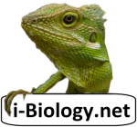
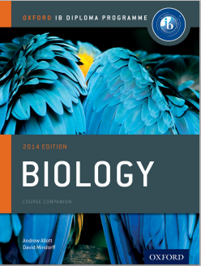
Bibliography / Acknowledgments
Bob Smullen

