Slide 1
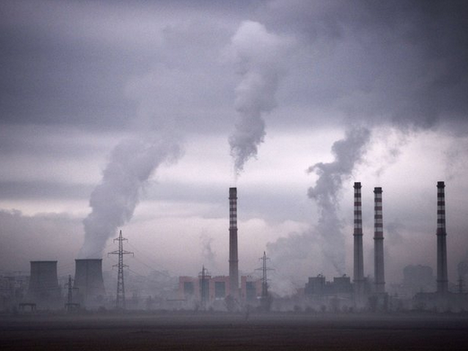
Carbon Cycles & Climate Change (4.3-4.4)
IB Diploma Biology

Slide 2
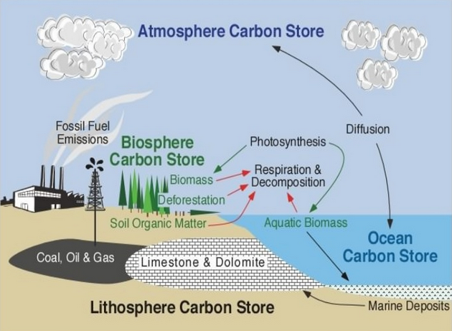

Slide 5
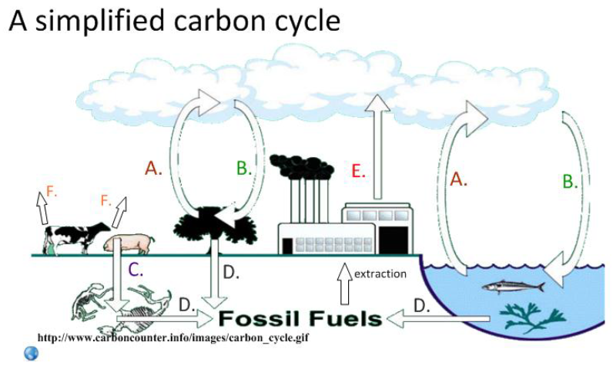

Slide 6
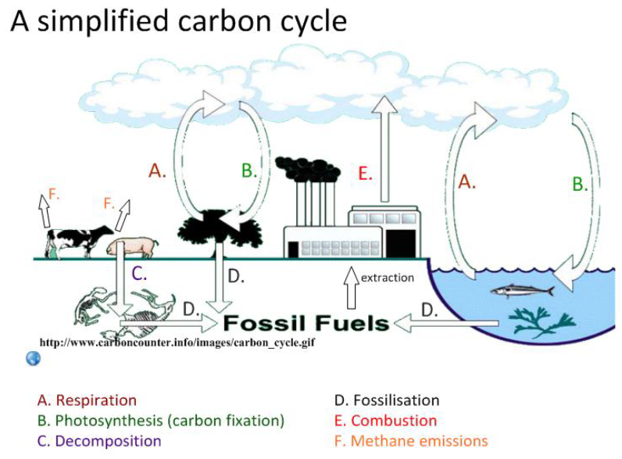

Slide 7
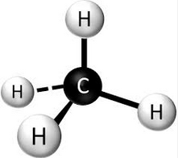
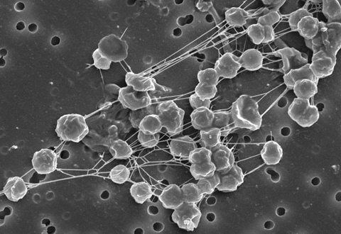
It’s not just Carbon Dioxide…
Methane! (Oxidized to Water and CO2)
Methanogenesis: Methane is produced from organic matter in anaerobic conditions by archaeans and some diffuses into the atmosphere.
Archaea are single-celled prokaryotic microorganisms that share some traits of bacteria and some of eukaryotes

Slide 8
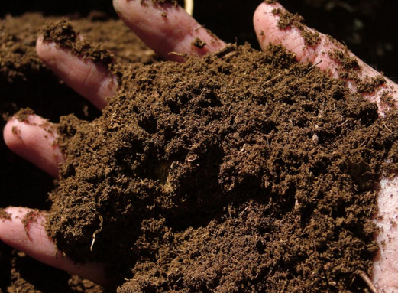
Peat Formation
Soil-like peat forms when organic matter is partially decomposed in anaerobic conditions in waterlogged soils.
Peatlands contain 180-455 billion tons of sequestered carbon and release 20-45 million tons of methane, annually

Slide 9
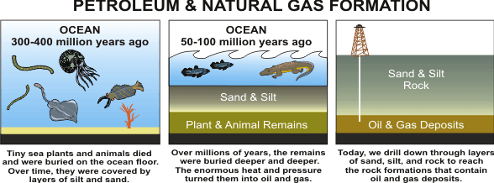
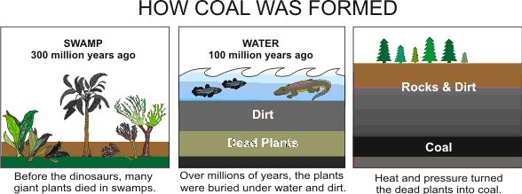
Coal, Oil, and Gas Formation
Partially decomposed organic matter from past geological eras was converted into oil and gas in porous rocks or into coal.

Slide 10
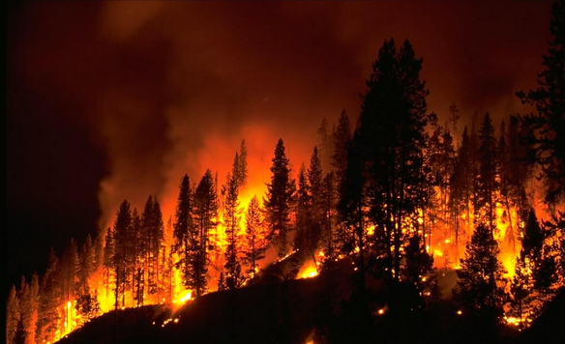
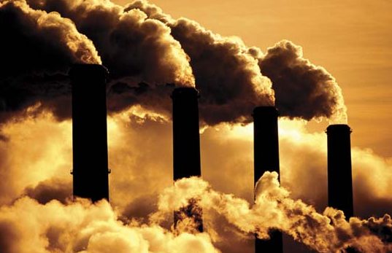
Combustion!
Reaction of hydrocarbons (like fossil fuels) with heat and oxygen to release energy and produce CO2 and water…

Slide 11
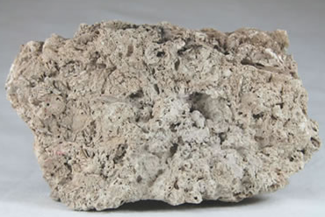
Limestone Formation
Animals such as reef-building corals and mollusks have hard parts that are composed of calcium carbonate and can become fossilized in limestone
An aquatic carbon sink

Slide 12
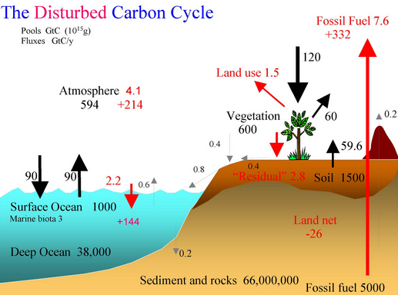
Carbon Fluxes

Slide 13
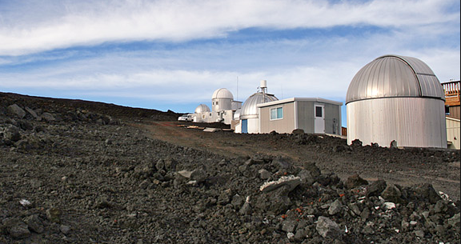
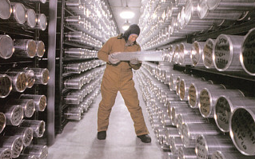
Monitoring of CO2
Atmospheric monitoring stations
Ice cores

Slide 15
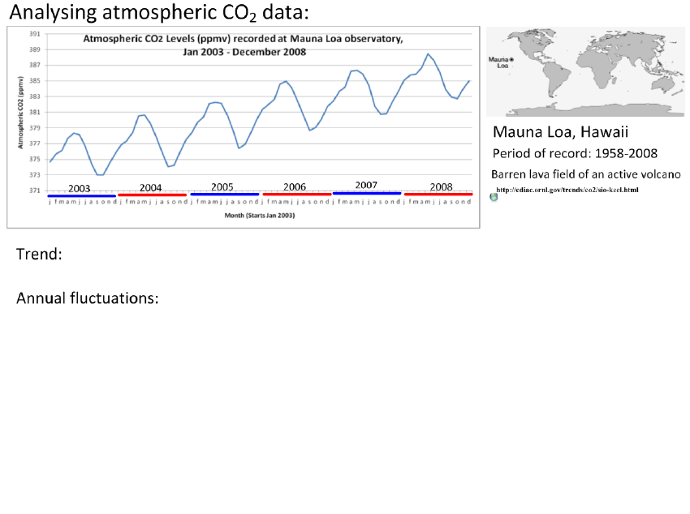

Slide 18
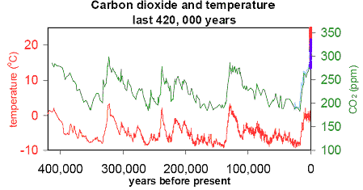
A Strong Correlation…

Slide 19
Greenhouse Gases
Carbon Dioxide, Water Vapor, Methane, Nitrous Oxides
The impact of a gas depends on its ability to absorb long-wave radiation as well as on its concentration in the atmosphere.

Slide 20
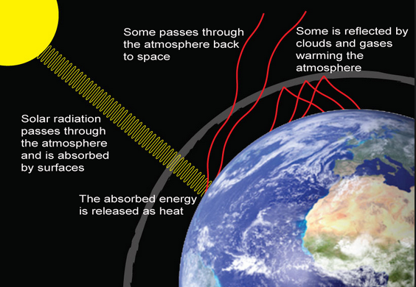

Slide 23
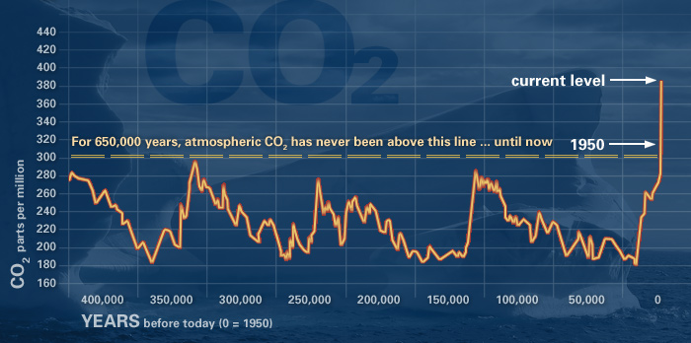
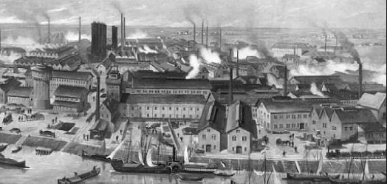
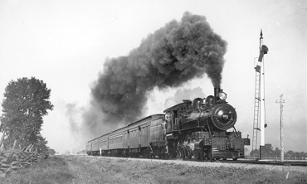

Slide 24
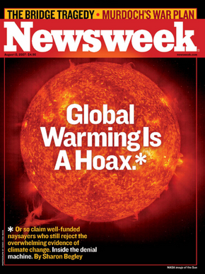
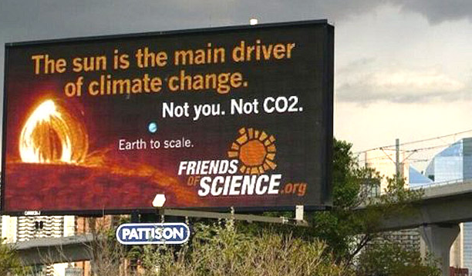
Climate Science “Controversy”
Some claim human actions are not main reason (or even any reason) for recent increases in carbon and global temperatures

Slide 25
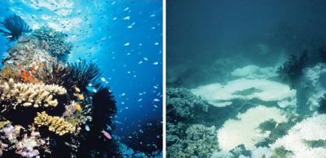
Threats to Coral Reefs
Dissolved carbon dioxide increases acidity of oceans which breaks down calcium carbonate that makes up reefs

Slide 26
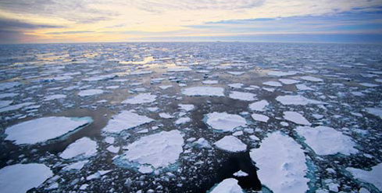
THE END

Slide 27
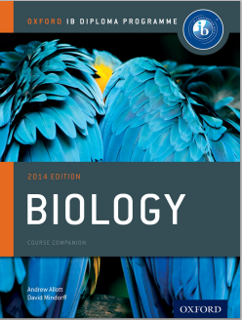
Bibliography / Acknowledgments
Jason de Nys
Chris Paine

