Slide 1
Cyclins
Controlling a Cell’s Progress through the Cell Cycle

Slide 2
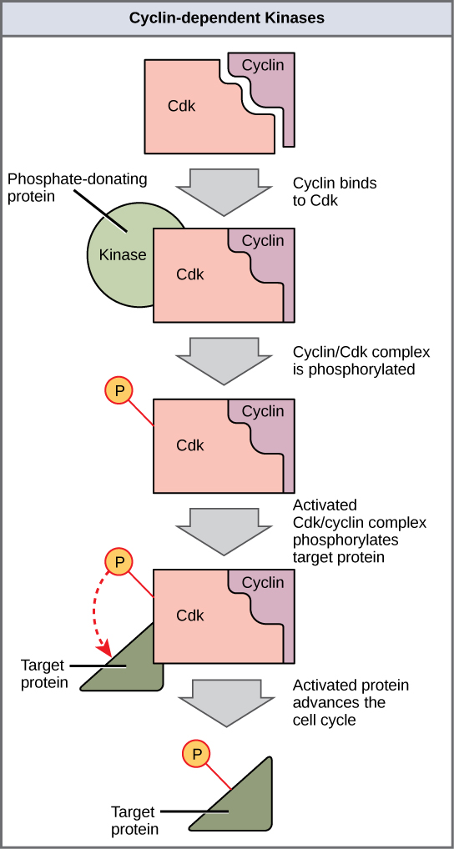
REVIEW:
Cyclins are a family of proteins that control the progression of cells through the cell cycle.
Cyclins activate cyclin-dependent kinase (CDK) enzymes.
Active CDK complexes are able to phosphorylate target proteins that then do jobs related to moving the cell through the phases of the cell cycle.

Slide 3
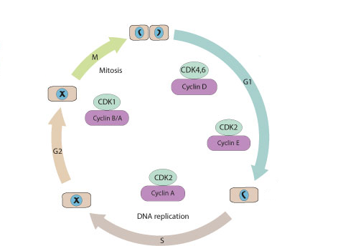
Cyclins:
There are four different types of cyclins
The different cyclins are active at different times of the cell cycle.

Slide 4
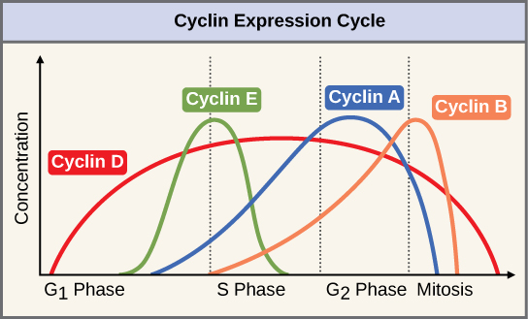

Slide 5
Cyclin D
NORMAL
Cyclin D begins being synthesized during early G1.
Once at a high enough concentration, Cyclin D triggers the cell’s transition from G1 to S phase.
The active cyclin D-CDK complex phosphorylates a target protein that is a tumor suppressor.
Before the target protein is phosphorylated (when cyclin D levels are low), the tumor suppressor protein STOPS the cell from moving into S phase.
After the target protein is phosphorylated (when cyclin D levels are high), the tumor suppressor protein no longer stops the cell from moving into S phase.

Slide 6
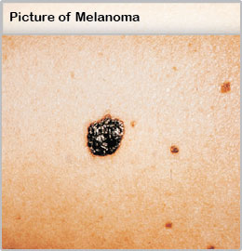
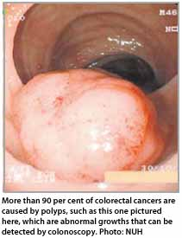
Cyclin D
CANCER
In some cancers (usually colon and melanoma), the cell makes Cyclin D when it shouldn’t.
As a result, the target protein remains active...
Cell moves to S phase even if it shouldn’t.

Slide 7
Cyclin E
NORMAL
Cyclin E begins being synthesized midway through G1.
Once at a high enough concentration, Cyclin E triggers the cell’s transition from G1 to S phase.
The active cyclin E-CDK complex phosphorylates a target protein that gets DNA ready for replication.
Before the target protein is phosphorylated (when cyclin E levels are low), the DNA will not prepare for replication.
After the target protein is phosphorylated (when cyclin E levels are high), the DNA will prepare for replication.

Slide 8
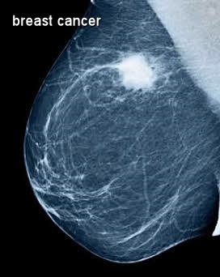
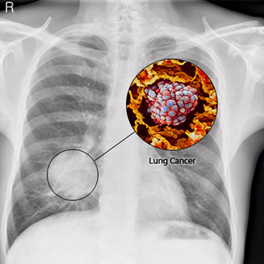
Cyclin E
CANCER
In some cancers (often breast, lung, stomach and colon), the cell makes Cyclin E when it shouldn’t.
As a result, the target protein remains active...
DNA prepares for replication even if it shouldn’t.

Slide 9
Cyclin A
NORMAL
Cyclin A can regulate multiple cell cycle steps because it activates two distinct CDKs.
In S phase, the cyclin A-CDK complex initiates DNA replication and ensures that DNA is replicated once per cell cycle
In G2 phase, the cyclin A-CDK complex prepares the centrosome for mitosis

Slide 10
Cyclin B
NORMAL
Cyclin B is necessary for the progression of the cells into and out of mitosis phase of the cell cycle.
At the end of S phase the cyclin B-CDK complex serves to trigger entry into prophase (only if DNA replicated properly in S phase). The active cyclin B-CDK complex phosphorylates a target protein that is necessary for proper creation of the mitotic spindle.
In order for the cell to being anaphase, the degradation of cyclin B is necessary.

Slide 11
Cyclin B
CANCER
When cyclin B levels are elevated, cells can enter M phase prematurely (and therefore divide when they shouldn’t)
Some anti-cancer therapies have been designed to prevent cyclin B/CDK1 complex formation in cancer cells to slow or prevent cell division.

