Slide 1
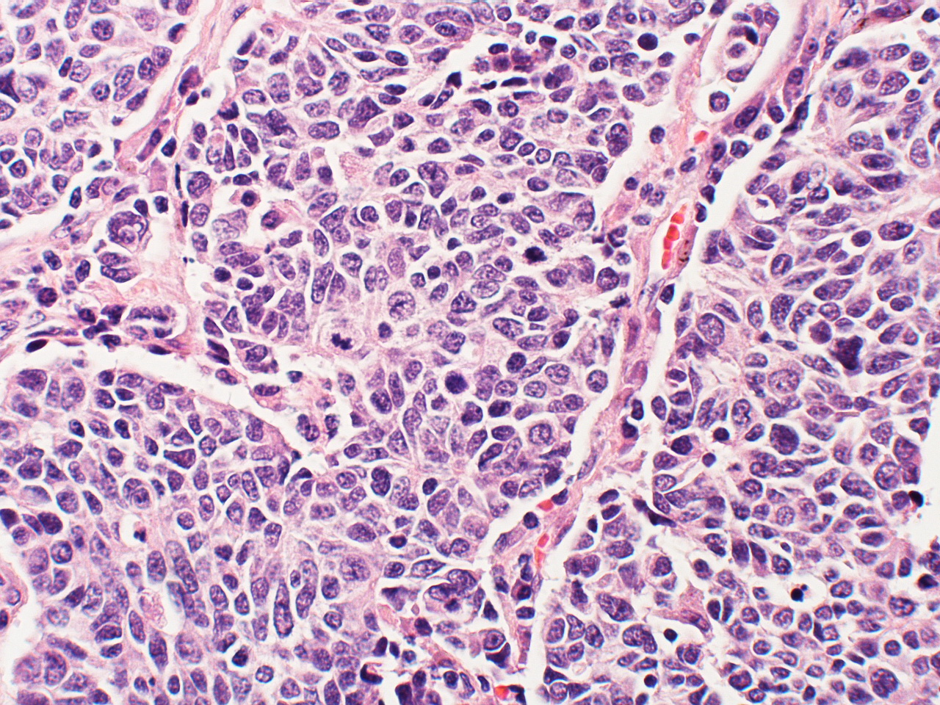
1.6 Cell division
Essential idea: Cell division is essential but must be controlled.
The background image shows a cancerous tumor in the lungs. Tumors are caused by uncontrolled cell division.
By Chris Paine
https://bioknowledgy.weebly.com/
http://www.flickr.com/photos/pulmonary_pathology/4388301142/

Slide 2
Understandings
 | Statement | Guidance
1.6.U1 | Mitosis is division of the nucleus into two genetically identical daughter nuclei. | The sequence of events in the four phases of mitosis should be known. To avoid confusion in terminology, teachers are encouraged to refer to the two parts of a chromosome as sister chromatids, while they are attached to each other by a centromere in the early stages of mitosis. From anaphase onwards, when sister chromatids have separated to form individual structures, they should be referred to as chromosomes.
1.6.U2 | Chromosomes condense by supercoiling during mitosis.
1.6.U3 | Cytokinesis occurs after mitosis and is different in plant and animal cells.
1.6.U4 | Interphase is a very active phase of the cell cycle with many processes occurring in the nucleus and cytoplasm.
1.6.U5 | Cyclins are involved in the control of the cell cycle.
1.6.U6 | Mutagens, oncogenes and metastasis are involved in the development of primary and secondary tumours.

Slide 3
Applications and Skills
 | Statement | Guidance
1.6.A1 | The correlation between smoking and incidence of cancers.
1.6.S1 | Identification of phases of mitosis in cells viewed with a microscope or in a micrograph. | Preparation of temporary mounts of root squashes is recommended but phases in mitosis can also be viewed using permanent slides.
1.6.S2 | Determination of a mitotic index from a micrograph.

Slide 4
http://youtu.be/s1ylUTbXyWU

Slide 5
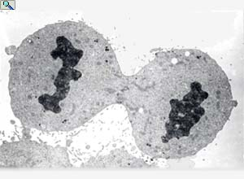
In summary any time new cells are required, mitosis is required:
Growth: | Multicellular organisms increase their size by increasing their number of cells through mitosis
Asexual reproduction: | Certain eukaryotic organisms may reproduce asexually by mitosis (e.g. vegetative reproduction)
Tissue Repair: | Damaged tissue can recover by replacing dead or damaged cells
Embryonic development: | A fertilised egg (zygote) will undergo mitosis and differentiation in order to develop into an embryo
http://www.haroldsmithlab.com/images/pg_HeLa_cell_division.jpg

Slide 6
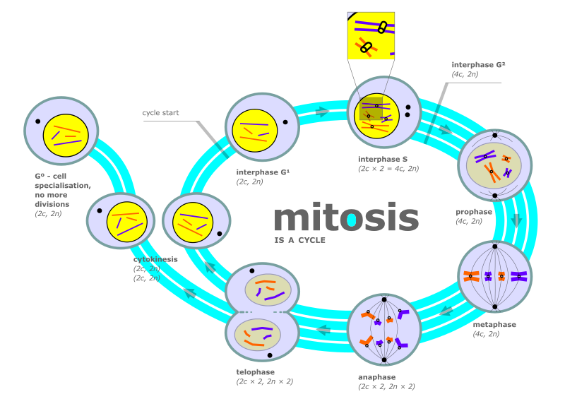
The cell cycle is the series of events through which cells pass to divide and create two identical daughter cells.
http://upload.wikimedia.org/wikipedia/commons/thumb/7/71/Diagram_of_mitosis.svg/800px-Diagram_of_mitosis.svg.png

Slide 7
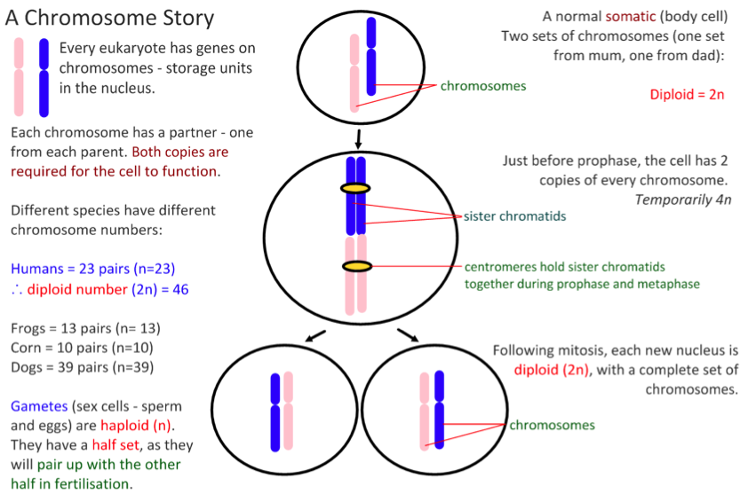

Slide 8
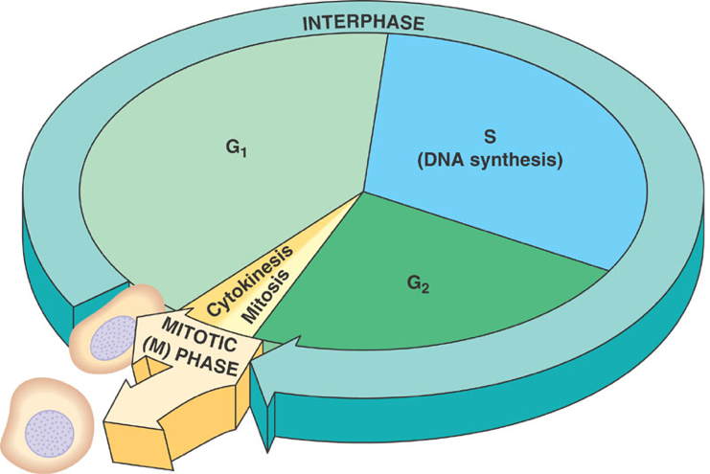
1.6.U4 Interphase is a very active phase of the cell cycle with many processes occurring in the nucleus and cytoplasm.
Interphase consists of the parts of the cell cycle that don’t involve cell division.
G1 (Gap 1)
Increase the volume of cytoplasm
Organelles produced
Proteins synthesised
S (Synthesis)
DNA replicated
n.b. cells can also be said to be in G0 (Gap 0). This is a ‘resting’ phase where the cell has left the cycle and has stopped dividing. Cells in G0 still carry out all their normal functions.
G2 (Gap 2)
Increase the volume of cytoplasm
Organelles produced
Proteins synthesised
http://gardeningstudio.com/wp-content/uploads/the-cell-cycle-diagram-318.jpg

Slide 9
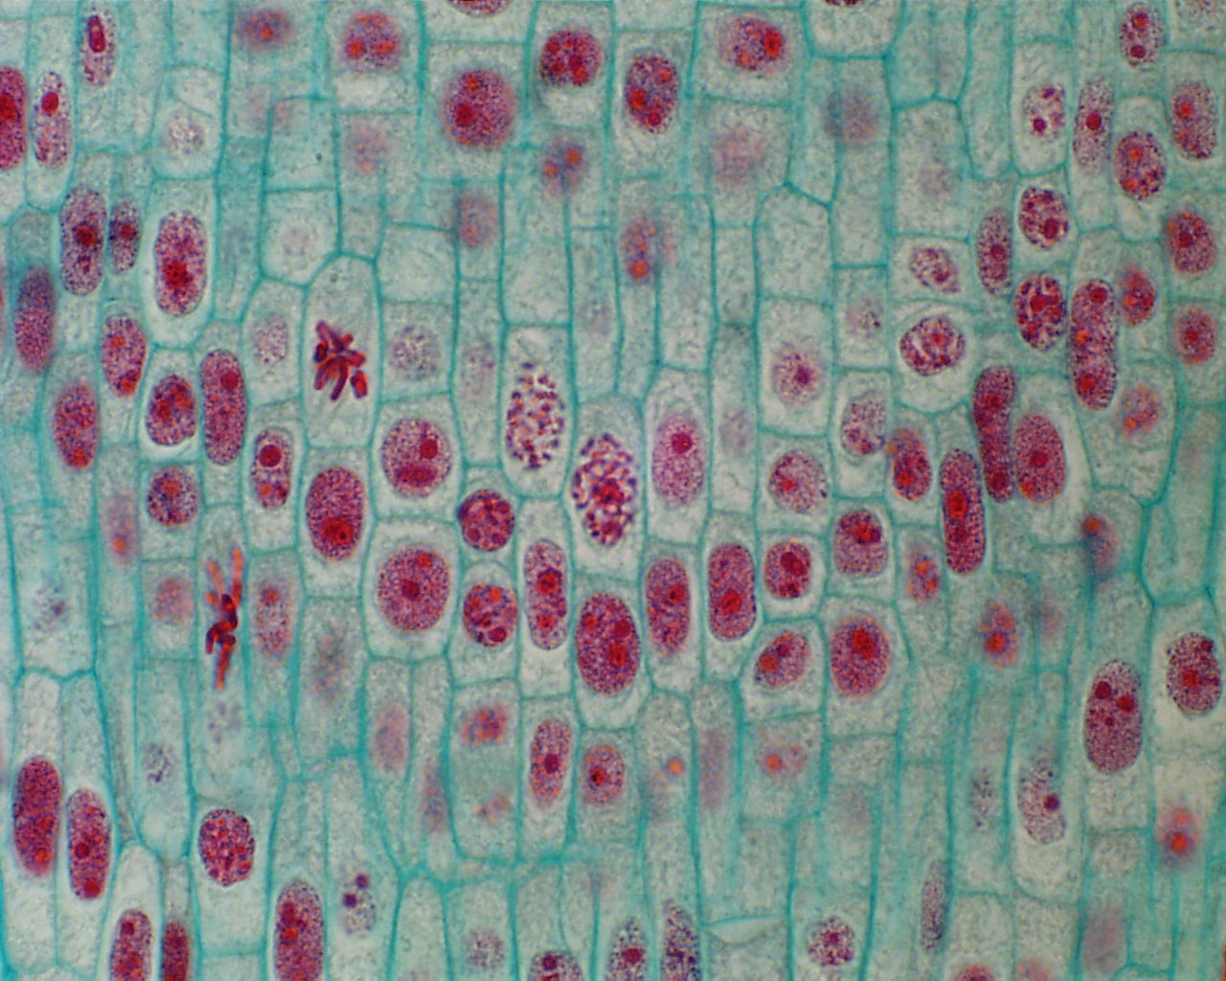
1.6.U4 Interphase is a very active phase of the cell cycle with many processes occurring in the nucleus and cytoplasm.
Interphase
Cells spend the majority of their time in interphase. It is a very active phase of the cycle.
This when the cell carries out it’s normal functions
Mr
P
O
D
Metabolic reactions (e.g. respiration to produce ATP) are necessary for the life of the cell
Protein synthesis - proteins and enzymes are necessary to allow cell grow
Organelles numbers are increased to first support the enlarged cell
DNA is replicated to ensure a second copy is available to enable mitosis
http://botit.botany.wisc.edu/Resources/Botany/Mitosis/Allium/Various%20views/Interphase%20prophase.JPG

Slide 10
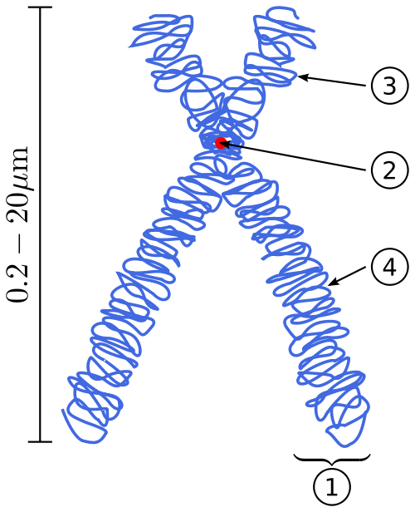
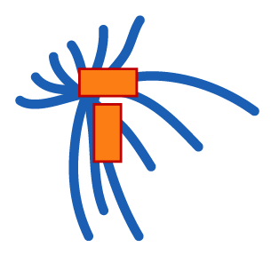
1.6.U1 Mitosis is division of the nucleus into two genetically identical daughter nuclei.
Get the terminology right
centrioles organise spindle microtubules
centromere is the part of a chromosome that links sister chromatids
Spindle microtubules (also referred to as spindle fibres)
In animal cells two centrioles are held by a protein mass referred to as a centrosome
Sister chromatids are duplicated chromosomes attached by a centromere
It is easy to misuse the terms chromatid and chromosome. It is even easier to confuse the terms centromere, centriole and centrosome due to their similar spelling. Keep the terms clear in your mind to avoid losing marks.
After anaphase when the sister chromatids separate they should then be referred to as chromosomes
http://commons.wikimedia.org/wiki/File:Chromosome.svg
http://commons.wikimedia.org/wiki/Mitosis#mediaviewer/File:Mitosis_cells_sequence.svg

Slide 11
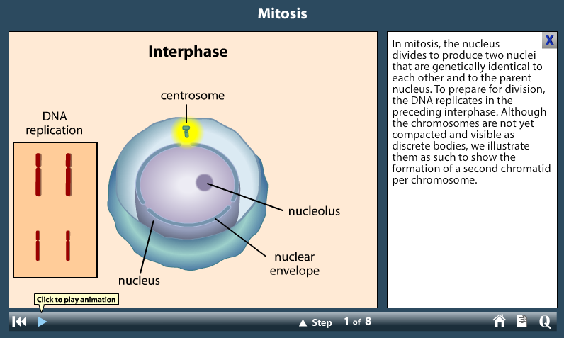
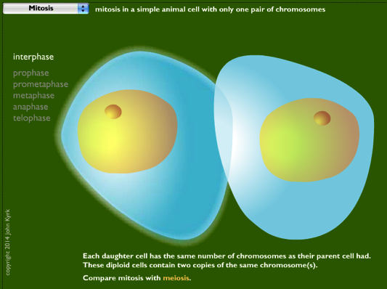
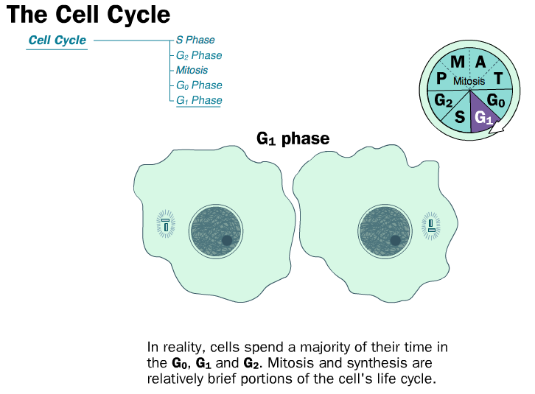
1.6.U1 Mitosis is division of the nucleus into two genetically identical daughter nuclei.
Use the animated tutorials to learn about mitosis
http://highered.mheducation.com/sites/0072495855/student_view0/chapter2/animation__mitosis_and_cytokinesis.html
http://www.sumanasinc.com/webcontent/animations/content/mitosis.html
http://www.johnkyrk.com/mitosis.html
http://outreach.mcb.harvard.edu/animations/cellcycle.swf

Slide 12
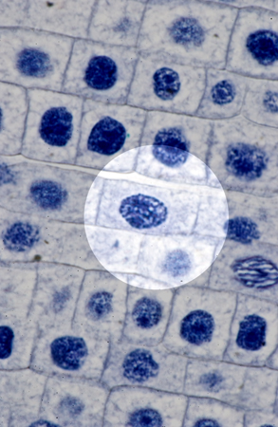
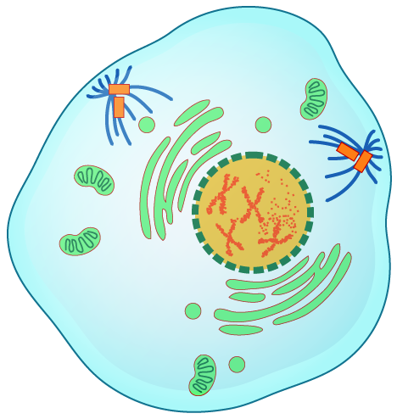
1.6.U1 Mitosis is division of the nucleus into two genetically identical daughter nuclei.
Prophase
DNA supercoils* chromatin condenses and becomes sister chromatids, which are visible under a light microscope
The centrosomes move to opposite poles of the cell and spindle fibres begin to form between them
The nuclear membrane is broken down and disappears
*supercoling is dealt with in more detail by 1.6.U2
http://www.microscopy-uk.org.uk/mag/artnov04macro/jronionroot.html
http://commons.wikimedia.org/wiki/Mitosis#mediaviewer/File:Mitosis_cells_sequence.svg

Slide 13
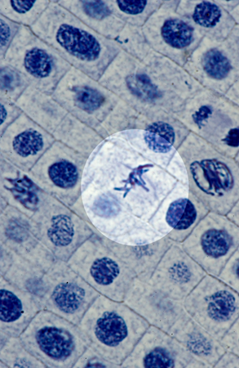
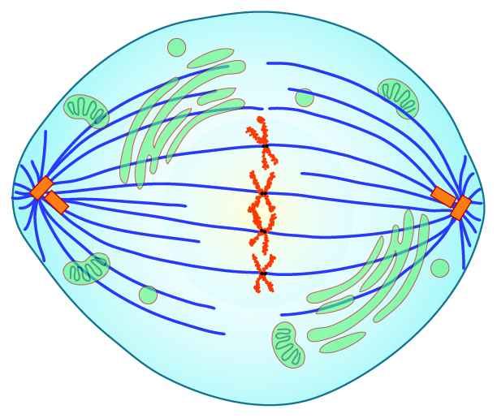
1.6.U1 Mitosis is division of the nucleus into two genetically identical daughter nuclei.
Metaphase
Spindle fibres from each of the two centrosomes attach to the centromere of each pair of sister chromatids
Contraction of the microtubule spindle fibres cause the sister chromatids to line up along the centre of the cell.
http://www.microscopy-uk.org.uk/mag/artnov04macro/jronionroot.html
http://commons.wikimedia.org/wiki/Mitosis#mediaviewer/File:Mitosis_cells_sequence.svg

Slide 14
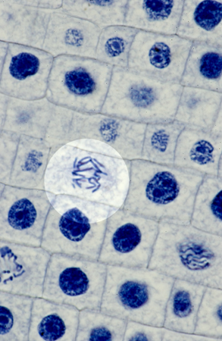
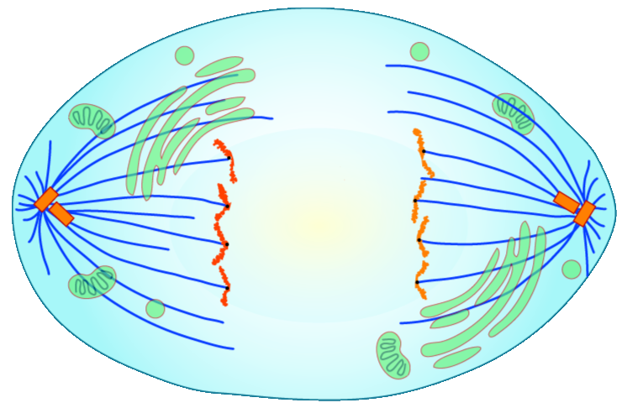
1.6.U1 Mitosis is division of the nucleus into two genetically identical daughter nuclei.
Anaphase
Continued contraction of the microtubule spindle fibres cause the separation of the sister chromatids
The chromatids are now referred to as chromosomes
Chromosomes move to the opposite poles of the cell
http://www.microscopy-uk.org.uk/mag/artnov04macro/jronionroot.html
http://commons.wikimedia.org/wiki/Mitosis#mediaviewer/File:Mitosis_cells_sequence.svg

Slide 15
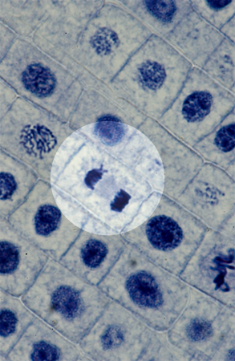
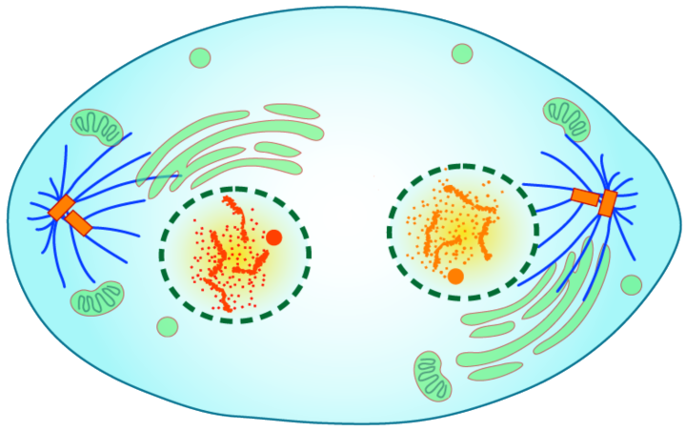
1.6.U1 Mitosis is division of the nucleus into two genetically identical daughter nuclei.
Telophase
The chromosomes uncoil de-condense to chromatin (and are no longer visible under a light microscope).
Chromosomes arrive at the poles.
Microtubule spindle fibers disappear
New nuclear membranes reform around each set of chromosomes
Now cytokinesis begins!
http://www.microscopy-uk.org.uk/mag/artnov04macro/jronionroot.html
http://commons.wikimedia.org/wiki/Mitosis#mediaviewer/File:Mitosis_cells_sequence.svg

Slide 16
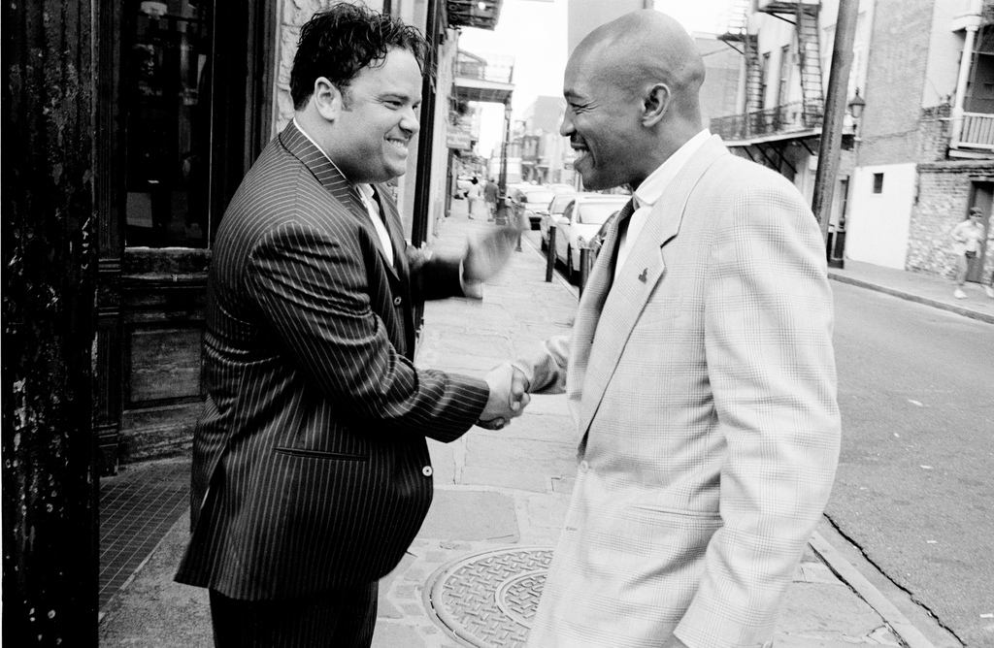
1.6.U1 Mitosis is division of the nucleus into two genetically identical daughter nuclei.
Prophase
Metaphase
Anaphase
Telophase
http://www.flickr.com/photos/chuckp/252924532/

Slide 17
1.6.U1 Mitosis is division of the nucleus into two genetically identical daughter nuclei.
People
Meet
And
Talk
http://www.flickr.com/photos/chuckp/252924532/

Slide 18
1.6.U3 Cytokinesis occurs after mitosis and is different in plant and animal cells.
Urrrmm, we have only divided the nucleus … what about the rest of the cell?
http://www.haroldsmithlab.com/images/pg_HeLa_cell_division.jpg

Slide 19
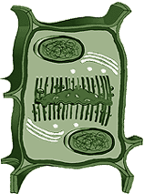
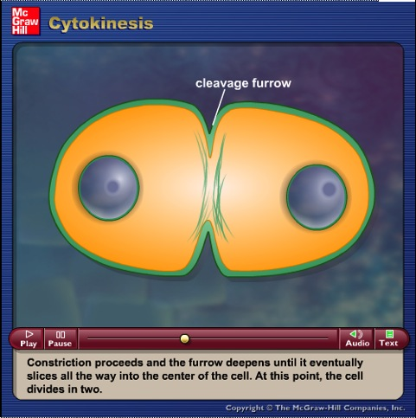
1.6.U3 Cytokinesis occurs after mitosis and is different in plant and animal cells.
mitosis is the division of the nucleus whereas
cytokinesis is the division of the cytoplasm
and hence the cell
The division of the cell into two daughter cells (cytokinesis) occurs concurrently with telophase.
Though mitosis is similar for animal and plant cells cytokinesis is very different.
http://glencoe.mheducation.com/sites/9834092339/student_view0/chapter10/animation_-_cytokinesis.html
http://www.haroldsmithlab.com/images/pg_HeLa_cell_division.jpg
http://wwwprod.biochem.wisc.edu/biochem/faculty/bednarek/images/figure_color.gif
http://commons.wikimedia.org/wiki/Mitosis#mediaviewer/File:Mitosis_cells_sequence.svg

Slide 20
1.6.U3 Cytokinesis occurs after mitosis and is different in plant and animal cells.
Animal cells | Plant cells
A ring of contractile protein (microfilaments) immediately inside the plasma membrane at the equator pulls the plasma membrane inward. The inward pull on the plasma membrane produces the characteristic cleavage furrow. When the cleavage furrow reaches the centre of the cells it is pinched apart to form two daughter cells. | During telophase, membrane-enclosed vesicles derived from the Golgi apparatus migrate to the centre of the cell. Vesicles fuse to form tubular structures. The tubular structures merge (with the addition of more vesicles) to form two layers of plasma membrane (i.e. the cell plate) The cell plate continues to develop until it connects with the existing cell’s plasma membrane. This completes the division of the cytoplasm and the formation of two daughter cells. Vesicles deposit, by exocytosis, pectins and other substances in the lumen between the daughter cells to form the middle lamella (‘gluing’ the cells together) Both daughter cell secrete cellulose to form their new adjoining cell walls.
http://www.haroldsmithlab.com/images/pg_HeLa_cell_division.jpg
http://upload.wikimedia.org/wikibooks/en/thumb/9/98/Cyto.png/800px-Cyto.png

Slide 21
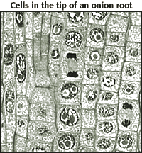
1.6.S1 Identification of phases of mitosis in cells viewed with a microscope or in a micrograph. 1.6.S2 Determination of a mitotic index from a micrograph.
http://www.nuffieldfoundation.org/practical-biology/investigating-mitosis-allium-root-tip-squash
A very good, well explained lab outline for creating slides and calculating the mitotic index.
An excellent online alternative if resources don’t permit students to create and view their own slides
http://www.biology.arizona.edu/cell_bio/activities/cell_cycle/cell_cycle.html

Slide 22
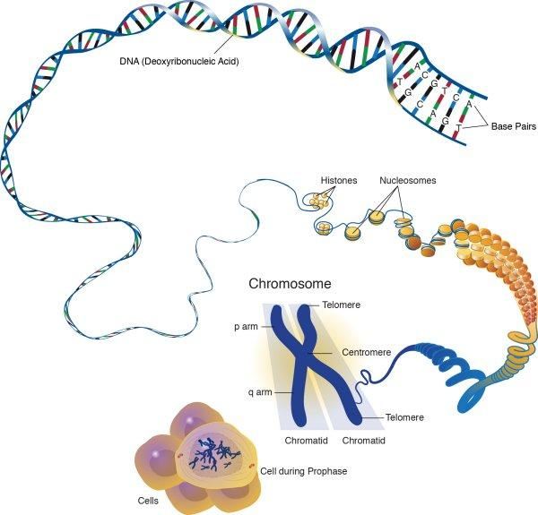
1.6.U2 Chromosomes condense by supercoiling during mitosis.
Why supercoil chromosomes?
Human cells are on average 10μm in diameter and the nucelus within each is less than 5 μm in diameter.
Human chromosomes are 15mm to 85mm (15,000μm to 85,000 μm) in length.
Chromosomes need to be stored compactly to fit within the nuclei of cells.
This problem becomes more acute during mitosis when chromosomes need to be short and compact enough that they can be separated and moved to each end of the cell.
Chromatin fibres
http://www.genome.gov/dmd/img.cfm?node=Photos/Graphics&id=85282

Slide 23
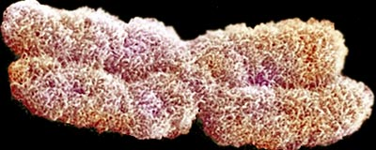
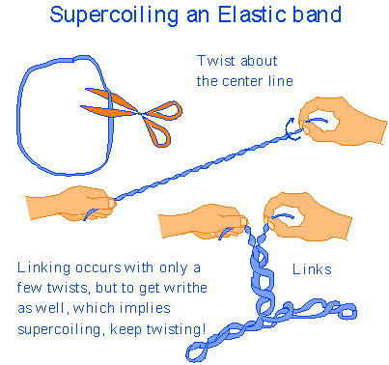
1.6.U2 Chromosomes condense by supercoiling during mitosis.
How are chromosomes supercoiled?
Strain is placed on a DNA helix by overwinding or underwinding of the helix
This causes the DNA molecule to coil back on itself becoming shorter and wider
n.b. in eukaryotes proteins called histones aid the process
Try it yourself
http://vanat.cvm.umn.edu/mMeiosis/images/chromosome-X.jpg
http://www.maths.uq.edu.au/~infinity/Infinity7/images/supercoiling.gif

Slide 24
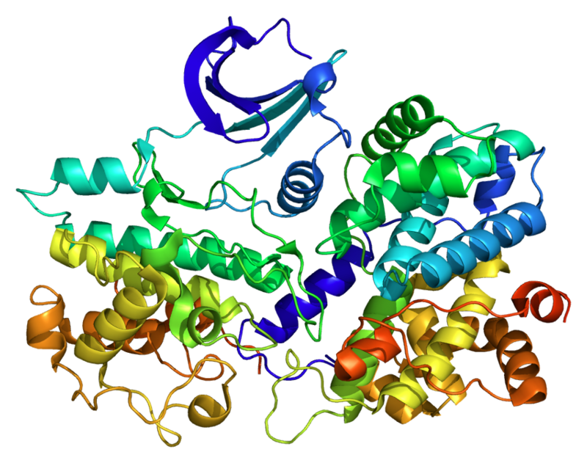
1.6.U5 Cyclins are involved in the control of the cell cycle.
Cyclins are a family of proteins that control the progression of cells through the cell cycle
1
Cells cannot progress to the next stage of the cell cycle unless the specific cyclin reaches it threshold.
2
Cyclins bind to enzymes called cyclin-dependent kinases
3
These kinases then become active and attach phosphate groups to other proteins in the cell.
4
The attachment of phosphate triggers the other proteins to become active and carry out tasks (specific to one of the phases of the cell cycle).
http://upload.wikimedia.org/wikipedia/commons/thumb/9/99/Protein_CCNE1_PDB_1w98.png/800px-Protein_CCNE1_PDB_1w98.png

Slide 25
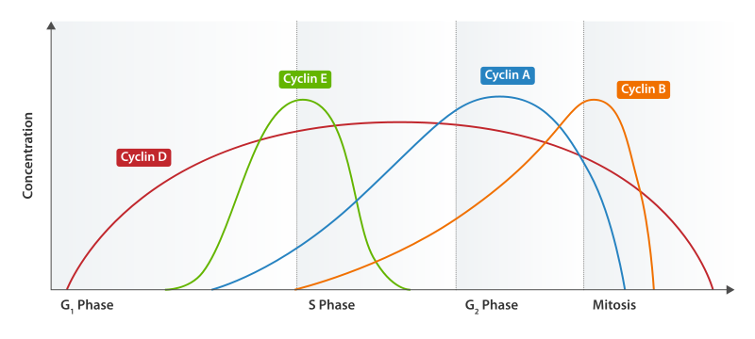
1.6.U5 Cyclins are involved in the control of the cell cycle.
Progression through parts of the cell cycle are affected in various ways by specific cyclins
prepares the cell for DNA replication in S phase.
activates DNA replication inside the nucleus in S phase.
promotes the assembly of the mitotic spindle and other tasks in the cytoplasm to prepare for mitosis.
Triggers cells to move from G0 to G1 and from G1 into S phase.
http://upload.wikimedia.org/wikipedia/commons/thumb/9/99/Protein_CCNE1_PDB_1w98.png/800px-Protein_CCNE1_PDB_1w98.png

Slide 26
1.6.U6 Mutagens, oncogenes and metastasis are involved in the development of primary and secondary tumours.
Tumours are abnormal growth of tissue that develop at any stage of life in any part of the body. A cancer is a malignant tumour and is named after the part of the body where the cancer (primary tumour) first develops. Use the links to find out:
most common types of cancer
what causes cancer and associated risk factors
how cancer can be treated
http://youtu.be/8BJ8_5Gyhg8
http://www.e-learningforkids.org/health/lesson/cancer/
What causes cancer?
http://www.cancerresearchuk.org/cancer-info/cancerandresearch/all-about-cancer/what-is-cancer/
http://www.cancer.gov/cancertopics/types/commoncancers

Slide 27
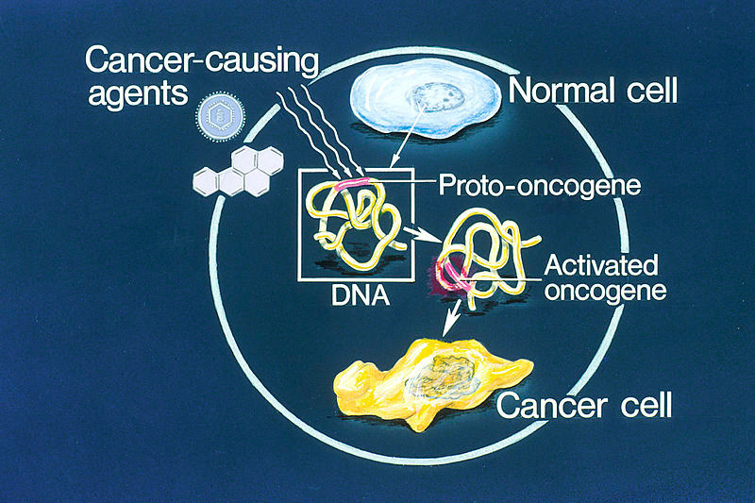
1.6.U6 Mutagens, oncogenes and metastasis are involved in the development of primary and secondary tumours.
A mutation is a change in an organisms genetic code. A mutation/change in the base sequence of a certain genes can result in cancer.
Mutagens are agents that cause gene mutations. Not all mutations result in cancers, but anything that causes a mutation has the potential to cause a cancer.
Mutagens can be:
chemicals that cause mutations are referred to as carcinogens
high energy radiation such as X-rays
short-wave ultraviolet light
Some viruses
http://en.wikipedia.org/wiki/Oncogene#mediaviewer/File:Oncogenes_illustration.jpg

Slide 28
1.6.U6 Mutagens, oncogenes and metastasis are involved in the development of primary and secondary tumours.
If a mutation occurs in an oncogenes it can become cancerous. In normal cells oncogenes control of the cell cycle and cell division.
mutation in a oncogene
malfunction in the control of the cell cycle
uncontrolled cell division
tumour formation
http://en.wikipedia.org/wiki/Oncogene#mediaviewer/File:Oncogenes_illustration.jpg

Slide 29
1.6.U6 Mutagens, oncogenes and metastasis are involved in the development of primary and secondary tumours.
Several mutations must occur in the same cell for it to become a tumour causing cell. The probability of this happening in a single cell is extremely small.
Factors (other than exposure to mutagens) that increase the probability of tumour development include:
The vast number of cells in a human body – the greater the number of cells the greater the chance of a mutation.
The longer a life span the greater the chance of a mutation.
http://en.wikipedia.org/wiki/Oncogene#mediaviewer/File:Oncogenes_illustration.jpg

Slide 30
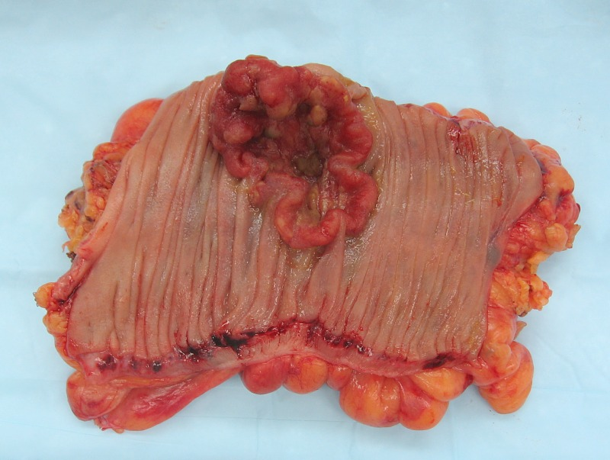
1.6.U6 Mutagens, oncogenes and metastasis are involved in the development of primary and secondary tumours.
The development of a primary tumours (cancers) have been outlined. Below is how a primary tumor can become a secondary tumour.
A primary tumor is a malignant tumor growing at the site where the abnormal growth first occurred.
Cancerous cells can detach from the primary tumour.
Metastasis is the movement of cells from a primary tumour to set up secondary tumours in other parts of the body.
Some cancerous cells gain the ability to penetrate the walls of lymph or blood vessels and hence circulate around the body
The circulating cancerous cells invade tissues at a different locations and develop, by uncontrolled cell division, into a secondary tumours.
http://en.wikipedia.org/wiki/Neoplasm#mediaviewer/File:Colon_cancer_2.jpg

Slide 31
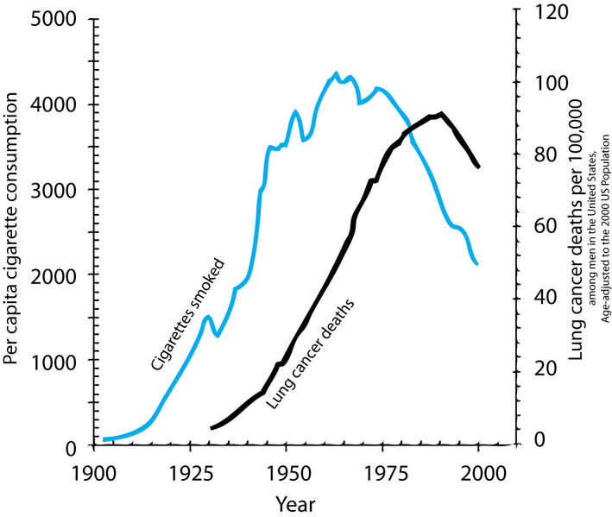
1.6.A1 The correlation between smoking and incidence of cancers.
There are many other similar surveys in different countries, with different demographics that show similar results. Along with lung cancer, cancers of mouth and throat are very common as these areas are in direct contact with the smoke too. It might surprise you that the following cancers are also more common in smokers:
Head and neck
Bladder
Kidneys
Breast
Pancreas
Colon
Describe the relationship shown.
What type of correlation is shown
How strong is the correlation? Justify your answer by discussing the evidence.
The correlation shown here is lagged. A lag is a time gap between the factors. Estimate the size of the lag between cigarette consumption and lung cancer death.
http://en.wikipedia.org/wiki/File:Smoking_lung_cancer.png

Slide 32
1.6.A1 The correlation between smoking and incidence of cancers.
There are many other similar surveys in different countries, with different demographics that show similar results. Along with lung cancer, cancers of mouth and throat are very common as these areas are in direct contact with the smoke too. It might surprise you that the following cancers are also more common in smokers:
Head and neck
Bladder
Kidneys
Breast
Pancreas
Colon
Correlation ≠ causation, however laboratory investigations have found:
more then 20 chemicals found in tobacco have caused cancers in laboratory animals and/or humans
More than 40 other chemicals found in tobacco have been identified as carcinogens
Describe the relationship shown.
What type of correlation is shown
How strong is the correlation? Justify your answer by discussing the evidence.
The correlation shown here is lagged. A lag is a time gap between the factors. Estimate the size of the lag between cigarette consumption and lung cancer death.
http://en.wikipedia.org/wiki/File:Smoking_lung_cancer.png

Slide 33
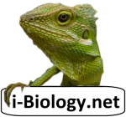
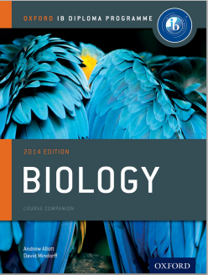
Bibliography / Acknowledgments
Jason de Nys

