Slide 1
1.3 Membrane Structure
Essential idea: The structure of biological membranes makes them fluid and dynamic.
Above are models of a plasma membrane showing how it's fluidity allows lipid soluble molecules to move directly through the membrane.
By Chris Paine
https://bioknowledgy.weebly.com/
http://www.europhysicsnews.org/doc_journal/images/epn/hl/435/Sommer.jpg

Slide 2
Understandings, Applications and Skills
 | Statement | Guidance
1.3.U1 | Phospholipids form bilayers in water due to the amphipathic properties of phospholipid molecules. | Amphipathic phospholipids have hydrophilic and hydrophobic properties.
1.3.U2 | Membrane proteins are diverse in terms of structure, position in the membrane and function.
1.3.U3 | Cholesterol is a component of animal cell membranes.
1.3.A1 | Cholesterol in mammalian membranes reduces membrane fluidity and permeability to some solutes.
1.3.S1 | Drawing of the fluid mosaic model. | Drawings of the fluid mosaic model of membrane structure can be two dimensional rather than three dimensional. Individual phospholipid molecules should be shown using the symbol of a circle with two parallel lines attached. A range of membrane proteins should be shown including glycoproteins.
1.3.S2 | Analysis of evidence from electron microscopy that led to the proposal of the Davson-Danielli model.
1.3.S3 | Analysis of the falsification of the Davson-Danielli model that led to the Singer-Nicolson model.

Slide 3
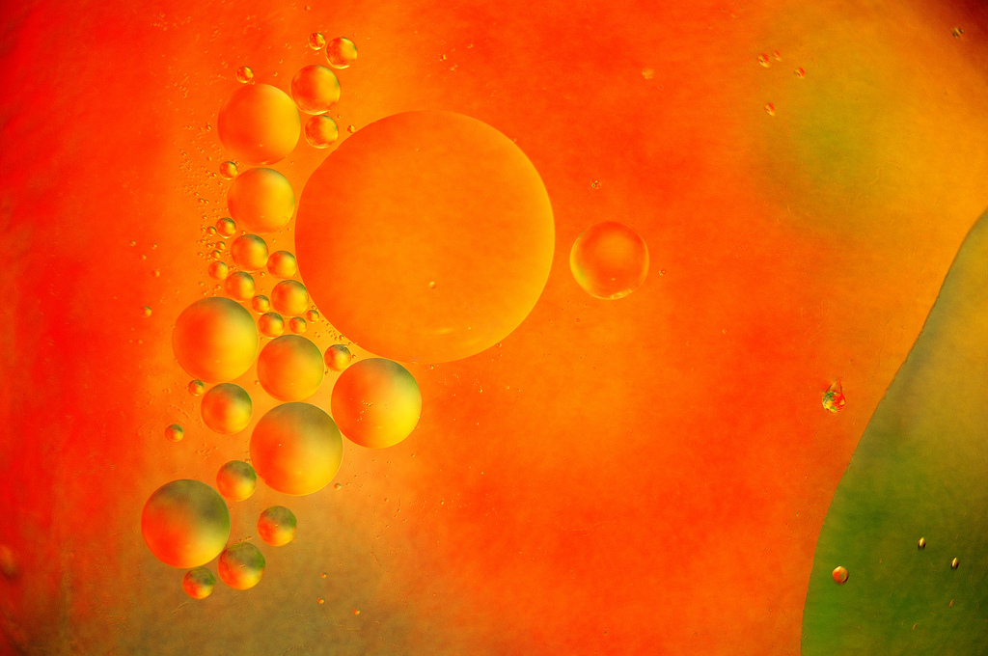
1.3.U1 Phospholipids form bilayers in water due to the amphipathic properties of phospholipid molecules.
What happens when you put a drop
of oil in
water?
http://www.flickr.com/photos/zorin-denu/5385963280/

Slide 4
1.3.U1 Phospholipids form bilayers in water due to the amphipathic properties of phospholipid molecules.
The Oil droplet stays together and makes a perfect circular shape.
The oil molecules are
Hydrophobic
Oil Molecules are non-polar and water
molecules are polar.
See 3.1.5
http://www.flickr.com/photos/zorin-denu/5385963280/

Slide 5
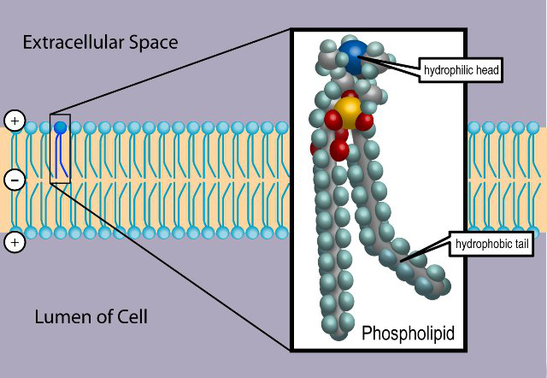
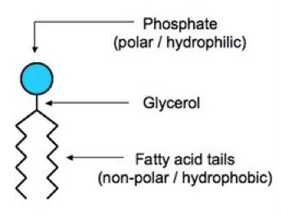
1.3.U1 Phospholipids form bilayers in water due to the amphipathic properties of phospholipid molecules.
Phospholipid molecules have a polar (charged) phosphate head and long non-polar lipid tails
The head is hydrophillic (attracted to water)
The tails are hydrophobic (repelled by water)
When drawing a diagram of a phospholipid this is a good example which shows all the key features
http://www.ib.bioninja.com.au/_Media/phospholipid_bilayer_med.jpeg
http://upload.wikimedia.org/wikipedia/commons/3/39/Phospholipid_TvanBrussel.jpg

Slide 6
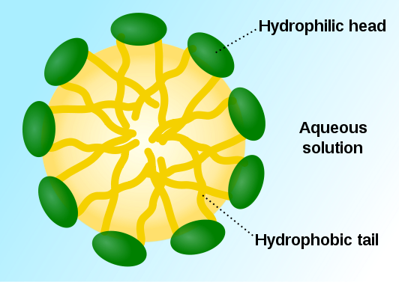
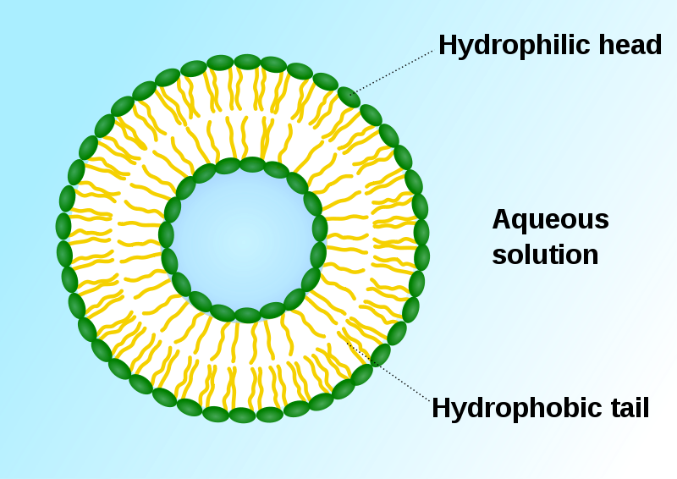
1.3.U1 Phospholipids form bilayers in water due to the amphipathic properties of phospholipid molecules.
When put into water, an emergent property is that phospholipids will self-organise to keep their heads ‘wet’ and their tails ‘dry’
micelle
liposome
http://commons.wikimedia.org/wiki/File:Micelle_scheme-en.svg
http://commons.wikimedia.org/wiki/File:Liposome_scheme-en.svg

Slide 7
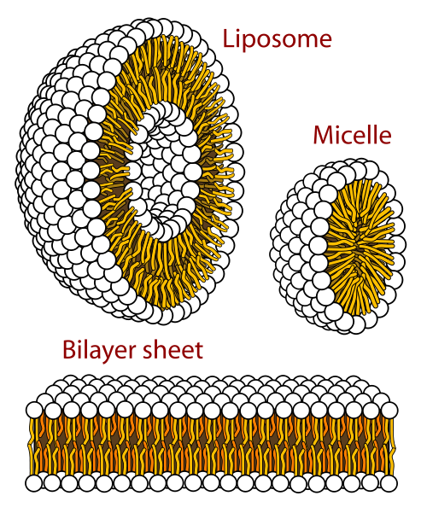
1.3.U1 Phospholipids form bilayers in water due to the amphipathic properties of phospholipid molecules.
In this 3D representation you can see that a phospholipid bilayer is one way that the tails can be removed from the water.
Phospholipid molecules can flow past each other laterally but can’t move vertically
http://commons.wikimedia.org/wiki/File:Phospholipids_aqueous_solution_structures.svg

Slide 8
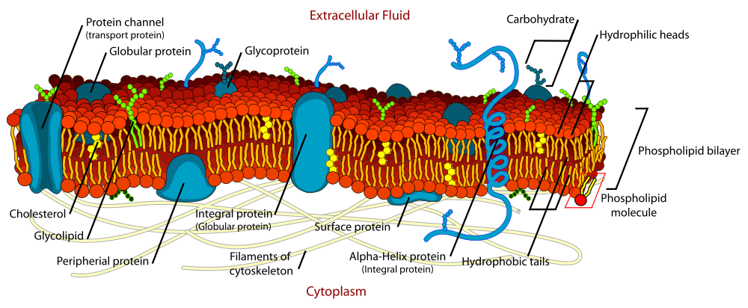
1.3.U1 Phospholipids form bilayers in water due to the amphipathic properties of phospholipid molecules.
But wait! there’s more!
The plasma membrane is not just made of phospholipids
http://commons.wikimedia.org/wiki/File:Cell_membrane_detailed_diagram_en.svg?uselang=en-gb

Slide 9
1.3.U2 Membrane proteins are diverse in terms of structure, position in the membrane and function.
Proteins:
Integral proteins are permanently embedded, many go all the way through and are polytopic (poly = many, topic = surface), integral proteins penetrating just one surface are monotopic.
Peripheral proteins usually have a temporary association with the membrane, they can be monotopic or attach to the surface
http://commons.wikimedia.org/wiki/File:Cell_membrane_detailed_diagram_en.svg?uselang=en-gb

Slide 10
1.3.U2 Membrane proteins are diverse in terms of structure, position in the membrane and function.
Glycoproteins:
Are proteins with an oligosaccaride (oligo = few, saccharide = sugar) chain attached.
They are important for cell recognition by the immune system and as hormone receptors
http://commons.wikimedia.org/wiki/File:Cell_membrane_detailed_diagram_en.svg?uselang=en-gb

Slide 11
1.3.U2 Membrane proteins are diverse in terms of structure, position in the membrane and function.
Transport: Protein channels (facilitated) and protein pumps (active)
Receptors: Peptide-based hormones (insulin, glucagon, etc.)
Anchorage: Cytoskeleton attachments and extracellular matrix
Cell recognition: MHC proteins and antigens
Intercellular joinings: Tight junctions and plasmodesmata
Enzymatic activity: Metabolic pathways (e.g. electron transport chain)
http://www.ib.bioninja.com.au/standard-level/topic-2-cells/24-membranes.html

Slide 12
1.3.U3 Cholesterol is a component of animal cell membranes.
Cholesterol: (It’s not all bad!)
It makes the phospholipids pack more tightly and regulates the fluidity and flexibility of the membrane.
Bad analogy: imagine a room full of people wearing fluffy jumpers (sweaters).
It is crowded but they can slip past each other easily enough.
Now sprinkle the crowd with people wearing Velcro™ suits…

Slide 13
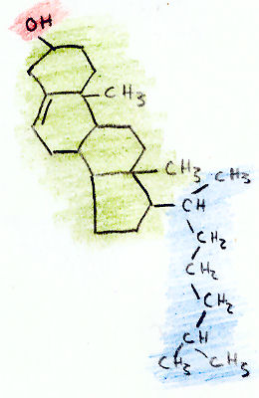
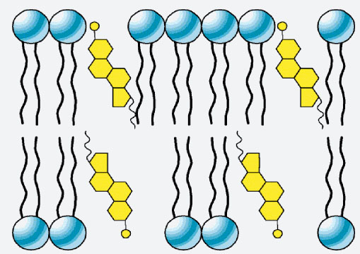
1.3.U3 Cholesterol is a component of animal cell membranes.
Cholesterol
Hydroxyl group makes the head polar and hydrophilic - attracted to the phosphate heads on the periphery of the membrane.
Carbon rings – it’s not classed as a fat or an oil, cholesterol is a steroid
Non-polar (hydrophobic) tail –attracted to the hydrophobic tails of phospholipids in the centre of the membrane
http://www.uic.edu/classes/bios/bios100/lectf03am/cholesterol.jpg
http://www.cholesterol-and-health.com/images/Cholesterol_Structure.jpg

Slide 14
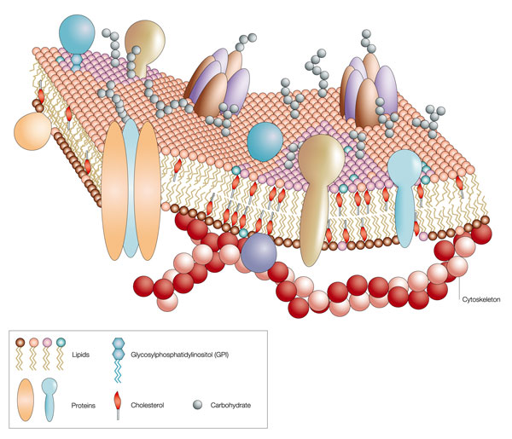
1.3.A1 Cholesterol in mammalian membranes reduces membrane fluidity and permeability to some solutes.
Membrane fluidity
The hydrophobic hydrocarbon tails usually behave as a liquid. Hydrophilic phosphate heads act more like a solid.
Though it is difficult to determine whether the membrane is truly either a solid or liquid it can definitely be said to be fluid.
It is important to regulate the degree of fluidity:
Membranes need to be fluid enough that the cell can move
Membranes need to be fluid enough that the required substances can move across the membrane
If too fluid however the membrane could not effectively restrict the movement of substances across itself
http://www.nature.com/scitable/content/ne0000/ne0000/ne0000/ne0000/14668965/U2.cp5.3_membrane_f2.jpg

Slide 15
1.3.A1 Cholesterol in mammalian membranes reduces membrane fluidity and permeability to some solutes.
Cholesterol’s role in membrane fluidity
1.
The presence of cholesterol in the membrane restricts the movement of phospholipids and other molecules – this reduces membrane fluidity.
2.
The presence of cholesterol disrupts the regular packing of the of the hydrocarbon tails of phospholipid molecules - this is increases the flexibility as it prevents the tails from crystallising and hence behaving like a solid.
3.
Cholesterol also reduces the permeability to hydrophilic/water soluble molecules and ions such as sodium and hydrogen.
http://www.nature.com/scitable/content/ne0000/ne0000/ne0000/ne0000/14668965/U2.cp5.3_membrane_f2.jpg

Slide 16
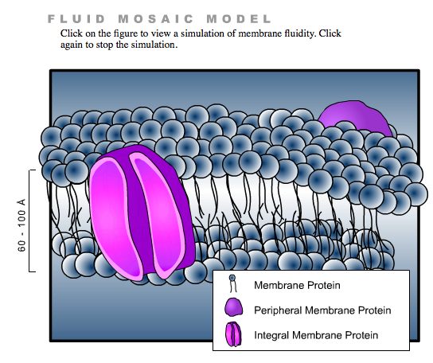
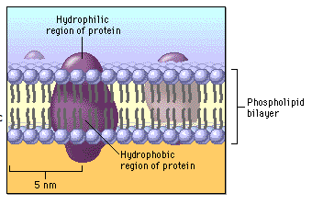
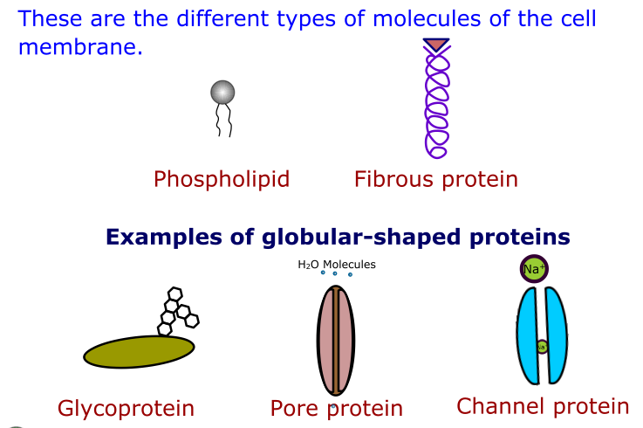
1.3.S1 Drawing of the fluid mosaic model.
Use the tutorials to learn and review membrane structure
http://www.bio.davidson.edu/people/macampbell/111/memb-swf/membranes.swf
http://www.phschool.com/science/biology_place/biocoach/biomembrane1/regions.html
https://www.wisc-online.com//LearningContent/ap1101/index.html

Slide 17
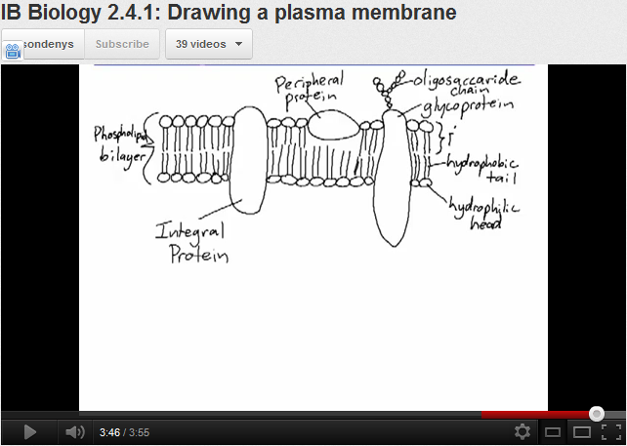
1.3.S1 Drawing of the fluid mosaic model.
http://www.youtube.com/watch?v=w9VBHGNoFrY

Slide 18
1.3.S1 Drawing of the fluid mosaic model.
Reminder of features that make good diagrams:
Good use of space
Clear strong lines
Label lines are straight
Labels clearly written
(Scale bar if appropriate)
Lines touch the labeled structure
No unnecessary shading or colouring
http://www.ib.bioninja.com.au/_Media/phospholipid_bilayer_med.jpeg

Slide 19
1.3.S3 Analysis of the falsification of the Davson-Danielli model that led to the Singer-Nicolson model.
Our current model of the cell membrane is called the Singer-Nicholson fluid mosaic model
Key features:
Phospholipid molecules form a bilayer - phospholipids are fluid and move laterally
Peripheral proteins are bound to either the inner or outer surface of the membrane
Integral proteins - permeate the surface of the membrane
The membrane is a fluid mosaic of phospholipids and proteins
Proteins can move laterally along membrane
http://commons.wikimedia.org/wiki/File:Cell_membrane_detailed_diagram_en.svg?uselang=en-gb

Slide 20
1.3.S3 Analysis of the falsification of the Davson-Danielli model that led to the Singer-Nicolson model.
Our current model of the cell membrane is called the Singer-Nicholson fluid mosaic model
There is strong evidence for this model:
Biochemical techniques
Membrane proteins were found to be very varied in size and globular in shape
Such proteins would be unable to form continuous layers on the periphery of the membrane.
The membrane proteins had hydrophobic regions and therefore would embed in the membrane not layer the outside
http://commons.wikimedia.org/wiki/File:Cell_membrane_detailed_diagram_en.svg?uselang=en-gb

Slide 21
1.3.S3 Analysis of the falsification of the Davson-Danielli model that led to the Singer-Nicolson model.
Our current model of the cell membrane is called the Singer-Nicholson fluid mosaic model
There is strong evidence for this model:
Fluorescent antibody tagging
red or green fluorescent markers attached to antibodies which would bind to membrane proteins
The membrane proteins of some cells were tagged with red markers and other cells with green markers.
Within 40 minutes the red and green markers were mixed throughout the membrane of the fused cell.
This showed that membrane proteins are free to move within the membrane rather than being fixed in a peripheral layer.
The cells were fused together.
http://commons.wikimedia.org/wiki/File:Cell_membrane_detailed_diagram_en.svg?uselang=en-gb

Slide 22
1.3.S3 Analysis of the falsification of the Davson-Danielli model that led to the Singer-Nicolson model.
Our current model of the cell membrane is called the Singer-Nicholson fluid mosaic model
This model was first proposed in by Singer-Nicolson in 1972
Before then Davson-Danielli model was widely accepted …
http://commons.wikimedia.org/wiki/File:Cell_membrane_detailed_diagram_en.svg?uselang=en-gb

Slide 23
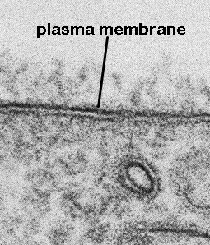
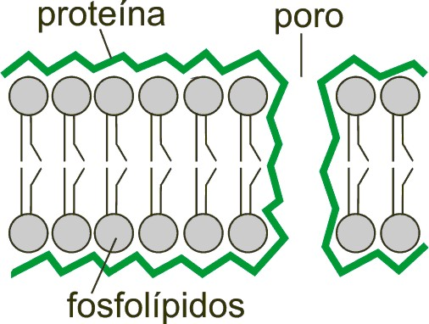
1.3.S2 Analysis of evidence from electron microscopy that led to the proposal of the Davson-Danielli model.
The evidence: In high magnification electron micrographs membranes appeared as two dark parallel lines with a lighter coloured region in between.
Proteins appear dark in electron micrographs and phospholipids appear light - possibly indicating proteins layers either side of a phospholipid core.
Davson-Danielli
Model
Proteins
Pore
The model:
A protein-lipid sandwich
Lipid bilayer composed of phospholipids (hydrophobic tails inside, hydrophilic heads outside)
Proteins coat outer surface
Proteins do not permeate the lipid bilayer
Phospholipids
This explains: Despite being very thin membranes are an effective barrier to the movement of certain substances.
http://www.cytochemistry.net/cell-biology/EMview.jpg
http://upload.wikimedia.org/wikipedia/commons/6/69/Davson_danielli_miguelferig.jpg

Slide 24
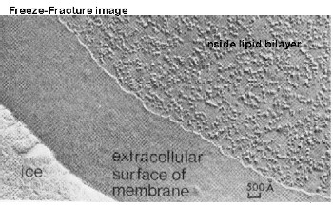
1.3.S3 Analysis of the falsification of the Davson-Danielli model that led to the Singer-Nicolson model.
Falsification of the Davson-Danielli model
– freeze fracturing
Interpreting the image:
The fracture occurs along lines of weakness, including the centre of membranes.
The fracture reveals an irregular rough surface inside the phospholipid bilayer
The globular structures were interpreted as trans-membrane proteins.
This technique involves rapid freezing of cells and then fracturing them.
Conclusion:
This is contrary to the Davson-Danielli model which only involves proteins coating the surface of the membrane. A new model is needed to explain the presence of as trans-membrane proteins.
http://www.cytochemistry.net/cell-biology/ffimage.jpg

Slide 25
Bibliography / Acknowledgments
Jason de Nys

